Slide 1
Unit 7
Teenagers should be allowed to
choose their own clothes.
Section B (第2课时)
WWW.PPT818.COM

Slide 2
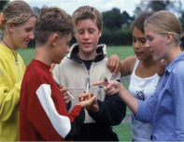
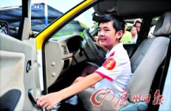
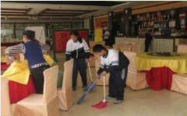
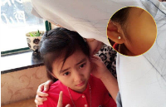
Revision
Do you agree that teenagers should be allowed to …?
I agree, because …/I don't think they should be …
smoke
drive
have part-time jobs
get ears pierced
choose their own clothes

Slide 3
With a partner, discuss some rules at home that you agree or disagree with. Make some notes in the chart.
3a
Rule | Why you agree or disagree with it | How you think the rule should be changed
can't play computer games can't watch TV

Slide 4
Write a diary entry explaining which rule(s) you do not agree with at home and how you think the rule(s) should be changed.
3b
Use the following expressions to help you:
I do not agree with…
I think I should be allowed to…
I would like to…
I could … if I …

Slide 5
Self Check
1 Match the words in the two columns and choose
five phrases to make sentences.
____________________
____________________
____________________
____________________
____________________
——————————
take do get achieve make go | shopping photos my dream ears pierced part-time work a choice
take do get achieve make go | shopping photos my dream ears pierced part-time work a choice

Slide 6
2 Complete the sentences using the correct forms of the words in
brackets. Translate them into Chinese.
1. No matter how many difficulties we have, I believe all problems can
_____________(solve) in the end.
2. Mobile phones should _____________(keep) off during the meeting.
3. Teenagers under eighteen must _____________(not allow) to smoke or
drink.
4. Many parents think going to school must _____________(put) first, so
teenagers should _______________(not encourage) to work part-time.
take do get achieve make go | shopping photos my dream ears pierced part-time work a choice
be solved
be kept
not be allowed
be put
not be encouraged

Slide 7
Language Points
1.get in the way of (doing) sth. 影响（干）……/挡……的道
【拓展】on the way to 在去……的路上；by the way顺便说一下；in this way这样
2.It is the only thing I have ever wanted to do.这是我至今唯一想做的事。
I have ever wanted to do 是定语从句，省去了引导词that。

Slide 8
3.But they always talk about what will happen if I don't succeed.但他们总是说如果我不成功怎么办。
（1）sth. happen to sb.某人发生某事。
2）succeed 动词，意为“成功，达到，完成”。常用短语为succeed in doing sth.=be successful in doing sth. 意为"成功做某事"。

Slide 9
4.Only then will I have a chance to achieve my dream.只有那时，我才有机会实现梦想。（教材第54页）
（1）achieve one's dream=one's dream comes true实现梦想
（2）have a chance to do =have a chance of doing sth.有机会干……
（3）此句是倒装句：Only +状语/从句+系动词/助动词/情态动词+主+动词原形。
5.其他重点短语：
（1）have nothing against (doing) sth. 没有理由反对……
（2）care about关心，担心
（3）make a choice oneself 自己做选择
（4）spend time on... 在……上花时间

Slide 10
Exercise
一、选择方框内的单词并用其正确形式填空。
1.You can’t get in the way of me ____________ good results.
2.We should spend ____________ time on study than hobbies.
3.Maybe he has no other ____________ except me.
4.It's very difficult ____________ my dream.
achieve get much choose
to get
more
choices
to achieve

Slide 11
二、单项选择。
( )1.He is tall.His head gets _____ of my view(视线).
A.on the way B.by the way
C.in the way D.out of the way
( )2.Only when the work is done_____ be able to get back home.
A.will you B.you will
C.you have D.have you
C
A

Slide 12
( )3.Li Na is serious _____ playing tennis all the time.
A.of B.about C.at D.in
( )4.She finally _____ passing her driving test.
A.succeeded B.succeeded in
C.achieved D.achieved in
B
B

Slide 13
Homework
Write an article about rule changes.

Slide 14
Thank you！

