Slide 1
Unit 2 They're near the window
WWW.PPT818.COM

Slide 2
单词突破
for长达（……时间）

Slide 3
minute 分钟

Slide 4
for one minute一分钟

Slide 5
look看
PPT模板：www.1ppt.com/moban/ PPT素材：www.1ppt.com/sucai/
PPT背景：www.1ppt.com/beijing/ PPT图表：www.1ppt.com/tubiao/
PPT下载：www.1ppt.com/xiazai/ PPT教程： www.1ppt.com/powerpoint/
资料下载：www.1ppt.com/ziliao/ 范文下载：www.1ppt.com/fanwen/
试卷下载：www.1ppt.com/shiti/ 教案下载：www.1ppt.com/jiaoan/
PPT论坛：www.1ppt.cn PPT课件：www.1ppt.com/kejian/
语文课件：www.1ppt.com/kejian/yuwen/ 数学课件：www.1ppt.com/kejian/shuxue/
英语课件：www.1ppt.com/kejian/yingyu/ 美术课件：www.1ppt.com/kejian/meishu/
科学课件：www.1ppt.com/kejian/kexue/ 物理课件：www.1ppt.com/kejian/wuli/
化学课件：www.1ppt.com/kejian/huaxue/ 生物课件：www.1ppt.com/kejian/shengwu/
地理课件：www.1ppt.com/kejian/dili/ 历史课件：www.1ppt.com/kejian/lishi/

Slide 6
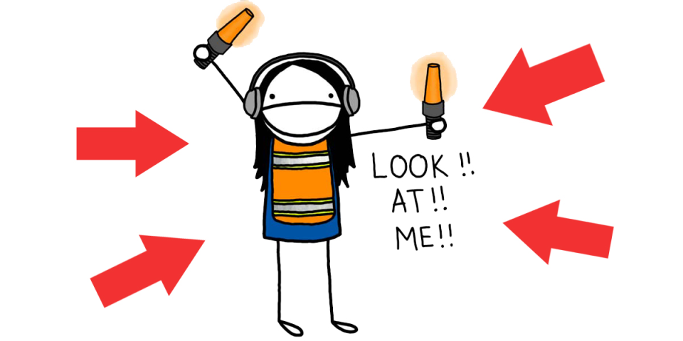

Slide 7
Look at my bedroom for one minute.
看我的卧室一分钟。
看一分钟我的卧室。

Slide 8
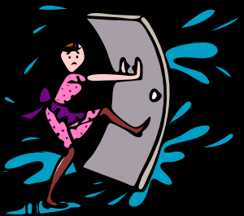
close 合上，闭上 close the door 关门

Slide 9
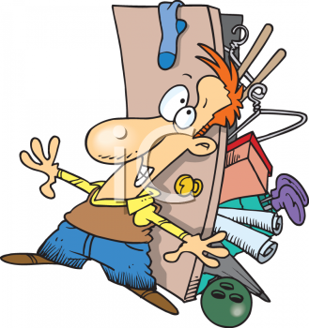

Slide 10
close your eyes 闭上你的眼睛

Slide 11
open 打开 ，睁开
open the door 打开门

Slide 13
open your eyes 睁开眼睛

Slide 15
now 现在

Slide 16
Now open your eyes.
现在睁开你的眼睛
Now close your eyes.
现在闭上你的眼睛

Slide 17
right 对的

Slide 18
wrong 错的

Slide 19
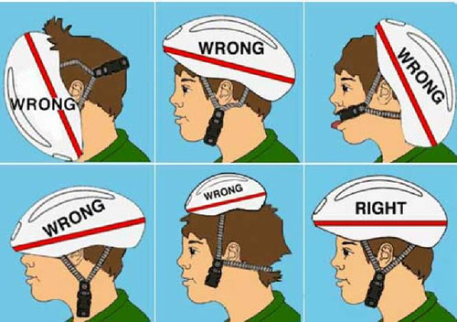

Slide 20
You are right.
你是对的

Slide 21
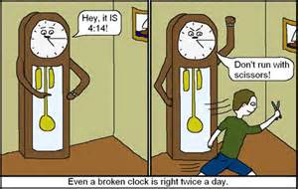
clock 钟

Slide 22
floor 地板

Slide 23
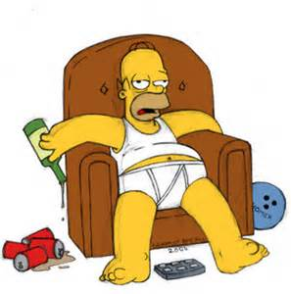
sofa 沙发

