Slide 1
Module 10 The weather
Unit 2 The weather is fine
all year round.
WWW.PPT818.COM

Slide 2
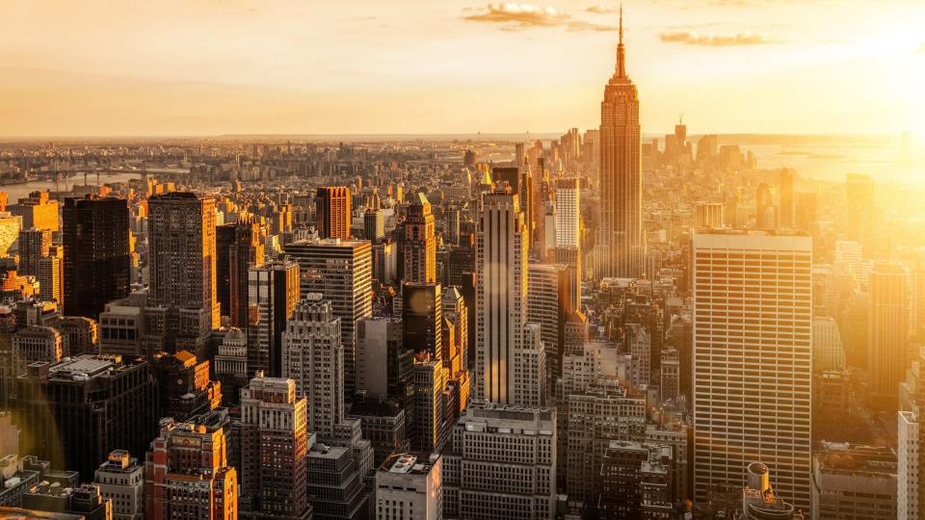
New York
sunny

Slide 3
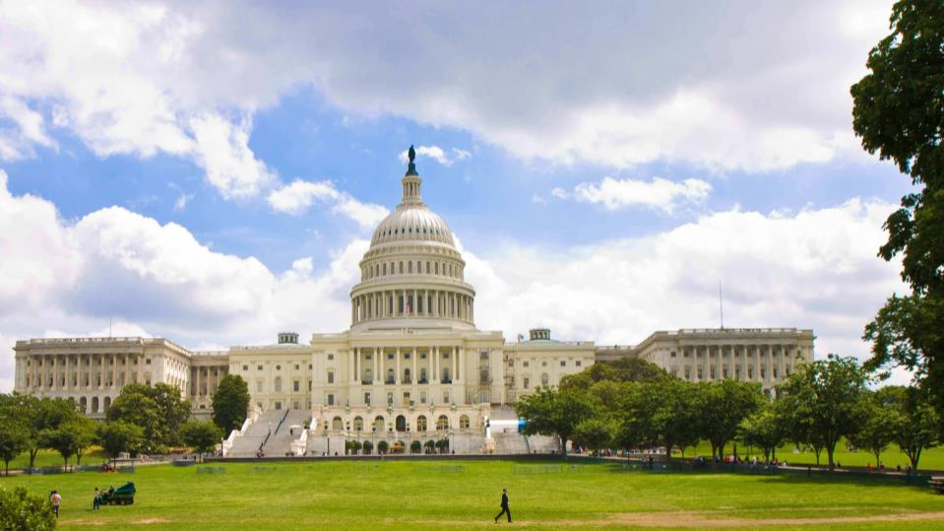
Washington D.C
cloudy

Slide 4
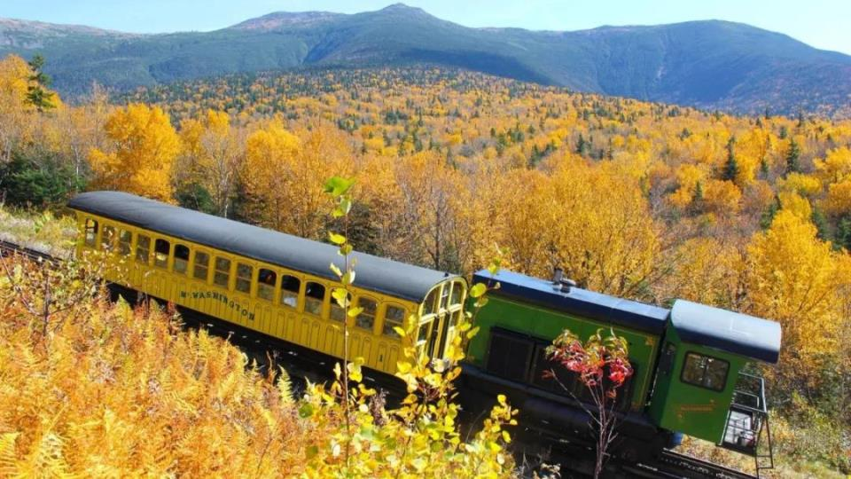
New England
windy

Slide 5
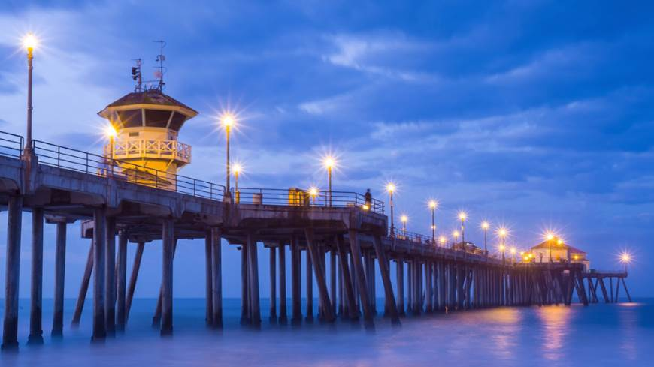
California
showery

Slide 6
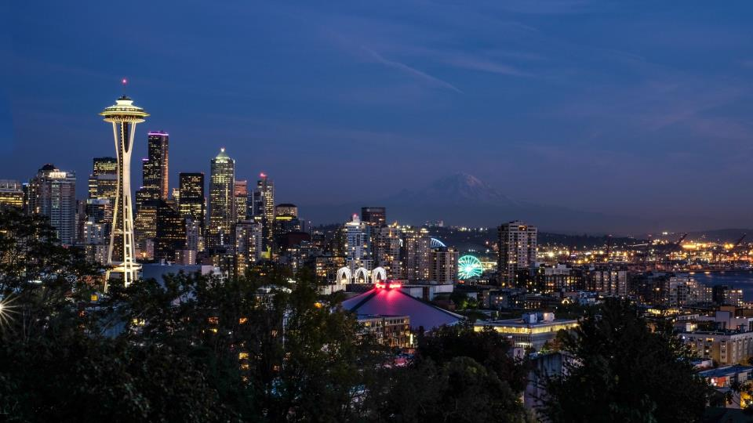
Seattle
rainy

Slide 7
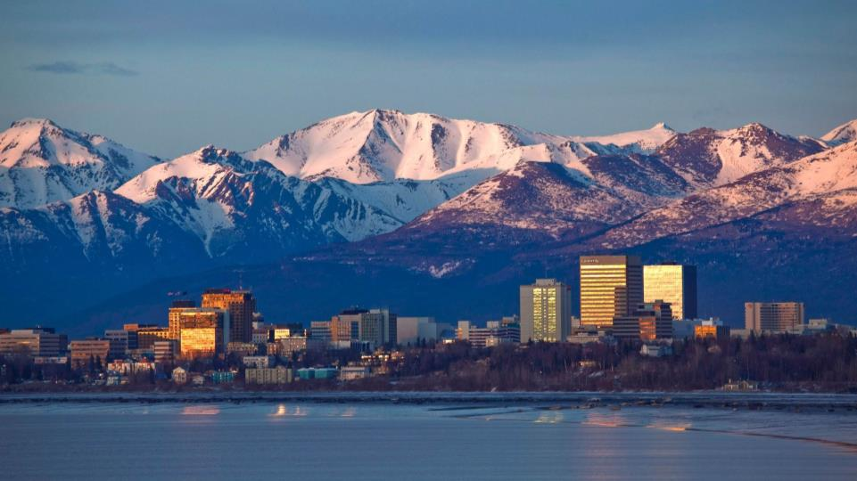
snowy
Alaska

Slide 8
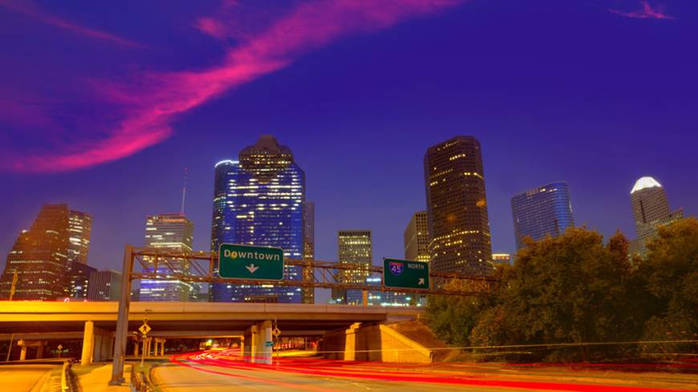
Texas
sunny

Slide 9
Revision
City | Today’s Temperature | Today’s weather | Tomorrow’s weather
Shanghai | 13℃~15℃
Jinan | -5℃~2℃
Lhasa | 16℃~19℃
Harbin | -6℃~-1℃
It may/might be…
…
…
…

Slide 10
New words & phrases
mile
n.英里
round
adv.围绕地
northwest
n.西北
adj.西北的；朝西北的
southeast
n.东南
adj.东南的；朝东南的
from time to time
有时；间或

Slide 11
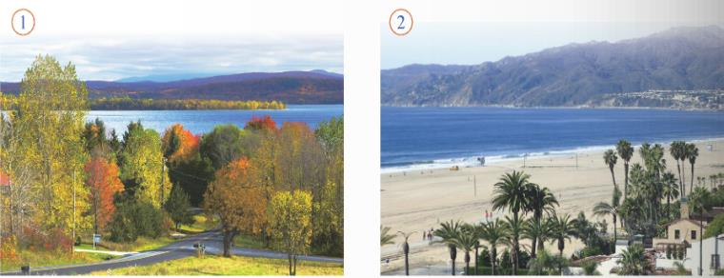
Reading and vocabulary
Talk about what you can see in the pictures.
1
For example: Where is it?
What’s the weather like?
What season is it?

Slide 12
Listen and choose
1. Bring ______ because you may want to travel
around.
A. a pair of shoes B. a map C. a sports bag
2. New York and ______ are good places to visit in
May or October.
A. Washington D.C. B. Boston C. Chicago

Slide 13
3. The best time to visit New England is in
______.
A. October B. September C. May
4. In the northwest, there’s a lot of ______
A. snow B. wind C. rain

Slide 14
In Texas and the southeast, there are ______
from time to time in summer and autumn.
A. showers B. lightning C. storms

Slide 15
Read the passage and find out the best time
to visit the US.
2
When is the best time to visit the US?
The US is a very big country. It is about 3,000 miles from the east coast to the west coast, so choose carefully the places to see and the time to go. Bring a map because you may want to travel around.

Slide 16
New York and Washington D.C are good places to visit in May or October, but in winter there is a lot of snow.
The best time to visit New England is in September. The weather gets cooler, and the green leaves start to turn gold, then brown. Bring your camera so you can take photos of the autumn trees.
变得更凉快
开始做……
给……拍照

Slide 17
California is on the Pacific coast, and the weather is fine all year round. Take your swimming clothes because you might want to go swimming in the sea, even in December.
全年

Slide 18
在西北
In Seattle, in the northwest, it is not very cold but it rains a lot, so bring an umbrella. In Alaska, the days are long and warm in summer, but may be cool in the evening. In winter, Alaska can be very very cold. If you want to visit Alaska, you had better go in summer. Do not forget to bring a warm sweater with you.
=remember to do sth
记得要去做某事

Slide 19
In Texas and the southeast, it is usually very hot and sunny compared to other places. There are storms from time to time in summer and autumn.
So when is the best time to visit the US? Any time you like!
与……相比
有时，间或

Slide 20
Read and answer
1. When is the best time to visit New England?
2. What’s the weather like in September in New
England?
3. Why do you need to bring your camera in New
England?
In September.
It starts to get cooler.
Because I may want to take photos of the autumn
trees.

Slide 21
4. What’s the weather like in California?
5. Why do you need to bring your swimming
clothes in California?
6. When is it pleasant to visit Alaska?
It is fine all year.
Because I might swim in the sea.
In summer.

Slide 22
When is the best time to visit the USA?
8. New York is in the east and California is in the west.
Is the best time to visit the two cities the same?
Any time you like!
No, it isn’t.

Slide 23
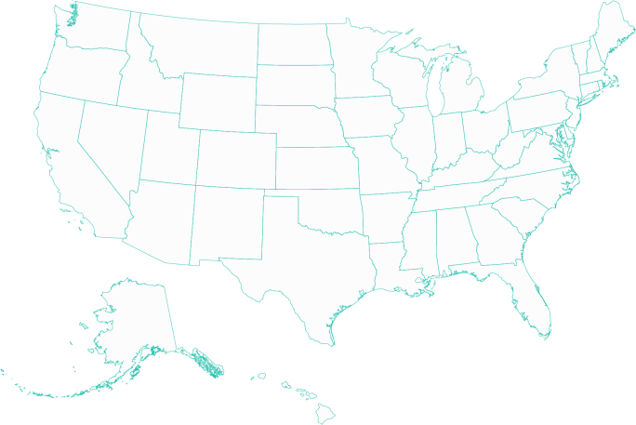
Retell the passage according to the map.
Seattle
New York
Washington D.C
California
New England
Texas
Alaska

Slide 24
Complete the table.
3
Place | Weather | Best time to visit
New York | Winter:
New England
California
Alaska | Summer： Winter：
A lot of snow
In May or October.
It gets cooler
in September.
In September.
fine all year round
All year.
warm day,
cool night
In summer.
very cold

Slide 25
Complete the sentences with the correct
form of the words from the box.
4
brown mile storm sweater umbrella
1 In autumn the leaves turn gold and then _______.
2 It is about 3,000 ______ from the east coast to the
west coast.
brown
miles

Slide 26
brown mile storm sweater umbrella
3 You might need a(n) __________ in the evening.
4 Sometimes there are ________ in summer and
autumn on the southeast coast.
5 You will need a(n) ____________ in Seattle
because it rains a lot.
sweater
storms
umbrella

Slide 27
Writing
Match the two parts of the sentences.
5
1 You can come any time
you like, but…
2 It often rains in spring,
so…
3 Bring a coat because…
4 Our plan is to walk in
the countryside, so…
5 Sydney is a big city,
but…
6 Let’s stay for a long
time because…
a) …it will soon become cold.
b) …there are lots of things to
see.
c) … the best time to visit
England is in spring.
d) …it is a good idea to bring
an umbrella.
e) …wear comfortable shoes.
f) …we will find our way with
a good map.

Slide 28
Being a good writer
My American friend is coming to China,
and he wants to visit somewhere interesting
in China. Please give her some advice.
Where can he go?
When is the best time?
Why?
What should he bring?

Slide 29
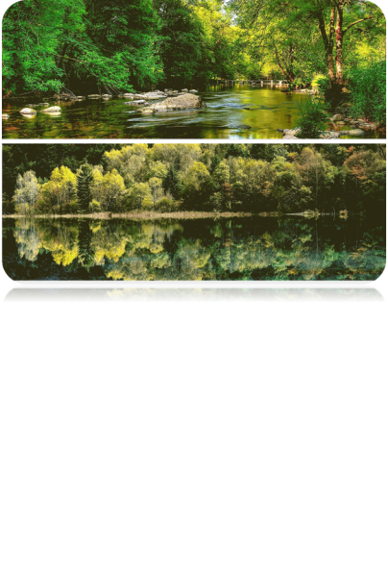
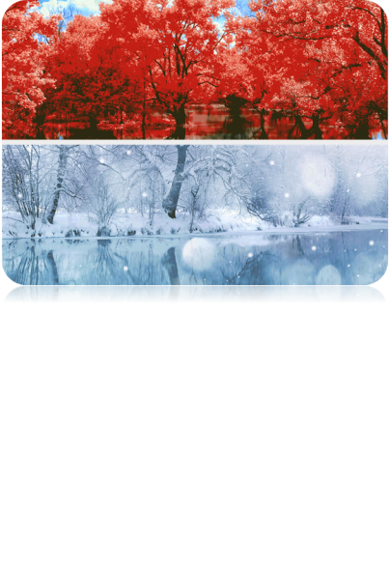
Write some advice for visiting your home
town and give reasons. Use because, so and but.
6
The best time to visit my home town is in…
because the weather is…

Slide 30
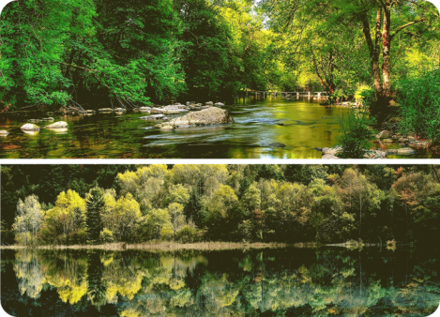
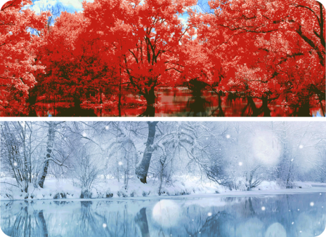
Any time you like is the best time to visit
my home town but you need to do some preparation.
spring
autumn
summer
winter

Slide 31
spring
summer
autumn
winter
Preparation
warm, pleasant,
fly kites
often rains,
windy
bring an
umbrella…
sunny,
swim...
wear a pair of sunglasses…
hot...
cool,
red tree leaves
drink more
water…
dry...
snowy, make a
snowman…
wear some
warm clothes…
cold…

Slide 32
The best time to vist … is in ______. Because there is a lot thing to do and see. When you come here it’s a good idea to ______. Because you may want to ______. You might ______, because ______, but you need to ______, so ______.
I wish you will have a good time.

Slide 33
Exercise
一、选择题。
1. —_____________?
—It’s sunny and hot.
A. What is the weather like?
B. How is the weather like?
C. What is the weather?

Slide 34
2. The car don’t move at all. There ____ be
something wrong with it.
A. maybe B. possible C. may
3. It’s interesting ______ games with the children.
A. play B. to playing C. to play

Slide 35
4.（长沙中考）—The weather report says it’s going
to have a shower this afternoon.
—It does? We’d better ______ now, just in case.
A. to leave B. leaving C. leave

Slide 36
5.（四川乐山中考）
—When shall we go hiking again?
—Make it ______ day you like. It’s all the same
to me.
A. either B. any C. one

Slide 37
二、完成下列句子。
1. 他有时给我发电子邮件。
from time to time
He sends me emails __________________.
2. 照些动物的相是一个好主意。
take photos of
It’s a good idea to _____________ animals.
3. 比起其它城市，住在珠海很舒适。
compared to
It’s pleasant to live in Zhuhai ____________ other cities.

Slide 38
Homework
1. Read and retell the article.
2. Do the exercises.

