Slide 1
Unit 1 Past and present
第5课时
WWW.PPT818.COM

Slide 2
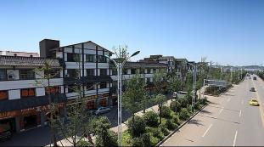
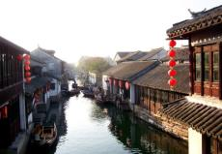
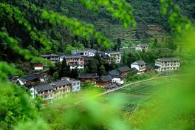
What do you think of your hometown?

Slide 3
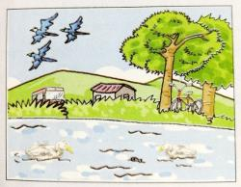
Integrated skills
A1)Daniel and Kitty are doing their history project. Listen to their conversation. Complete the information below about Starlight Town in the past.
Past
Environment：green (1)________，clean and fresh (2)________，wild (3)________ near the lake
Transport：bus and (4)________
Living conditions：old (5)________
hills
air
birds
bicycle
houses

Slide 4
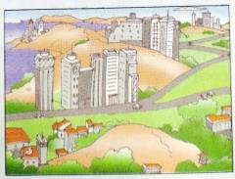
A2)Listen to the rest of their conversation and complete the information about today's Starlight Town.
Present
Environment：smaller (1)________，new (2)______ station, tall (3)________ and new roads
Transport：bus, taxi and (4)________
Living conditions：new (5)________
lake
railway
buildings
train
flat

Slide 5
A3)Kitty is writing about Starlight Town in her diary. Complete her diary entry on the next page with the words in the box.
air bicycle birds buildings flats
hills houses modern railway taxi
13 February
Dear Diary，
Today I borrowed a book about Starlight Town's past and present. Starlight Town was very beautiful years ago. There were green (1)________ and wild (2)________ near the lake. The (3)________ was clean and fresh then.
hills
birds
air

Slide 6
Now it has become a (4)________ town. There is a new (5)________ station. There are some new roads too. People can now travel to and from the town by bus，(6)________ or train，but in the past，people could only travel by bus or (7)________. Another big change is the many tall (8)________ in the town. Local people used to live in old (9)________，but now，most of them have moved into new (10)________.
Starlight Town has changed a lot over the years. I hope I can visit it again.
modern
railway
taxi
bicycle
buildings
town
flats

Slide 7
B)Speak up：We haven't seen each other since then.
Millie is telling Sandy about an old friend. Work in pairs and tell your partner about the changes in your life. Use the conversation below as a model.
Millie：I met my old friend Becky last week. She's just returned from the USA.
Sandy：Really？When did you last see each other?
Millie：About five years ago. She went abroad with her parents. We haven't seen each other since then.

Slide 8
Sandy：Oh，you were still in primary school then. So how do you keep in touch with each other?
Millie：We mainly communicate by email. The Internet makes communication much easier.
Sandy：Exactly.

Slide 9
知识点
keep in touch 保持联系
1
eg：Do you and your brother keep in touch?
你和你弟弟保持联系吗？
考向
keep in touch同义短语为stay in touch，其反义短语为be out of touch失去联系。

Slide 10
典例
别忘了毕业后与你的老师和同班同学保持联系。
Don't ________ to keep in ________ with your teachers and classmates after you graduate.
forget touch

Slide 11
知识点
communicate /kə'mjuːnɪkeɪt/ vi.&vt. 交流，交际
2
考向
常用搭配：communicate with sb.和某人交流。communicate的名词形式为communication，意为“交流”。
eg：Do you often communicate with your parents？ 你经常和你父母交流吗？

Slide 12
魔法记忆
一语巧记 : For better communication，I also communicate with him by email.
为了更好沟通，我还和他用电子邮件交流。)
典例
After you argue with your parents you must _____________ (交流)with them and explain why you did that.(枣庄)
communicate

Slide 13
Study skills
Facts and opinions
We often use facts and opinions when we write. Facts are true statements. They include names，dates，events and numbers. Opinions tell what we believe，feel or think. They may not be true.
Beijing is the capital of China.(Fact)
Beijing is the best city in the world.(Opinion)
Many changes have taken place in my hometown.(Fact)
The new shopping mall is a good place to have fun.(Opinion)

Slide 14
A)Read the sentences below. Write an F for a fact or an O for an opinion.
1. There were only small shops and restaurants in the town.________
2. Old people used to play cards and Chinese chess together.________
3. The new park in the town centre looks beautiful.________
4. There was once a steel factory near the Sunshine River.________
5.Life is getting better in some ways.________
6. Many of Mr Chen's friends have moved away.________
F
F
O
F
O
F

Slide 15
B)Millie is writing about the changes in her life. Help her decide which are opinions and which are facts. Reorganize them into a short passage.
1. We have more subjects to learn.
2. It is not easy to get used to the changes of life quickly.
3. When I was at primary school, I walked to school with my mum.
4. Now I go to school by bus on my own.
5. I have to spend more time on my homework than before.
6. Some subjects are difficult. ( )
F
O
F
F
F
O
234165

Slide 16
知识点
get used to 习惯于，适应于
3
考向
辨析used to，be/get used to与be used to do sth.
词条 | 用法 | 示例
used to | 其后跟动词原形，表示过去的习惯、经常发生的动作或状态。 | This place used to be a park. 这个地方曾经是一个公园。

Slide 17
词条 | 用法 | 示例
be/get used to | “习惯于做某事”，其中to是介词，后接名词、代词或动名词。 | My grandpa has been used to living a simple life. 我的祖父已经过惯了简朴的生活。
be used to do sth. | 被动语态。意为“被用来做某事”。相当于：be used for doing sth. | This computer is used to control all the machines.＝ This computer is used for controlling all the machines.这台电脑是用来控制所有机器的。

Slide 18
典例
I used to ________ newspapers and watch TV after dinner. But now I'm used to _______ a walk.(新疆)
A. read; take B. read; taking
C. reading; taking D. reading; take
B

Slide 19
一、根据汉语提示完成句子
1. They have just ________(返回) to Beijing.
2. My cousin is teaching Maths in a ________(小学) school in our city.
3. Let's ________ ________ ________(保持联系).
4. My father has been ________(在国外) and he will be back in five days.
returned
primary
keep in touch
abroad

Slide 20
5. I do believe that a better ____________(环境) can be created in Lanzhou and we should all work together to make it come true.(兰州改编)
environment

Slide 21
二、用所给词的适当形式填空
6. ______________ (communicate)skills can be improved through practice.
7. He is used to________ (get)up early in the morning.
8.They used to________ (play)cards in the park.
Communication
getting
【点拨】be used to后接动名词形式，表示“习惯……”。
play
【点拨】used to后接动词原形，表示“过去常常”。

Slide 22
9. In the 1980s, the farmers' living__________(condition) were not so good as they are now.
10. What does VIP________( exact) stand for?
conditions
exactly

Slide 23
本节课主要学习了以下知识点，请同学们及时巩固练习：
communicate
keep in touch，get used to

