Slide 1
Unit12 whose rabbits are these?
WWW.PPT818.COM
Notes:
1

Slide 2
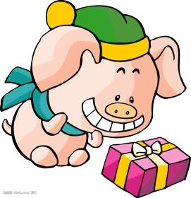
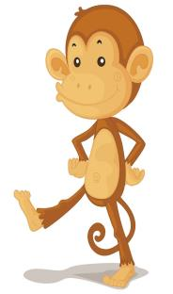
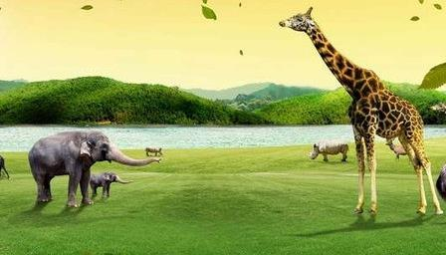
Look at that pig.
It’s .
Look at that monkey.
It’s .
fat
thin
Look at that elephant.
It’s .
short
Look at that giraffe.
It’s .
tall

Slide 3
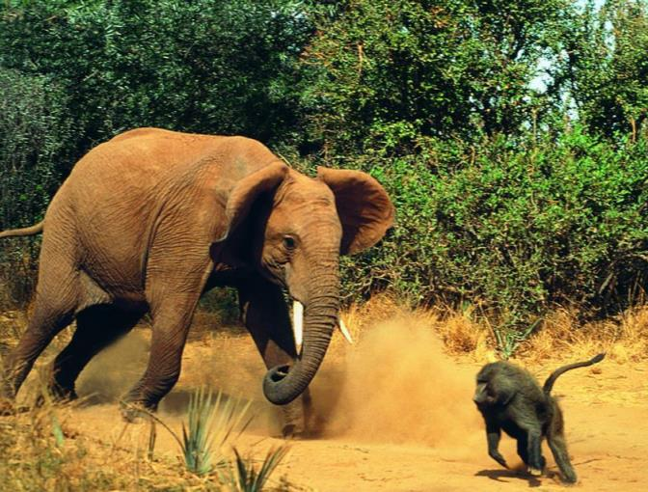
big
short
大的
短的
tail 尾巴
small
long
小的
长的

Slide 4
It has a head It has a tail.
Question(问题):
tail 尾巴

Slide 5
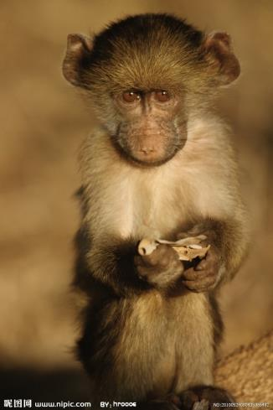
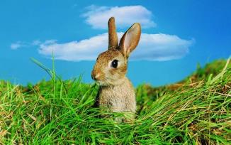
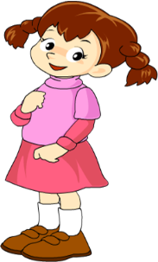
Look at this····
It’s ········！
short
long

Slide 6
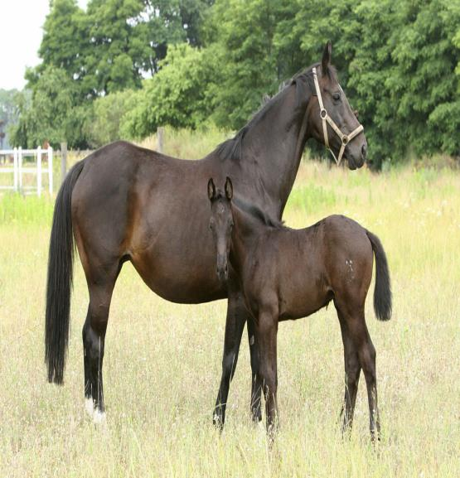
big
Look at this········
It’s ··········
small

Slide 7
It has a head. It has a tail.
Question(问题):
small
short
tail 尾巴

Slide 8
除此以外，你还能说说这只鸟的其它特征吗？
It has a
body.
tail 尾巴
It has
legs（腿.

Slide 9
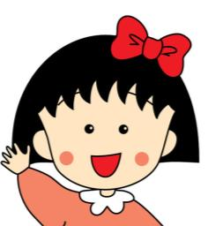
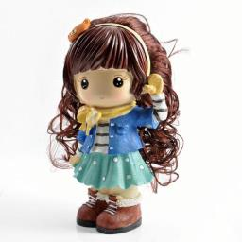
1.She has long hair(头发).
Which one is right?（根据句子判断哪个图片正确？）
A
B

Slide 10
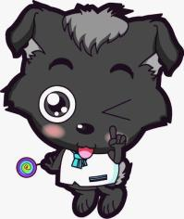
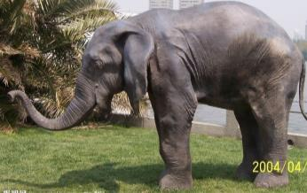
2. It has a small body.
Which one is right?（根据句子判断哪个图片正确？）
A
B

Slide 11
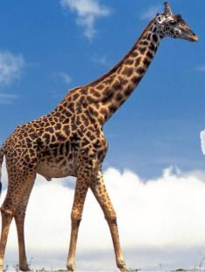
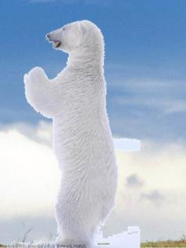
1.It has short neck(脖子).
Which one is right?（根据句子判断哪个图片正确？）
A
B

Slide 12
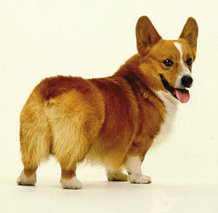
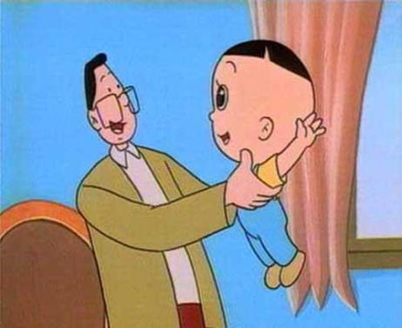
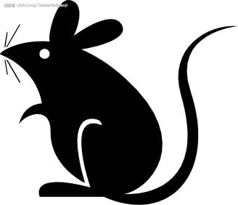
3.He has a head.
small
short
1.It has leg（腿）.
绿色圃中小学教育网http://www.lspjy.com
2.It’s has a tail.
4.He has a head.
long
big

Slide 13
Homework
跟读P68页的课文5遍，然后读给爸爸妈妈听。
抄写4个形容词，每个2行，一行6个,边读边写，注意格式。
完成“活动手册”33页的第3、4题。
Notes:
13

Slide 14
Thank you

