Slide 1
Unit 8 Have A Good Habit
第三课时
WWW.PPT818.COM

Slide 2
1
Be able to read!
Objectives:
2
Be able to listen!
3
Be able to understand!
4
Be able to communicate!

Slide 3
Warm-up
What did you learn in part A?
Discuss with your partner.

Slide 4
Let's Learn More!

Slide 5
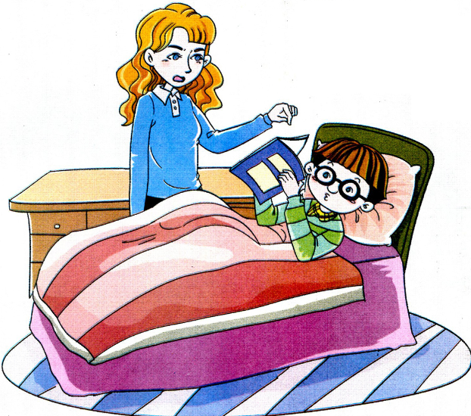
Let's Learn！
Mom: What are you doing, Kevin?
Kevin: I'm reading in bed.
Mom: You shouldn't do that. It's a bad habit. You'd better read at the desk.

Slide 6
Let's Learn！
Mom: 凯文，你在干什么？
Kevin: 我卧床读书呢。
Mom: 你不应该那样。这是个坏习惯。你最好在桌旁读书。

Slide 7
Let's Learn！
Kevin: All right, Mom.
Mom: And you shouldn't have the book so close to your eyes. You should take care of your eyes.
Kevin: OK.

Slide 8
Let's Learn！
Kevin: 好吧，妈妈。
Mom: 而且你眼睛不应离书太近。你应该保护好眼睛。
Kevin: 好的。

Slide 9
Read and Think!

Slide 10
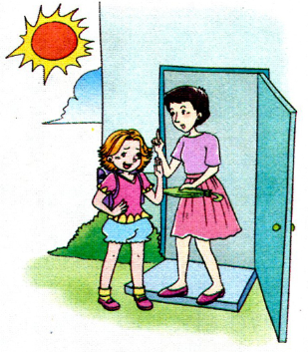
Try to read more
Mom: It often rains in summer. You'd better take your umbrella.
Alice: Look at the sun. It won't rain today.

Slide 11
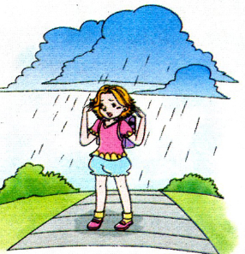
Try to read more
Alice: Oh! It's raining!

Slide 12
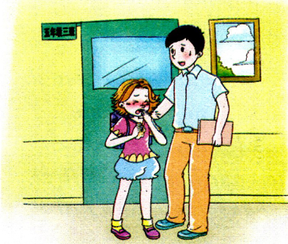
Try to read more
Alice: Kerchoo!
Mr. Zhao: You'd better go to see a doctor.

Slide 13
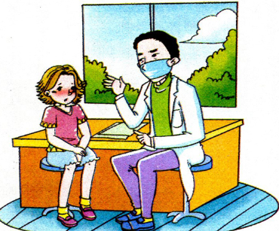
Try to read more
Doctor: You'd better not to go to school today.

Slide 14
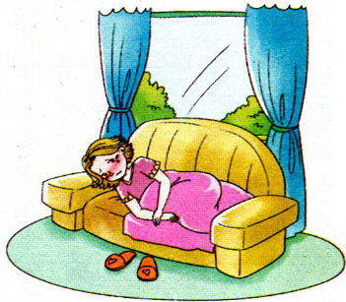
Try to read more
Alice: Sometimes we'd better listen to our parents.

Slide 15
Try to read more
Can you use Chinese to tell us this story?

Slide 16
Let's Sing!

Slide 17
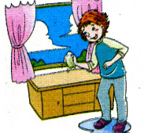
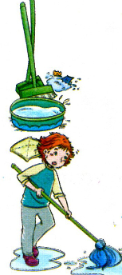
Try to read more
You should wash your face every day
You should brush your teeth every day
You should tidy your room every day
You should clean your floor every day
Every day, every day, every day
You will be healthy every day
Every day, every day, every day
You will be happy every day

Slide 18
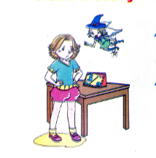
Try to read more
Can you chant the song by yourself !

Slide 19
请课后认真朗读单词课文，在记忆的基础上运用词句进行对话！

