Slide 1

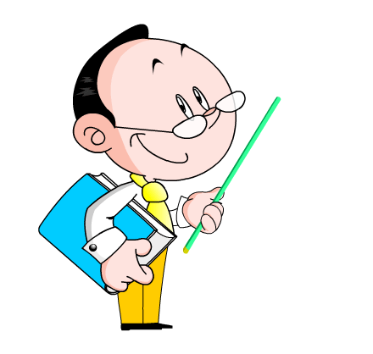
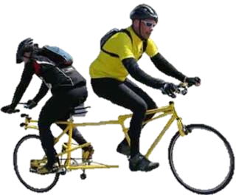
Module 2 Education
Unit 3 Language in use
WWW.PPT818.COM

Slide 2
Lead in
Are you able to read through the
sentences?
1. Did you do anything interesting?
2. Did you visit her school?
3. She took me there herself.
4. It isn’t as big as ours.
5. There are a few science laboratories.

Slide 3
Presentation
Grammar
代词是用来代替名词的词。它是英语语法结构中的一个重要项目, 也是中考测试的重点内容之一。纵观历年中考试题, 出现频率最高的是不定代词，其次是it用法、疑问代词、反身代词以及人称代词等。

Slide 4
类别 | 组成
人称代词 | 主格: I, you, she, he, it，we, you, they 宾格: me, you, her, him, it, us, you, them
指示代词 | this, these, that, those
物主代词 | 形容词性: my, your, her, his, its, our, your, their 名词性: mine, yours, hers, his, its, ours, yours, theirs

Slide 5
续表
反身代词 | myself, yourself, herself, himself, itself, ourselves, yourselves, themselves
疑问代词 | what, which, who, whom, whose
不定代词 | some, any, both, either, neither, all, none, each, every, many, much, few, a few, little, a little, other, another, one, nobody, somebody, anybody, everyone, everything, something, anything, nothing

Slide 6
1) some和any
a. some和any 是单数还是复数, 要看其所代替的是什么。some和any 都既可以指人, 也可以指物, 可以表示可数的事物和人, 也可以表示不可数的概念。例如: some (any) books, some (any) money, some people, some water
b. 作为代词, 它们在句中可以作主语和宾语。例如:
There are many people in the park. Some are dancing; others are playing Taijiquan.

Slide 7
c. some 用于肯定句中, 而any 用于疑问句、否定句和条件句中。
—I am thirsty. Can you give me some water?
—Sorry, I don’t have any. If I have any, I will give you some.
但在征求对方意见，并希望得到肯定回答时，要用 some
Eg: Would you like some tea ?
Can I have some bread ?

Slide 8

2) none和neither
a. none和neither 都表示否定的意思, 两者的区别在于, neither 用于两者, 而none 用于两者以上。例如：Yes, I saw two boys at the door, but neither (of them) is my brother. None (of the students) in my class wants to take part in this trip.

Slide 9

b. none 除指可数的人和物外, 还可以表示不可数的东西, 可以指与one, two, three一样的数字概念。例如：
I have a lot of money in my bag, but none is mine.
—How many postcards have you sent?
—None.

Slide 10

3) (a) little和(a) few
a. a little和a few 表示肯定的概念, 而little和few 却表示否定的概念。
b. (a) little 用于不可数名词,
而(a) few 用于可数名词。例如:

Slide 11
—Do you have any water?
—Yes, but only a little.
—Sorry, I have little myself. I can’t give you any.
He has many friends, but few are true friends/ but only a few are true friends.

Slide 12
4) all和both
a. all 表示“所有的, 全体, 一切”的 概念, both 表示“两个都”, 而all指两者以上, 同时还可以指不可数的东西。例如：
All of the boys went to the cinema yesterday evening.
All of the money is mine.
—Which of the two shirts do you like?
—I like both.

Slide 13

b. all和both 可用于be动词之后, 行为动词之前。 例如：
We are all / both from China.
We all/both passed the exam.

Slide 14
5) each和either
each和either 都可以表示“每一个”, each 可以表示两者、也可以表示两者以上的“每一个”, 而either只能表示两者中的“每一个”。例如: Each of us/We each got a nice card on that special day.

Slide 15
—Which of the two shirts do you want?
—Either will do.
注意: either 表示一种选择, 如上面一例, 表示“哪个都可以”, 说明购物者要买一件衬衣而不是两件都要。如表示两件都要, 则用both。each 也可用于句末。例如: The old man gave the boys two apples each.

Slide 16
1. There is ____ water left in the bottle. Would you go and get some?
A. little B. a little
C. few
2. We had ____ people this year than we had last year.
A. little B. less
C. fewer

Slide 17
3. You don’t like the same colours and I don’t like them, ____.
A. too B. also C. either
4. I asked Kate and Mary to come for a talk, but ____ of them came.
A. both B. either C. neither

Slide 18

5. Hello, John! Come here, please. I have ____ to tell you.
A. important something
B. something important
C. important anything

Slide 19
6. —Mum, Ann’s coming tonight. Let’s give her ____ to eat.
—Good idea!
A. anything nice
B. nice anything
C. something nice

Slide 20
Complete the conversation with the correct words and expressions.
Anna: Hi, how did your exams go?
Bob: I’m really pleased! I didn’t expect
to do well in (1) neither / either
maths or geography, but in the end,
I got good grades in (2) both / each
subjects. What about you?

Slide 21
Anna: I did really well in English.
That’s (3) anything / something
I’ve always enjoyed. My grades
in history and art weren’t so good,
because (4) none / neither of those
is my favourite subject. What will
you study next year?

Slide 22
Bob: I’ve still got (5) a few / few weeks before I have to
decide. I’m going to speak to (6) every / all my
teachers and ask for their advice.
Anna: The teachers say that we must decide for (7)
themselves / ourselves , that (8) none / neither of
them can tell us what to do.

Slide 23

Bob: But I have to get (9) some / any
information because there are
so (10) much / many subjects
and it’s very hard to choose.

Slide 24

Rewrite the sentences.
Replace the circled words with the correct form of the words and expressions in the box.
each other either his myself
of mine who is whose is

Slide 25

1. Meet John. He’s a friend I have .
2. You don’t need to help me. I can do it on my own .
3. They will help Kate, and Kate helps them with the homework.
4. Who owns that silver bike? Is it Mr Scott’s bike?
of mine
myself
each other
Whose is

Slide 26
5. Yes, it is Mr Scott’s .
6. I know someone with the job as a dentist.
7. I don’t mind which apple you give me.
The red one or the green one will be fine.
his
who is
Either

Slide 27
Complete the sentences with the correct form of the words in the box.
he her him himself his our
ourselves she their themselves
they us we

Slide 28
1. Mr. Lee’s class put all _______ things away at the end of the lesson. _______ know that ______ have to tidy up the classroom ___________. They don’t wait for others to do it.
their
They
they
themselves

Slide 29
2. John has a lot of homework tonight. _______ isn’t able to do it ______ so I’m going to help ______ with it. I don’t think _______ teacher knows how difficult it is.
He
himself
him
his

Slide 30
3. Grandfather: Jane is doing a project about family history. _____ has asked us to give _____ some photos of ________ when we were young. Have ____ got any?
Grandmother: Yes, there is a photo of _____ with all the other children, in ____ school.
She
her
ourselves
we
ours
our

Slide 31
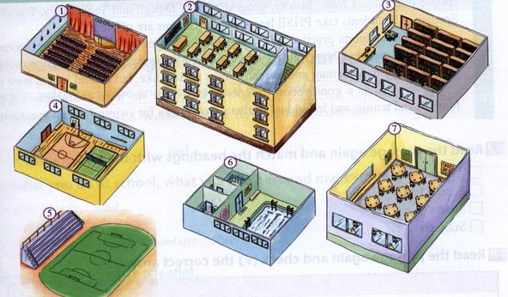
Practice
Ⅰ Label the different parts of the school.
hall
classroom
library
sports ground
dining room
gym
swimming pool

Slide 32

Ⅱ Listen and number the subjects in the order you hear them.
Art, Design and Technology
IT
Languages
PE
Personal Health and Safety Education
2
4
1
5
3

Slide 33
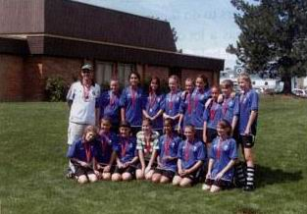
Ⅲ (1) Reading
Read the passage and say where you think it comes from.
A A dictionary
B A website
C A newspaper advertisement

Slide 34
(2)Read the passage again and match the headings with the paragraphs.
After-school activities
School hours
Sports
Subjects
3
1
4
2

Slide 35
(3)Read the passage again and check(√) the correct answer.
1. Do students have to come to lessons on Saturdays?
2. Is the lunch break longer than one hour?
3. Does the school offer team and individual sports?
√

Slide 36
4. Can students join more than one club?
5. Do students take exams in all the subjects they study?
√

Slide 37
Homework
1. Ask students to do the rest activities in the
Workbook.
2. Use your notes to write a leaflet.
3. Ask students to summarize what they have learnt in this module and preview the next.

