Slide 1
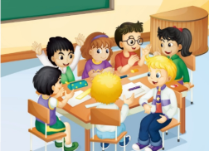
U4 General Revision 1
人教精通版六年级下册
WWW.PPT818.COM

Slide 2
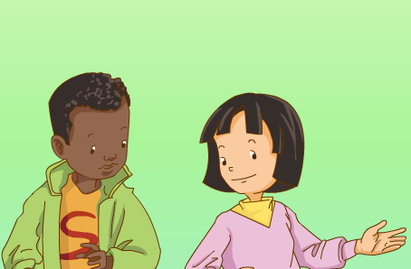
>>Warm-up
情景动画

Slide 3
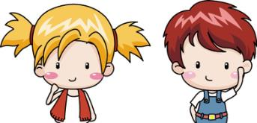
>>Lead-in
Discuss
1. When do you get up?
2. When do you have breakfast?
3. When do you go to bed?

Slide 4
>>Lead-in
Discuss
4. How many lessons do you have in a day?
5. How many subjects do you have?
6. What do you often do on weekends?

Slide 5
>>Presentation
Subjects
English
Chinese
maths
science
PE
art
music
English
I like _________ very much!

Slide 6
>>Presentation
Listen, read and talk
1. How many people are there in Li Yan’s family?
There are three people in her family.
2. What does her father do?
Her father is a doctor.
3. What does her mother do?
Her mother is a teacher.
Part1

Slide 7
>>Presentation
Listen, read and talk
1. When does Li Yan get up?
She gets up at 7:00.
2. When do the classes begin?
Classes begin at 8:00.
3. How many lessons do they have in a day?
They have six lessons in a day.
Part2

Slide 8
>>Presentation
Listen, read and talk
What does Li Yan do on weekends?
1. She usually go to see ______________________.
her grandpa and grandma
2. Sometimes she go to ____________,
__________________, the theme park
or the zoo with her parents.
the cinema
the science museum
Part3

Slide 9
>>Presentation
Listen, read and talk
1. She gets up at _______.
7:00
2. She has breakfast at _______.
7:30
3. Class began at _______.
8:00
4. School is over at _____ in the afternoon.
4:00
5. She has dinner at _____ in the evening.
7:00
6. She goes to bed at _______.
10:00

Slide 10
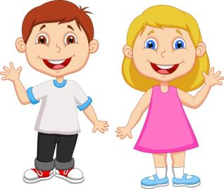
>>Practice
Pair Work
Talk about your daily life.

Slide 11
>>Practice
Let’s write
My Daily Life

Slide 12
>>Summary
描述日常生活时的常用句型：
例如：
I get up at 7:00.
On weekends, I usually…
Sometimes I go to…

Slide 13
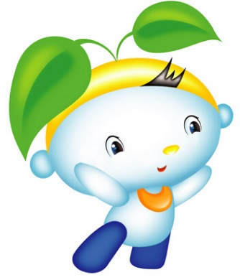
>>Homework
1. 观看课文动画，按照正确的语音、语调朗读课文。
2. 根据你所完成的My Daily Life小作文，制作一个描述你日常活动的表格。
close

