Slide 1
Unit6 I’m tall.
人教精通版四年级上册
WWW.PPT818.COM

Slide 2
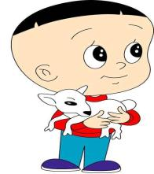
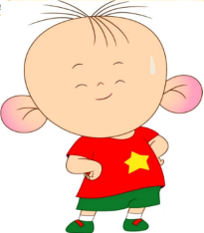
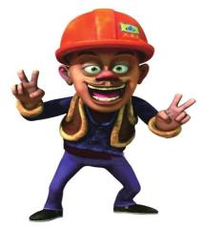
Look and say
Review
Look at … He has ...
Look at … He has ...
Look at … He has ...

Slide 3
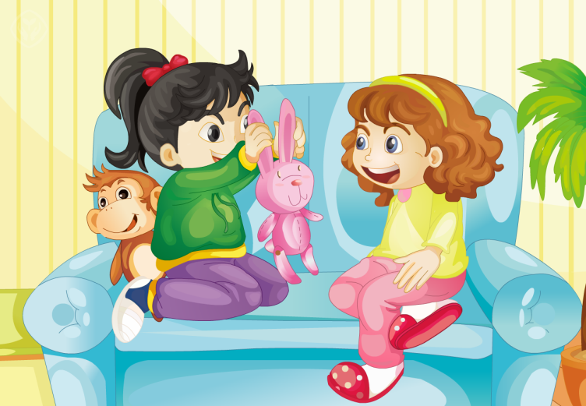
Presentation

Slide 4
Presentation
Look and answer
What animals are they talking about?
A. A rabbit and a monkey.
B. An elephant and a monkey.
C. A rabbit and a tiger.

Slide 5
Look and answer
Presentation
What animals are they talking about?

Slide 6
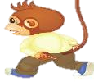
Presentation
Look and answer
What animals are they talking about?
A. A rabbit and a monkey.
B. An elephant and a monkey.
C. A rabbit and a tiger.

Slide 7
Presentation
Listen and answer
Listen and fill in the blanks.（听音并试着完成填空）
A: Look, Lisa. I _____ a rabbit.
have
B: Oh, it has _____ ears
and a _____ tail.
long
short

Slide 8
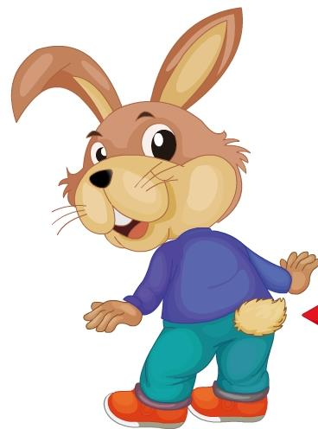
Presentation
Let’s learn
short
a tail

Slide 9
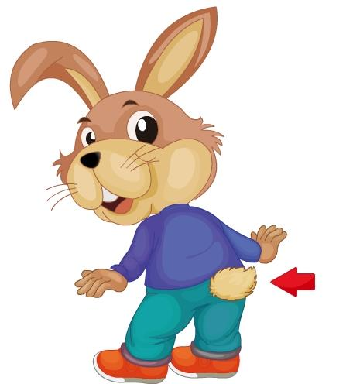
Presentation
Let’s learn
long ear

Slide 10
s
Presentation
Let’s learn
long ear
tail
a
short

Slide 11
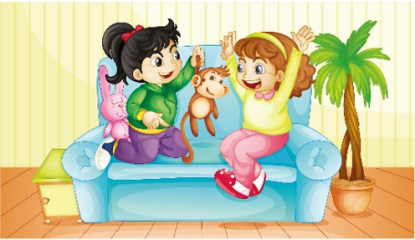
Presentation
Listen and answer
Listen, then fill in the blanks.（听音，再填空）
A: Look at my monkey.
B: It has a ___ mouth and a ___ tail.
big
long

Slide 12
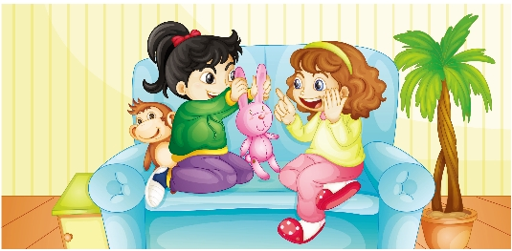
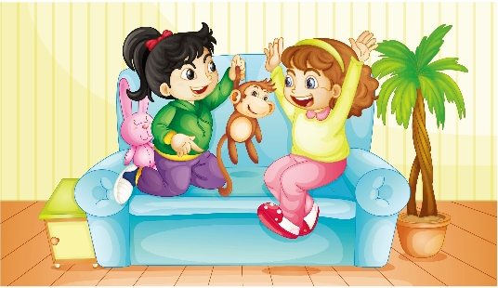
Presentation
Listen and imitate
1
2
Look, Lisa. I have a rabbit.
Oh, it has long ears and a short tail.
3
Look at my monkey.
4
Wow! It has a big mouth and a long tail.

Slide 13
Practice
Let’s read
1
2
3
Read together.
(齐读)
Read in roles.
（分角色读）
Read in groups.
(分组读）

Slide 14
Show time
两人一组试着来表演，其他同学来评价。
 | 模仿录音中的语音语调，有感情地朗读。
 | 可以脱离课本，适当改动其中部分，语音地道。
 | 适当添加内容，意思完整，有创新，表演生动。
Good
Great
Excellent

Slide 15
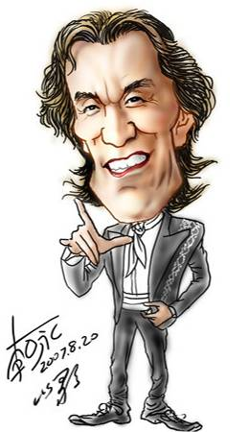
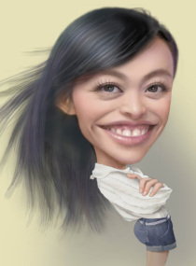
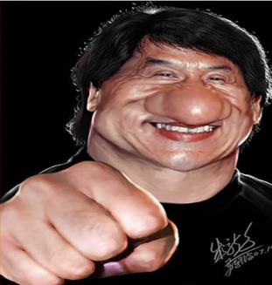
Look and say
…
He has…
…
…
She has…
…
…
He has…
…

Slide 16
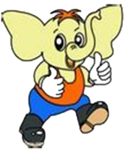
Guess what it is.
It’s big.
It has two big ears
and a long nose.

Slide 17
Guess what it is.
It has two small ears
and a long tail.
It likes fish.
It can catch mice.

Slide 18
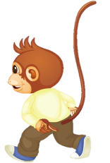
Guess what it is.
It has a big mouth.
It has a long tail.
It likes peaches and
bananas .

Slide 19
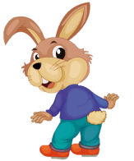
Guess what it is.
It has two long ears.
It has a short tail.
It likes carrots .

Slide 20
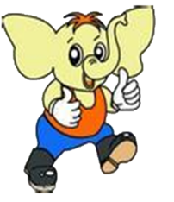
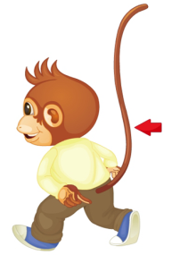
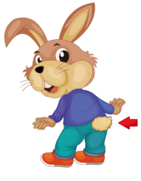
Look and write
An elephant has _____ ears.
A cat has
_____ ears.
big
small
A monkey has a _____ tail.
A rabbit has a _____ tail.
long
short

Slide 21
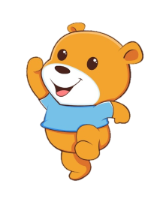
Let’s introduce your favourite animal or friend. (让我们来介绍自己最喜欢的小动物或者朋友。任选其一)
动物（animal）
人物（people）
…
It has …
…
…
He /She has…
…

Slide 22
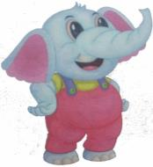
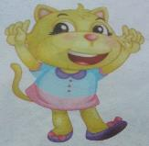
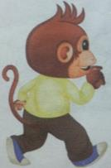
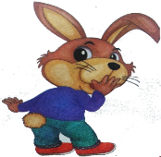
Practice
Let's chant!
An elephant has big ears.
A cat has small ears.
A monkey has a long tail.
A rabbit has a short tail.
Learning tip:
认真模仿，要注意节奏和语调！

Slide 23
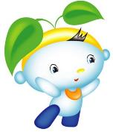
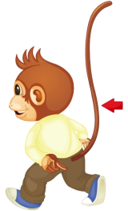
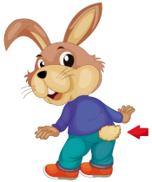
Summary
你会描述这些动物的特征吗？
A monkey has …
A rabbit has …

Slide 24
Homework
1. 跟读Just talk部分的课文动画或录音，并注意语音、语调。
2.用英文给自己的家人描述一下今天学习的两个动物的特征，让他们猜一猜这个动物是什么。
3. 预习Lesson33。
Close

