Slide 1
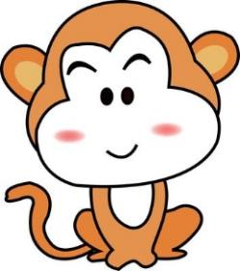
Unit1 My Body
陕旅版
三年级下册
Part A Draw yourself
Let’s learn
Part B Play a game
WWW.PPT818.COM

Slide 2
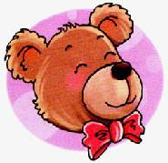
>>Review
Look and say
head
ear
nose
eye
mouth
face

Slide 3
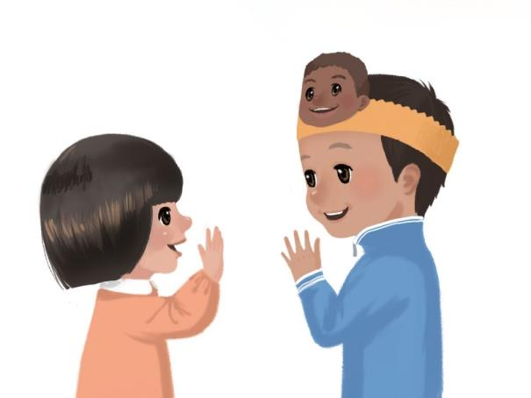
>>Warm-up
I say you do
Touch your ...

Slide 4
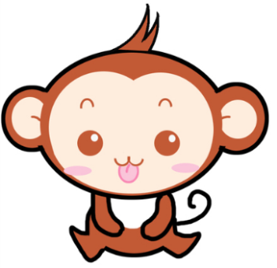
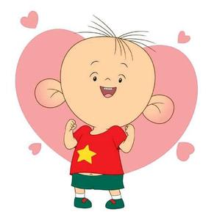
>>Lead-in
Look and say
Review

Slide 5
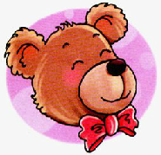
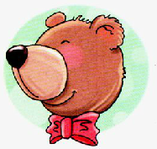
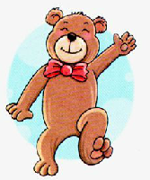
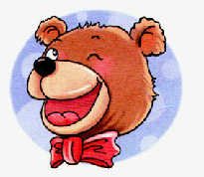
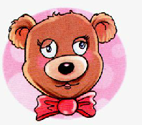
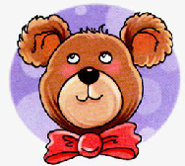
>>Presentation
Let’s say
Look at the bear.

Slide 6
>>Presentation
Let’s say
This is the head
and this is the face.

Slide 7
>>Presentation
Let’s say
It has a nose.

Slide 8
>>Presentation
Let’s say
It has a mouth.

Slide 9
>>Presentation
Let’s say
These are the eyes.

Slide 10
>>Presentation
Let’s say
Those are the ears.

Slide 11
>>Presentation
Let’s say
It is a nice bear.

Slide 12
>>Practice
Read it by yourselves for one minute .
自读课文一分钟。
一分钟倒计时
60
Learning tip :
10
50
当你自己朗读时，遇到不会读或不明白意思的单词或句子，可以把它圈起来，请教同学或老师！
20
40
30
开始

Slide 13
>>Practice
Look and say

Slide 14
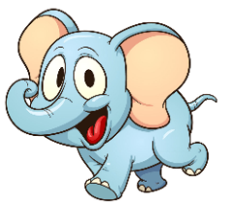
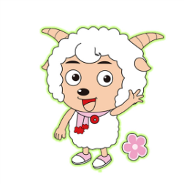
>>Practice
Make sentences
This is a /an … These are … It has …

Slide 15
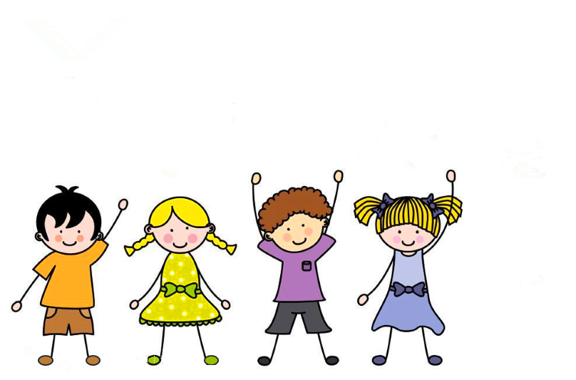
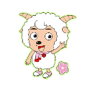
>>Practice
Activity 1
句子接龙
The elephant has a big eyes.
The monkey has a small eyes.

Slide 16
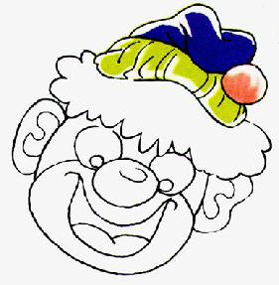
>>Practice
Look at the clown
hair
ear
face
eye
mouth
nose

Slide 17
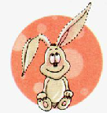
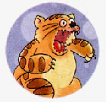
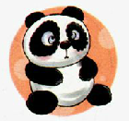
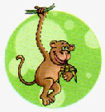
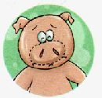
>>Practice
Point and say
This is a/an …
These are …
It has …

Slide 18
>>Summary
如何使用以下句型描述人或物的身体部位？
This is … There are …
Those are … It has …
例如
This is the head and this is the face.
It has a mouth.
There are the eyes.
Those are the ears.

Slide 19
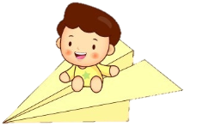
>>Homework
1.听课文录音并跟读，按照正确的语音、语调朗读并表演课文对话。 2.在练习本上描述1-2个小动物的身体部位。
3.预习B Let’s learn more。
close

