Slide 1
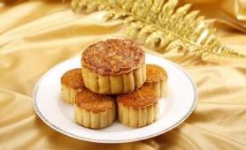
Unit 2
I think that mooncakes are delicious!
Section A (第1课时)
WWW.PPT818.COM

Slide 2
Warming up:
—What do you like best about...?
—I love...

Slide 3
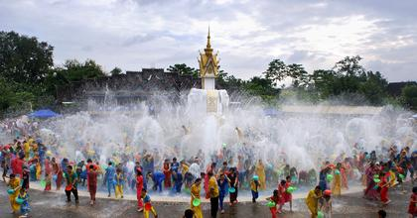
the Water Festival

Slide 4
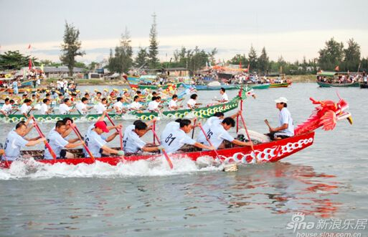
the Dragon Boat Festival

Slide 5
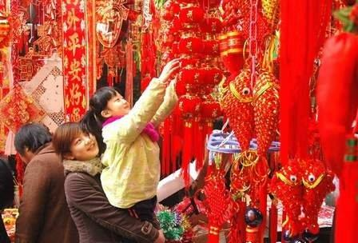
the Chinese Spring Festival

Slide 6
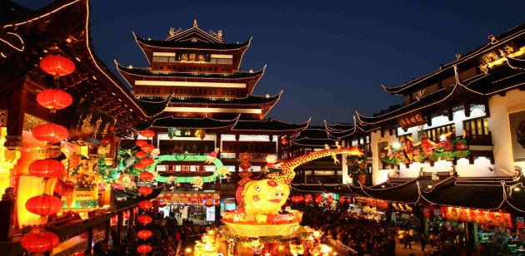
the Lantern Festival

Slide 7
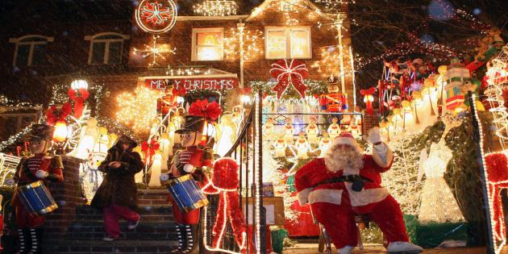
Christmas

Slide 8
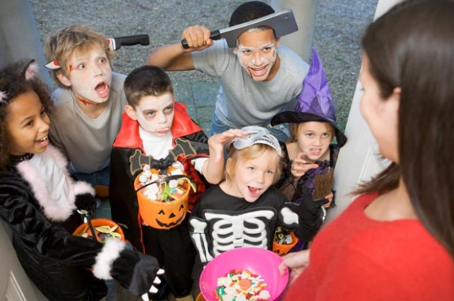
Halloween

Slide 9
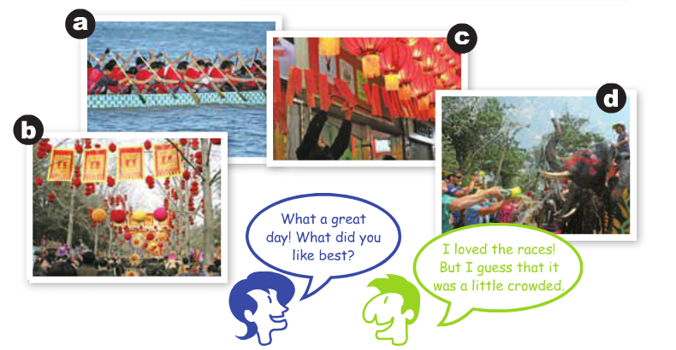
Match the pictures with the descriptions.
1a
1.______ The Water Festival in Thailand
2.______ The Dragon Boat Festival in Hong Kong
3.______ The Chinese Spring Festival in Beijing
4.______ The Lantern Festival in Jiangxi
d
a
b
c

Slide 10
Listen and circle T for true or F for false.
1b
1.Bill thinks that the races were not that interesting to watch.
T F
2.Mary thinks that the teams were fantastic.
T F
3.Bill wonders whether they'll have zongzi again next year.
T F
4.Bill and Mary believe that they'll be back next year to watch the races.
T F

Slide 11
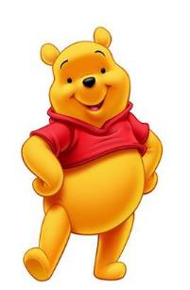
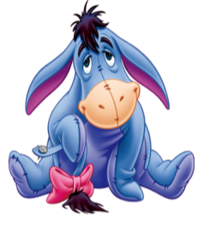
Talk about the festivals in 1a.
1c
What do you like best about the Dragon Boat Festival?
I love the races.I think that they're fun to watch.

Slide 12
Listen to the conversation between Wu Ming and Harry and circle the correct words in the sentences.
2a
1.Wu Ming and Harry are cousins / strangers / friends.
2.Wu Ming went to Singapore / Hong Kong / Macao for his vacation.
3.Wu Ming visited his relatives / friends / classmates.
4.Wu Ming liked eating out / shopping / the Dragon Boat Festival best.

Slide 13
Wu Ming did a lot of fun activities,but there were also downsides. Listen again and fill in the chart.
2b
Fun activities | Downsides
Eating out
Shopping
Dragon Boat Festival in June
He put on five pounds.
He spent so much money.
It's quite hot.

Slide 14
Role-play conversations between Wu Ming and Harry.Use the information in 2a and 2b or make your own conversations.
2c
A:What did you do on your vacation?
B:I visited my cousins.I think that we ate five meals a day!
I've put on five pounds!
A:I guess the food was delicious,right?

Slide 15
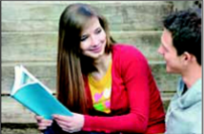
Role-play the conversation.
2d
Clara:Guess what? I’m going to Chiang Mai in two weeks.
Ben:Wow,sounds like fun! But I believe that April is the hottest month of the year there.
Clara:Yes,that’s true.But there’s a water festival there
from April 13th to 15th.
Ben:I wonder if it’s similar to the Water Festival of
the Dai people in Yunnan Province.

Slide 16
Clara:Yes,I think so.This is the time of the Thai New Year.People go on the streets to throw water
at each other.
Ben:Cool!But why do they do that?
Clara:Because the new year is a time for cleaning
and washing away bad things.Then you'll have
good luck in the new year.

Slide 17
Language Points
1.I've put on five pounds! 我胖了五磅！（教材第10页）
(1)put on 此处意为“增加（体重）；发胖”。
e.g.:She can eat what she wants but she never puts on weight.
【拓展】put on的其他含义：
①穿上；戴上
e.g.:My mother put on her coat and went out.
②上演；举办
e.g.:One summer our children put on a play.
(2)pound
e.g.:The apples cost one dollar a pound.
【拓展】pound还可译为“英镑”，是英国标准货币单位，1英镑等于100便士。
e.g.:They spent a thousand pounds.

Slide 18
2.I wonder if it's similar to the Water Festival of the Dai people in Yunnan Province.我想知道它是否和云南省傣族的泼水节相似。（教材第10页）
(1)I wonder if...是一个表示请求允许的交际用语，常用来询问对方是否允许自己做某事。
e.g.:I wonder if you would mind helping me.
【拓展】①对I wonder if...做肯定回答可用：
Sure,go ahead. Of course./Sure.
②对I wonder if...做否定回答可用：
I'm sorry,but... I'm afraid not. You'd better not.
(2)be similar to意为“与……相似”。其中similar为形容词，意为“相似的”，无比较级。
e.g.:A cat is similar to a tiger in many ways.

Slide 19
Exercise
根据所给汉语提示填空。
1.Can you see the_________(灯笼) over there?How
beautiful they are!
2.Parents often tell their children not to speak to _________ (陌生人).
3.I got a lot of gifts from my_________(亲戚) on my birthday.
4.Don't eat too much,or you'll_________(增加) your weight.
5.The car cost him 2,000_________(英镑).
lanterns
strangers
relatives
put on
pounds

Slide 20
Homework
1.Listen and read after the tape at home.
2.Read and recite 2d.

Slide 21
Thank you！

