Slide 1
Unit 1 Topic 1
Welcome to China!
Section D
WWW.PPT818.COM

Slide 2
Game Time!
Play the seizing cards game. Review the letters A--Z.
(Two students form a group. Each student disorders his/her cards before the game begins. Then each student shows one letter card at the same time. If student A’s letter is in front of student B’s in alphabetical order, student B will give his/her card to student A. If they show the same letter, compare the next card with each other. The student who has more cards will be the winner.)

Slide 3
1 Work alone
J
A
H
K
C
P
T
V
E
B
D G
Z
O
R
I Y
U Q ____
W
L
S
F ___ M N ___ X

Slide 4
PRC IQ EQ UN SOS UFO WTO DIY UK
3 Listen, read and understand

Slide 5
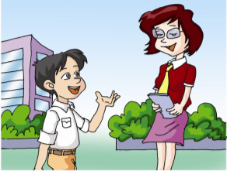
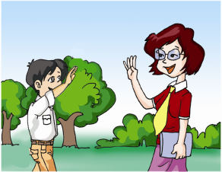
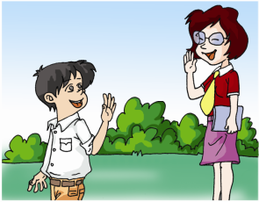
Work alone. Listen to the conversations
and number the pictures.
2
Fine, thanks.
Nice to see
you, too.
How are you?
Nice to see you.
3
2
Good morning,
Kangkang!
Goodbye,
Miss Wang.
Good morning,
Miss Wang!
Bye.
1
4

Slide 6
4a Grammar focus
Present Simple to be
I’m Kangkang. | I’m = I am
Are you Maria? | Yes, I am. / No, I’m not.
Miss Wang, this is Michael.

Slide 7
4b Useful expressions
Good morning /afternoon/evening! | Good morning/ afternoon/evening!
Welcome to China! | Thank you./ Thanks.
Hello! / Hi! | Hello! / Hi!
Nice to meet/see you. | Nice to meet/see you, too.

Slide 8
How do you do ? | How do you do ?
How are you? | I’m fine, thank you. /Fine, thanks.
Goodbye. | Bye.
See you later. | See you.

Slide 9
A: Good morning!
B:____________________
Good morning!
A: Nice to see you.
B:____________________
Nice to see you, too.
A: How are you ?
B:___________. And you ?
A: ___________
Fine, thanks
I’m fine, too.

Slide 10
初次见面
A: Hello, I’m ... . Are you ...? B: Yes, I am. A: Nice to meet you. B: Nice to meet you, too.

Slide 11
问候
A: Good morning, B.
B: Good morning, A.
A: How are you?
B: I’m fine, thanks.

Slide 12
介绍
A: Hello，B.
B: Hello，A.
A: B, this is my teacher, Mr. Lee.
Mr. Lee, this is B.
T: How do you do?
B: How do you do?

Slide 13
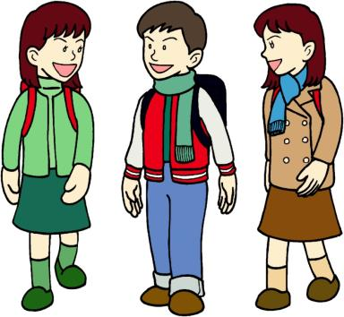
Key sentences
This is ... .
Nice to meet you.
Are you ...?
Yes, I am ... .
How do you do?

Slide 14
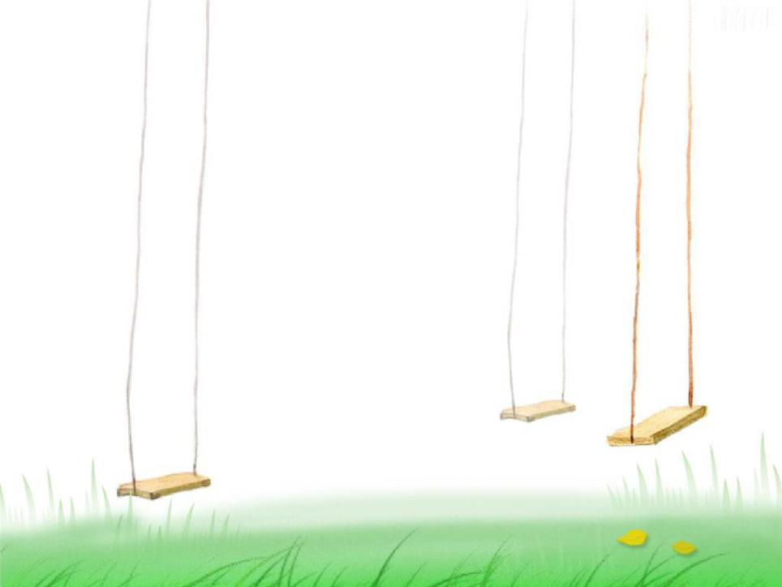
3. — Good afternoon!
— ________
A. Good! B. Good afternoon!
C. Thank you!
4. — How do you do?
— ________
A. How are you?
B. How do you do?
C. Good morning!
B
B

Slide 15
C
5. John, this is Jim. Jim, _____
A. he’s John. B. it’s John.
C. this is John.
6. — Are you Wang Li?
— __________
A. Yes, I’m.
B. No, I’m not.
C. Yes, I’m not.
B

Slide 16
在这个单元里，你学到了什么？
你能帮我总结吗？
Summary
26个英文字母；
2. 关于问候和介绍的日常用语
3. be 的用法。

Slide 17
Homework
1. Make a name card for yourself.

Slide 18
2. Make more friends and change your name cards.
3. Make sure to master the English letters A--Z.

