Slide 1
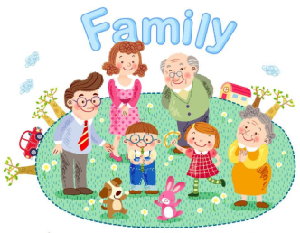
Unit 2 My Family
陕旅版
三年级下册
第三课时
WWW.PPT818.COM

Slide 2
>>Review
Make the right order
C: Miss White, this is my father.
And this is my mother.
B: Good afternoon, Wu Chen.
A: Good afternoon, Miss White.
E: Hello! Nice to meet you.
D: Nice to meet you, too, Miss White.
ABCED

Slide 3
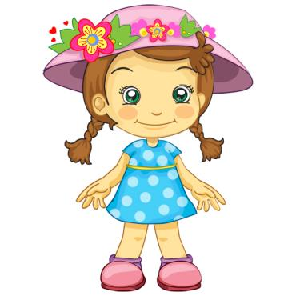
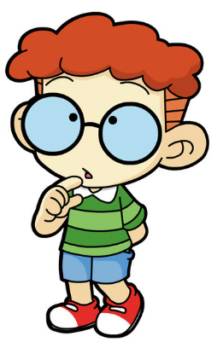
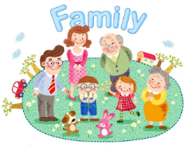
>>Review
Make New Dialogue
Hi, Good morning.
Hello, Good morning.

Slide 4
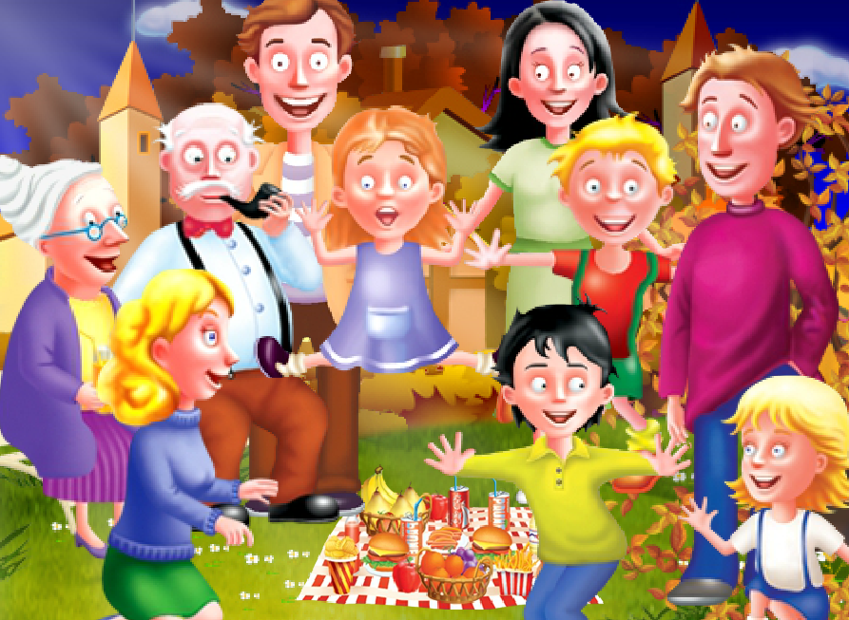

>>Warm-up
Sing a song

Slide 5
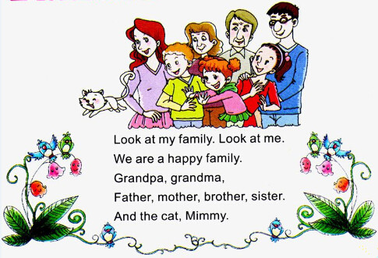
>>Lead-in
Read and guess

Slide 6


>>Presentation
Ask and answer
Who is she?
She is …
Who is he?
He is …

Slide 7
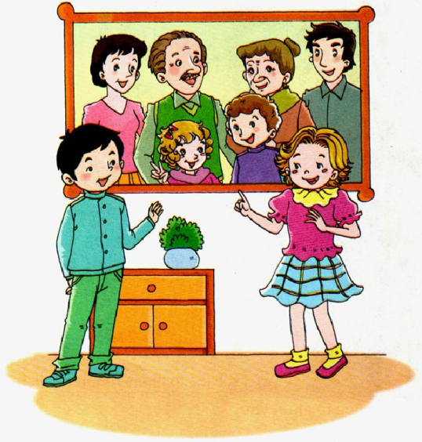
>>Presentation
Look and say

Slide 8

>>Presentation
Let’s learn more
Alice: Look at my family.
Su Nan: Who is he?
Alice: He is my father. This is my mother.
Su Nan: Who is the boy?
Alice: He is my brother.
Su Nan: Is this your grandma?
Alice: Yes, she is. And this is my grandpa.

Slide 9

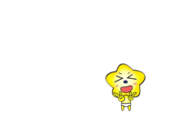




>>Practice
Show time
Work in two, choose a way you like to read or act the story.（2人一组,选择你喜欢的方式去读或者表演故事。）
Act out the story.（表演对话）
Read in roles.（分角色朗读）
Read together.（齐读）

Slide 10



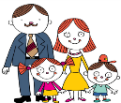

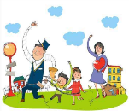
>>Practice
活动
家谱展示

Slide 11

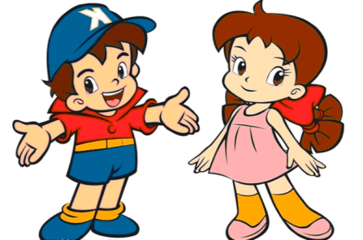
>>Practice
句子接龙
A: Who is he/she?
B: He / She is …
A: Is he/she …?
B: Yes, he/she is./
No, he/she isn’t.

Slide 12
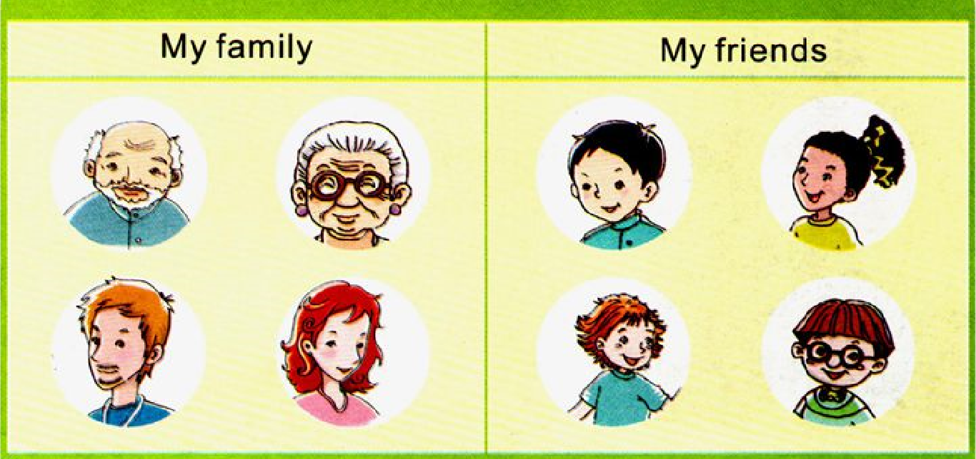
>>Practice
Look and say

Slide 13

>>Practice
Ask and answer
A: Who is he/she?
B: He / She is …
A: Is he/she …?
B: Yes, he/she is./
No, he/she isn’t.

Slide 14

>>Summary
如何询问某人是谁？
Who is he/she? He/ She is …
如何用一般疑问句询问别人是谁？
—Is this your …?
—Yes, he/she is.
No, he/she isn’t.

Slide 15
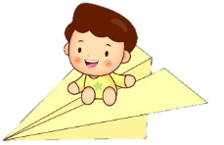

>>Homework
1.听课文录音并跟读，按照正确的语音、语调朗读并表演课文对话。
2.朗读课文Let’s learn more, 并会背诵。
3.预习B Read a story.
close

