Slide 1
Unit3 It’s a pineapple.
人教精通版四年级上册
WWW.PPT818.COM

Slide 2
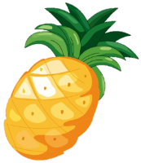
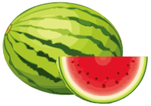
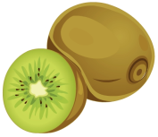
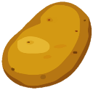
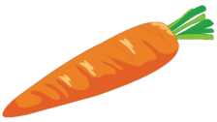
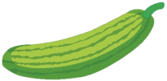
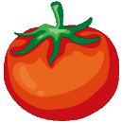
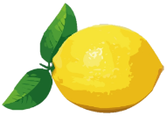
Play a game
Review
What’s missing?

Slide 3
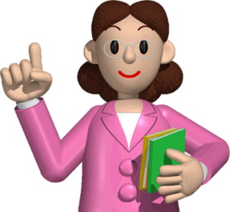
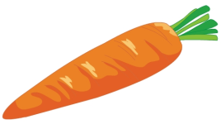
Review
I say you do
Show me a carrot.

Slide 4
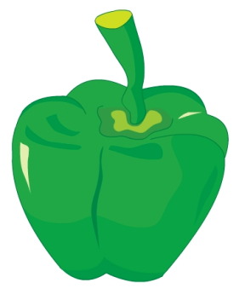
Let’s learn
Presentation
What’s this in English?
It’s a green pepper.

Slide 5
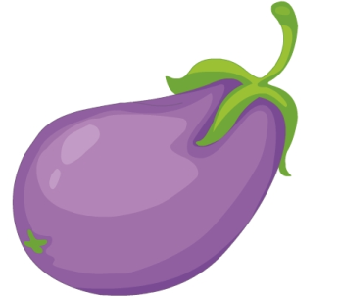
Let’s learn
Presentation
What’s this in English?
It’s an eggplant.

Slide 6
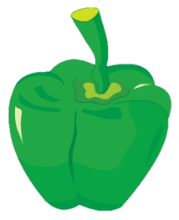
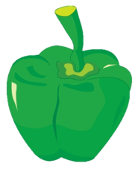
Let’s learn
Presentation
Do you like green peppers?
Yes, I do. / No, I don’t.
green pepper
green peppers

Slide 7
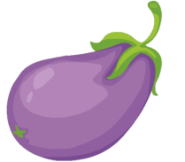
Let’s learn
Presentation
Do you like eggplants?
Yes, I do. / No, I don’t.
eggplant
eggplants

Slide 8
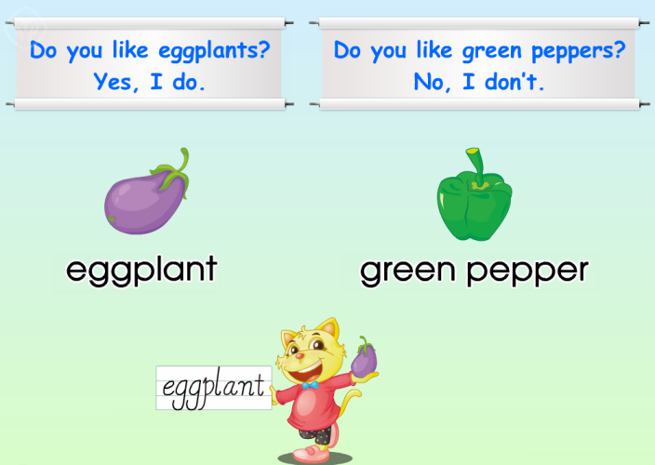
Just read and write
Presentation

Slide 9
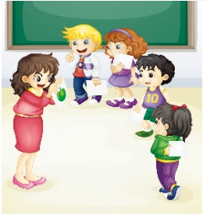
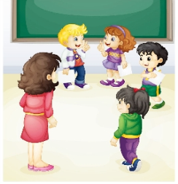
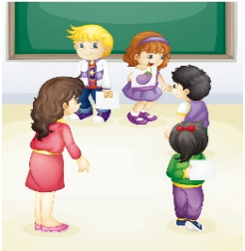
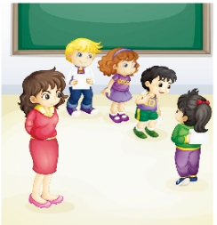
Presentation
They’re playing a chain game.

Slide 10
Presentation
Look and answer
1. Does Lisa like green peppers?
Yes, she does.
2. Does Li Yan like eggplants?
No, she doesn’t.

Slide 11
Presentation
Listen and imitate
2
1
OK!
OK!
Hi! Let’s play a chain game.
OK!
4
It’s a green pepper.
3
What’s this in English?

Slide 12
Presentation
Listen and imitate
6
5
Yes, I do.
Do you like green peppers?

Slide 13
Presentation
Listen and imitate
7
What’s this in English?
9
8
Do you like eggplants?
It’s an eggplant.
10
No, I don’t. I like tomatoes.

Slide 14
Show time
五人一组，练习对话并表演，其他同学评价。
 | 模仿录音中的语音语调，有感情地朗读。
 | 可以脱离课本，适当改动其中部分，语音地道。
 | 适当添加内容，意思完整，有创新，表演生动。
Good
Great
Excellent

Slide 15
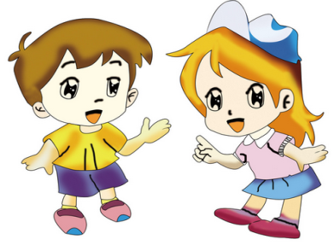
Ask and answer
What’s this in English?
It’s …
Do you like …?
Yes/No, …

Slide 16
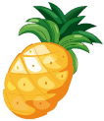
Do a survey
Practice
小组合作，调查组内成员喜欢的水果和蔬菜，用“Do you like …?”进行提问。
Vegetables
or Fruits
Name
Lily

Slide 17
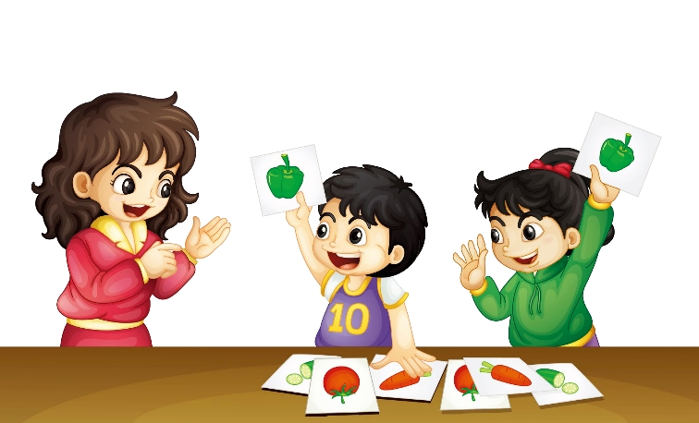
Let’s do
Practice
Show me a green pepper.
Green pepper!
Green pepper!

Slide 18
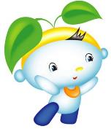
Summary
本课学习的蔬菜类单词有:
green pepper
eggplant

Slide 19
Summary
如何询问某人是否喜欢某物并做相应回答呢？
—Do you like …?
—Yes, I do. / No, I don’t.

Slide 20
Homework
1. 跟读Just talk部分的课文录音，并注意语音、语调。
2.运用本课所学知识，调查你的好朋友或父母喜欢的水果或蔬菜，并绘制成一张调查表。
3. 预习Lesson18。
Close

