Slide 1
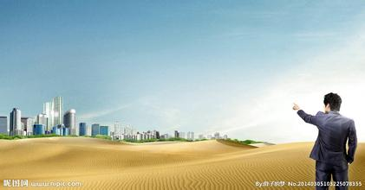
九年级英语·下 新课标 [冀教]
Unit 10 Get Ready for the Future
Look into the Future
WWW.PPT818.COM

Slide 2
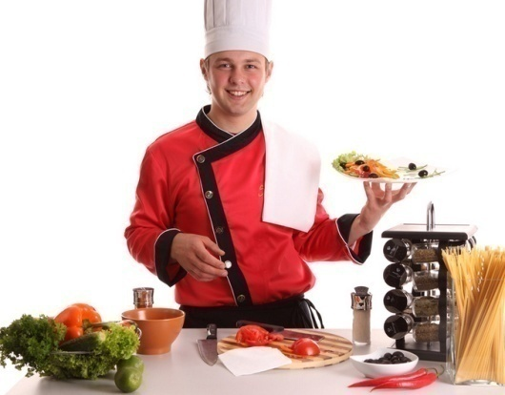
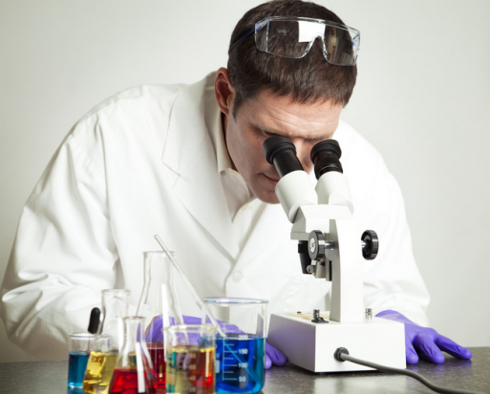
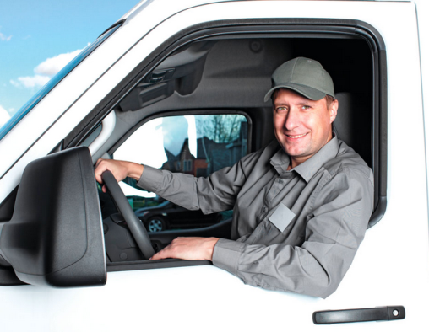
What do you want to be when you grow up?

Slide 3
What should you do now if you want to make your dream come true?

Slide 4
New words
boss n. 老板
manage v. 管理；负责
doubt v. 怀疑
wealth n. 钱财；财富
astronaut n. 宇航员

Slide 5
Read the lesson and fill in the blanks.
Some students are having a discussion about their future.Jenny wants to be a pilot.She loves to .Brian wants to be a ,but Jenny thinks Brian should do something that he enjoys.Steven wants to be an .He wants to invent something that won’t harm the environment.Kate likes meals and enjoys trying different kinds of food.As for Danny,he is going to choose the most fun and
job in the world.He is going to be an astronaut.
travel
boss
engineer
cooking
exciting

Slide 6
Read the text and find out main phrases and main sentences.
Main phrase:
·as for
Main sentences:
·Look into the Future
·What should you do now if you want to make your dream come true?
·What do you want to be when you grow up,Jenny?
·I love to travel,and it would be fun to fly an airplane.

Slide 7
·Well,I don’t doubt you would be a good boss,but I don’t think wealth is the most important thing in life.
·I love cooking,and I like creating new dishes myself.
·As for me,I’m going to choose the most fun and exciting job in the world.
·Astronauts need to know a lot about science,Danny.

Slide 8
☆教材解读☆
1.Look into the Future
look into在此意为“展望”。还有“朝……里面看;调查;浏览(书籍、资料等)”的意思。
2.What should you do now if you want to make your dream come true?
come true意为“实现,成为现实”,是不及物动词词组,不能接宾语,主语通常是梦想、希望、愿望等。

Slide 9
3.What do you want to be when you grow up,Jenny?
grow up意为“成长;成熟;发展”。
【辨析】 grow up,grow into
grow up意为“长大,成长”,主要强调现在的状态,后面通常不跟名词或者名词短语。grow into意为“成长为……,长成……”,主要强调从小到大这个发展过程,后面常跟名词或名词短语。

Slide 10
4.Well,I don’t doubt you would be a good boss,but I don’t think wealth is the most important thing in life.
doubt后接宾语从句时,如主句为肯定句,用whether或if连接;如主句为否定句或疑问句,用that连接。在这样的结构中,doubt意为“怀疑,不相信,不信任;不能肯定,对……没准儿”。

Slide 11
5.I love cooking,and I like creating new dishes myself.
句中的myself是反身代词,作主语的同位语,此时可放在句尾,也可放在主语后,故这句话还可说为:I love cooking,and I myself like creating new dishes.。
6.As for me,I’m going to choose the most fun and exciting job in the world.
as for意为“至于,关于”,是介词短语,常常用来引出新的话题,其后常跟名词、代词或v.-ing形式,且常位于句首。

Slide 12
7.Astronauts need to know a lot about science,Danny.
本句中need作实义动词,后面的动词用不定式,表示“需要做……”;另外,句中的a lot起副词作用,用在动词know后作状语,与very much同义;
about science是介词短语作状语。

Slide 13
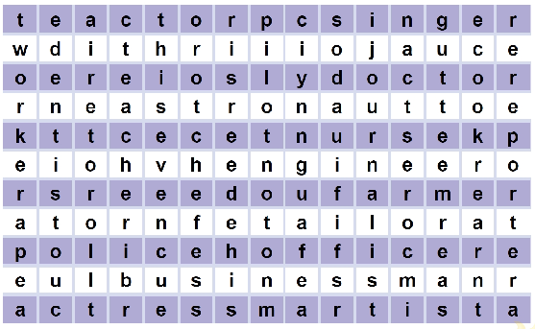
How many job words can you find? Write them down.
Across:actor,singer,doctor,astronaut,nurse,engineer,
farmer,tailor,(police)officer,businessman,actress,artist
Down:worker,dentist,teacher,pilot,journalist,
cook,reporter

Slide 14
WHAT DO YOU WANT TO BE?
Look at the job words you found above in Activity 2.Think about these questions:
·Are some jobs better than other jobs?
·What job do you like best in the list?Why?
·What job do you dislike in the list?Why?

Slide 15
Ⅰ.Fill in the blanks with the correct words according to the first letters.
1.What do you want to be when you
g up?
2.You work hard at your lessons.I don’t
d you will get good grades.
3.I am f to Paris next week.
4.Smoking is h to your health.
5.The students need to learn how to
o outdoor activities.
row
oubt
lying
armful
rganize

Slide 16
Ⅱ.Choose the correct answers.
6.Kate wants to be a because she is interested in cooking.
A.cook B.cooker C.cooking D.cookers
7.The football game was very and I felt about it.
A.excited,excited B.exciting,exciting
C.excited,exciting D.exciting,excited
8.I that he’s a hard-working student.
A.never doubt B.no doubt
C.usually doubt D.not doubt
A
D
A

Slide 17
9.At the meeting,Mr.Chen spoke .
A.lot B.a lot
C.lots of D.a lot of
10. most students,they find French hard to learn well.
A.Thanks to B.Because of
C.As for D.Ahead of
B
C

Slide 18
Ⅲ.Rewrite the following sentences as required.
11.I think Peter is going to America next week.(改为否定句)
I Peter going to America next week.
12.Lang Lang is good at playing the piano.(同义句转换)
Lang Lang playing the piano.
13.The students are discussing their future.(对画线部分提问)
the students ?
14.She needs to know a lot about science.(改为否定句)
She know a lot about science.
15.Danny wants to be an astronaut when he grows up.(对画线部分提问)
does Danny when he grows up?
don’t think is
does well in
What are doing
doesn’t need to
What want to be

Slide 19
Homework
1.Finish off the remaining exercises in the activity book.
2.The students are required to read the next text in the student’s book.

