Slide 1
Unit 3 Robots
Integrated skills
WWW.PPT818.COM

Slide 2
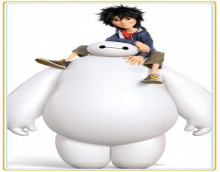
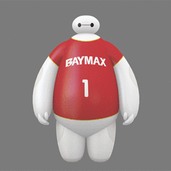
Hiro
Baymax
Notes:
2

Slide 3
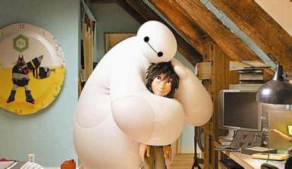
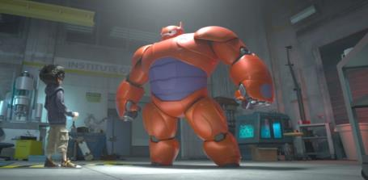
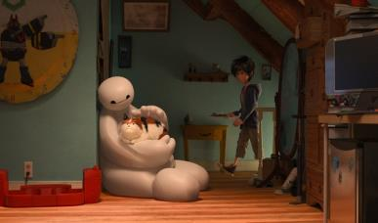
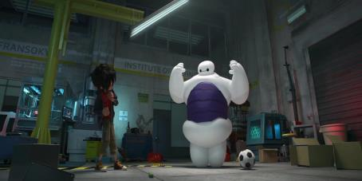
What is special about Baymax?
Notes:
3

Slide 4
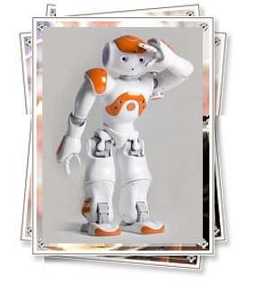
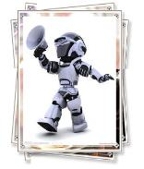
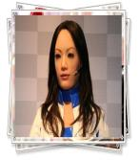
A poster
International Robot Show
Place: the town hall
Dates: 14—22 March
Time: 9 a.m.—4:30 p.m.
Ticket: ￥20 (free for children under 12)
Special gift!
Come to the robot show on 14 March and receive a copy of Robot magazine for free!
Notes:
4

Slide 5
Read and answer
where
At the town hall.
when
From 14 to 22 March.
what time
From 9 a.m. to 4:30 p.m.
ticket price
￥20 for people over 12.
A copy of Robot magazine for free on 14 March.
surprise

Slide 6
Before listening
There is going to be a (1)______________ soon.
The show will be held at the (3)______________.
It is from (4)________ to (5)________ March.
It begins at (6)_______and finishes at (7)_________.
The price of a ticket is (8)_________for people 12
years and above.
a robot show
town hall
14
22
9 a.m.
4:30 p.m.
￥ 20
Notes:
6

Slide 7
While listening
A radio programme
Robot from China, (2)_______ and South Korea will be displayed.
One of the robots is designed to help students
with their (9)___________. It can read a book in
(10) ______________ and tell you about it in (11)______________. It has a (12)_______ memory.
It never gets anything (13)_________. It does not get (14)_______. You need to give it some oil
(15)___________ and change the batteries (16)____________.
Japan
Listening tips:
1. Predict what the listening is about before listening.
2. Write the first letter of each word while listening.
3. Try to understand the main idea and pay attention to the details.
4. Check the spelling after listening.
homework
five minutes
clear language
good
wrong
tired
every month
two months
Notes:
7

Slide 8
After listening
An email
Hi Simon,
I know you are interested in robots. There is going to be a (1)___________ this week. The show is held at the
(2)___________. We can see robots from (3)___________
_________________. I have just learnt that one of the robots is designed to (4)___________________________
____________. It can read a book (5)_______________. That is really exciting news! I think we should go and find more.
robot show
town hall
China, Japan
and South Korea
help students with their
homework
in five minutes
Notes:
8

Slide 9
The robot show starts from this Saturday, 14 March. We will receive a (6)_________________________ for free if we go there on the first day of the show. Since we are over (7)_____________, we need to pay (8)_______ each for the tickets. The show begins at (9)________. Maybe we need to leave home earlier in order to get there on time.
Would you like to go with me this Saturday morning? Please let me know.
Yours,
Daniel
copy of Robot magazine
12 years old
￥20
9 a.m.

Slide 10
Hi Simon,
I know you are interested in robots. There is going to be a robot show this week. The show is held at the town hall. We can see robots from China, Japan and South Korea.
I have just learnt that one of the robots is designed to help students with their homework. It can read a book in five minutes. That is really exciting news! I think we should go and find out more.
The robot show starts from this Saturday, 14 March. We will receive a copy of Robot magazine for free if we go there on the first day of the show. Since we are over 12, we need to pay￥20 each for the tickets. The show begins at 9 a.m.. Maybe we need to leave home earlier in order to get there on time.
Would you like to go with me this Saturday morning? Please let me know.
Yours,
Daniel
Read the email and answer:
1. Do you think if Simon will go to the robot show? Why?
2. What is exciting news for Daniel?
Notes:
10

Slide 11
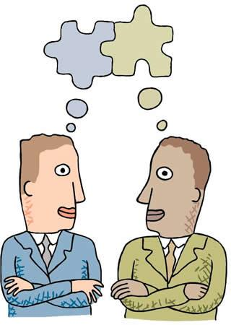
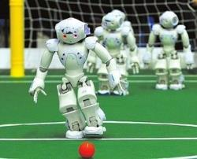
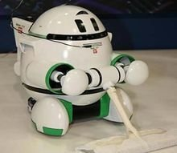
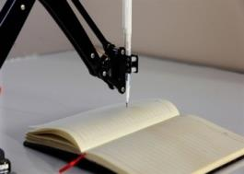
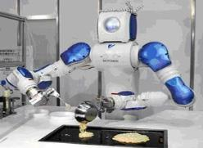
Pair work
What will you do if your robot goes wrong?
What is your ideal robot like? Why?

Slide 12
Listen and answer
Read and act out
1. Who does Mr Jiang want to speak to?
2. What will the robot shop do with the problem?
The Customer Service Department.
The robot engineer will contact Mr Jiang.
Mini-dictionary
customer n. 消费者
hold vi. 等待，不挂断
through adv. (电话)接通
put through 给……接通

Slide 13
Group work
Useful expressions:
Can I help you? / What can I do for you?
I’d like to speak to …. / May I speak to …?
This is … speaking.
Please hold and I’ll put you through.
My robot has caught a virus and it has gone wrong.
My mobile phone doesn’t ring.
My computer has stopped working completely.
I am sorry to hear that. / We’re sorry for the inconvenience.
Would you like us to have it checked? / We would like to
send you a new one.
We’ll contact you soon.
Make a phone call talking about what kind of service you need.

Slide 14
Baymax’s words
Teacher’s words
With the development of science and technology, more and more intelligent robots are being used in different fields, taking the place of humans to finish many tasks. With the help of robots, people can save time to do what they like; people can reduce the rate of death and injury in dangerous work; people can …. Robots are playing an important part today. But no matter how clever robots are, they are made by humans. Whatever they do, they just follow the instructions given to them by humans. Therefore, robots will never completely replace humans.
Let’s enjoy the convenience
brought by robots!

Slide 15
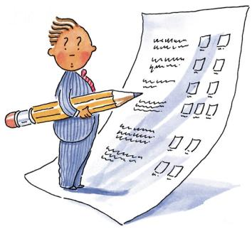
Homework
Remember the key phrases and expressions.
2. Make a phone call talking about what kind
of service you need.

