Slide 1
How’s the weather today?
人教精通版四年级上册
WWW.PPT818.COM

Slide 2
Let’s sing
Warm-up

Slide 3
Lead-in
How are you?
fine
I’m fine.

Slide 4
Presentation
How’s the weather today?
It’s fine today.
/ It’s nice today.
nice

Slide 5
Presentation
It’s fine today. Let’s play with my kite.
Great!

Slide 6
Presentation
It’s nice today. Let’s play football.
OK. Let’s go!

Slide 7
Presentation
It’s nice today. Let’s play balloons.
Good idea!

Slide 8
Look and say
Presentation
当我们建议或邀请某人做某事时，可以说：
Let’s ….

Slide 9
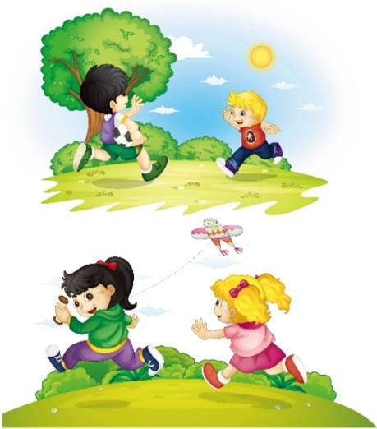
Look and guess
Presentation
Guess! What are they talking about?

Slide 10
Presentation
Listen and imitate
1
Hi, Peter! It’s fine today. Let’s play football.
2
Great!
3
Kate, it’s nice today. Let’s play with my kite.
4
OK. Let’s go!

Slide 11
Practice
Let’s read
1
2
3
Read together.
(齐读)
Read in roles.
（分角色读）
Read in groups.
(分组读）

Slide 12
Show time
四人一组试着来表演，其他同学来评价。
 | 模仿录音中的语音语调，有感情地朗读。
 | 可以脱离课本，适当改动其中部分，语音地道。
 | 适当添加内容，意思完整，有创新，表演生动。
Good
Great
Excellent

Slide 13
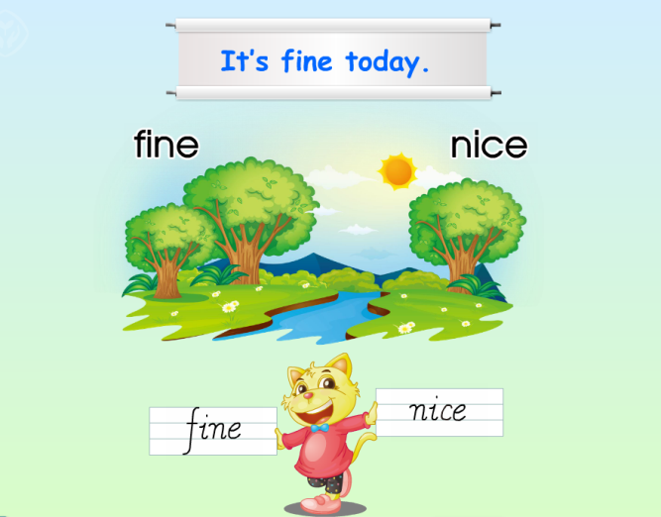
Just read and write
Presentation

Slide 14
Spell and read
Practice
r
i
v
b
k
f
n
f
c
e
n
t
k
Can you read them?

Slide 15
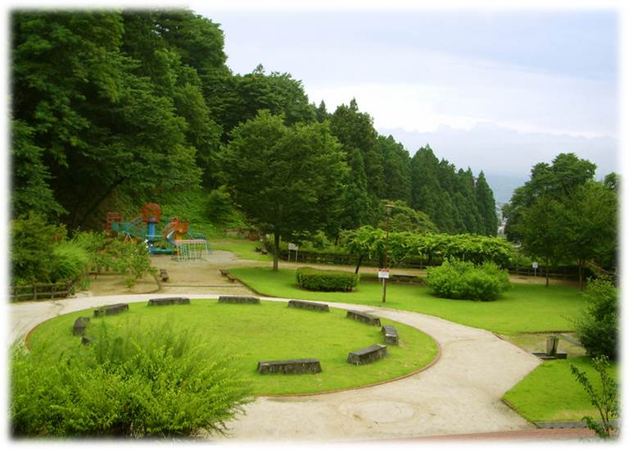
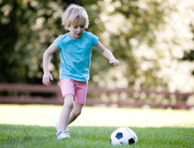
Look and say
Practice
It’s ___ today. Let’s _______.

Slide 16
Let’s chant
Practice

Slide 17
Summary
本课学习的描述天气状况的单词有:
fine
nice

Slide 18
Summary
如何表达天气状况良好，并邀请某人做某事呢？
It’s fine/nice today.
Let’s …

Slide 19
Homework
1. 跟读Just talk部分的课文录音，并注意语音、语调。
2.搜集在晴朗的天气里小朋友可以开展的户外活动有哪些，并将英文表达记录在本子上或做成图文并茂的英语手抄报。
3. 预习Lesson 20。
Close

