Slide 1
Section C Discovering Useful Structures & Listening and Talking
Unit 5 Languages Around The World
WWW.PPT818.COM

Slide 2
Ⅰ
Ⅱ
Ⅲ
Ⅳ
Ⅰ.知识体系图解
struggle
tongue
semester
gas
petrol
subway
apartment
pants

Slide 3
Ⅰ
Ⅱ
Ⅲ
Ⅳ
观点
为……而战斗
不同种类的
为……所熟悉
有空
放弃
不再
感觉像;想要
大小;尺寸
鼓励某人做某事

Slide 4
Ⅰ
Ⅱ
Ⅲ
Ⅳ
Ⅱ.单词拼写
1.Your mother t is the language that you learn from your parents when you are a baby.
2.The students are expected to do five experiments each s .
3.At present,the s plays an important role in the city’s transportation system.
4.Fire extinguishers(灭火器) are located on each floor and in each a .
tongue
semester
subway
apartment

Slide 5
Ⅰ
Ⅱ
Ⅲ
Ⅳ
Ⅲ.用适当的关系词填空
1.We will never forget the year 1949 the People’s Republic of China was founded.
2.The English Corner is the place people often go to practise their spoken English.
3.What especially impressed us was the way our teacher studied foreign languages.
4.This is the museum we saw an exhibition the other day.
5.Can you tell us the reason you refused to accept the job?
when
where
that/in which
where
why

Slide 6
Ⅰ
Ⅱ
Ⅲ
Ⅳ
Ⅳ.听说导学
听教材P65的Listening Part 1,回答第1、2小题。
1.What is the speaker talking about?
A.English vocabulary.
B.Non-English speakers.
C.Different kinds of English.
2.What does the speaker ask the listeners to do?
A.Take notes.
B.Listen to a conversation.
C.Make a conversation.
答案:C
答案:B

Slide 7
Ⅰ
Ⅱ
Ⅲ
Ⅳ
听教材P65的Listening Part 2,回答第3、4小题。
3.When will the speakers meet?
A.On Tuesday.
B.On Wednesday.
C.On Friday.
4.Where will the speakers meet?
A.At the man’s home.
B.At the woman’s home.
C.At a coffee shop.
答案:A
答案:C

Slide 8
重点词汇
重点句式
重点语法
随堂练习
struggle vi.& n.斗争;奋斗;搏斗
【课文原句】 When I started studying German,it was a struggle.当我开始学习德语的时候,那是一场斗争。
【词汇精讲】句中的struggle是名词,意为“斗争”。
The struggle between the two teams was hard.这两个队之间的斗争很激烈。
The old man has struggled with sickness for a few months.
数月来老人一直在与疾病作斗争。
The wounded soldier struggled in the forest.
受伤的士兵在森林中艰难地行进。

Slide 9
重点词汇
重点句式
重点语法
随堂练习
【词汇拓展】
Mandela struggled for the right of the blacks all his life.
曼德拉为争取黑人的权利而奋斗终生。
Mary struggled to lift the heavy basket.
玛丽努力要把那沉重的篮子提起来。

Slide 10
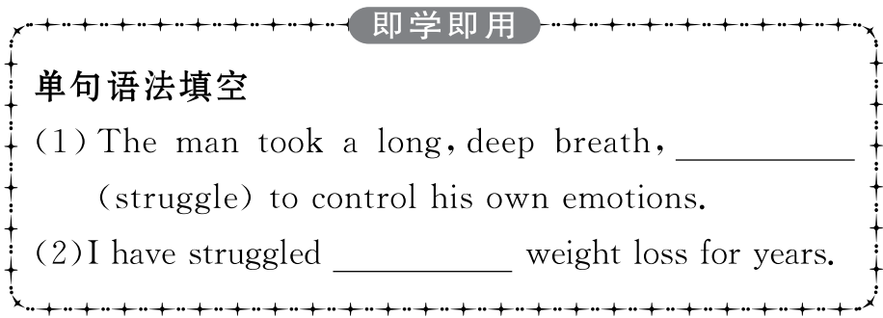
重点词汇
重点句式
重点语法
随堂练习

Slide 11
重点词汇
重点句式
重点语法
随堂练习
...the more I learnt of a language,the more my brain would grow.
……我学的语言越熟练,我的大脑就会越强大。
【句式剖析】
“The more...,the more...”句型常表示“越……就越……”,是一个复合句,其中前面的句子是状语从句,后面的句子是主句。在“The more...,the more...”句型中,主从句的时态常用一般现在时或一般过去时;若主句的谓语动词用一般将来时,从句的谓语动词要用一般现在时表示将来。

Slide 12
重点词汇
重点句式
重点语法
随堂练习
The more she learns,the more she wants to learn.
她越学越想学。
The higher the ground is,the thinner the air becomes.
离地面越高,空气就越稀薄。
The harder you work,the greater progress you will make.你越用功,进步就越大。
The longer the war lasts,the more the people there will suffer.战争持续得越久,那里的人们受难就越多。

Slide 13
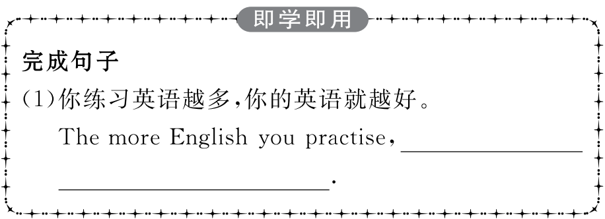
重点词汇
重点句式
重点语法
随堂练习

Slide 14
重点词汇
重点句式
重点语法
随堂练习

Slide 15
重点词汇
重点句式
重点语法
随堂练习
限制性定语从句(Ⅱ)
(where,when,why,prep+which/whom)
1.关系副词引导的定语从句
(1)when指时间,在定语从句中做时间状语。
I will always remember the day when I was admitted into the university.
我将永远记得我被大学录取的那一天。
(2)where指地点,在定语从句中做地点状语。
I would like to live in a country where there is less air pollution.
我想居住在一个空气污染少的国家。
The photo was taken at the place where stood the famous statue,a landmark of the city.
照片是在著名雕塑那照的,这是城市地标。

Slide 16
重点词汇
重点句式
重点语法
随堂练习
(3)why表示原因,在定语从句中做原因状语。
The reason why he has had such a success is that he never gives up.
他取得那么大的成功的原因是他从不放弃。
The reason why he failed the exam was that he didn’t study hard.
他考试失败的原因是他学习不努力。
(1)当先行词是the way时,关系词可用that,in which,也可不用关系词。
What made me angry was not what he said,but the way
使我生气的不是他说的话,而是他说话的方式。

Slide 17
重点词汇
重点句式
重点语法
随堂练习
(2)当先行词是表示时间、地点的名词或reason时,关系词用when,where,why还是which/that要看关系词在句中所做的成分来决定,做状语时要用when,where,why,做宾语、主语时要用that或which。
The building which is being painted is our library.
正在粉刷的大楼是我们的图书馆。
Is this the reason that he told you about his absence?
这就是他告诉你他缺席的原因吗?

Slide 18
重点词汇
重点句式
重点语法
随堂练习
(3)当先行词是一些表示地点的抽象名词,如:situation,point,stage,position等时,如果关系词在从句中做状语,常用where或“介词+关系代词”引导定语从句。
Soon they came to a point where the river divided.
很快他们就到了河流分岔处。
The country has reached a stage where they export goods on a large scale.
这个国家达到大规模出口商品的阶段。

Slide 19
重点词汇
重点句式
重点语法
随堂练习
2.“介词(短语)+关系代词”引导的定语从句
“介词(短语)+关系代词”也可引导定语从句,在句中做时间、地点和原因状语,代替相应的关系副词when,where和why。“介词(短语)+关系代词”表示地点时,有时句子需要用完全倒装形式。
I still remember the day on which (= when) I entered primary school.
我仍然记得我上小学的那一天。
This is the gym in which (=where) they used to work out.
这就是他们过去锻炼的体育馆。
Can you tell me the reason for which (=why) he got angry?
你能告诉我他生气的原因吗?
The man to whom I had a talk just now is my friend.
刚才和我谈话的那个男人是我的朋友。
注意:在“介词+关系代词”引导的定语从句中,介词的选用可根据下列三方面去考虑:

Slide 20
重点词汇
重点句式
重点语法
随堂练习
(1)根据定语从句中谓语动词的习惯搭配来考虑。
This is the library from which I often borrow.(介词from依据borrow from这一常见搭配)
这就是我经常借书的图书馆。
Have you met the person to whom I referred yesterday?(介词to依据refer to而定)
你见到过我昨天提到的那个人吗?
(2)根据先行词的习惯搭配或意义来考虑。
The farm on which they worked ten years ago has changed a great deal.(先行词The farm在从句中做地点状语,“在农场”常用on the farm,故用on which,相当于where)
十年前他们工作过的那个农场变化很大。
Do you still remember the day on which we visited the Dai Temple?(先行词the day在从句中做时间状语,on which相当于when)
你还记得我们一起参观岱庙的那天吗?

Slide 21
重点词汇
重点句式
重点语法
随堂练习
(3)根据句子的具体含义来考虑。
The pen with which he is writing now was bought yesterday.
他现在写字用的那支笔是昨天买的。(with which表示“使用工具”)
He made a hole in the wall,through which he could see what was happening outside.
他在墙上钻了个孔,通过这个孔他可以看到外面所发生的事情。(through which指“通过……”)

Slide 22
重点词汇
重点句式
重点语法
随堂练习
Ⅰ.单词拼写
1.We should s for ourselves,even if we are not able to succeed in the end.
答案:struggle
2.Mr.Brown was born in England and English is his mother t .
答案:tongue
3.Professor Wang offered two graduate courses last s .
答案:semester
4.It took all day to transport the furniture to the new a .
答案:apartment

Slide 23
重点词汇
重点句式
重点语法
随堂练习
Ⅱ.完成句子
1.我们正在寻找这本书的主人。
We are looking for the person to .
答案:whom the book belongs
2.我们决定参观的那个地方离这里不远。
The place is not far away from the city.
答案:which we’ve decided to visit
3.你度假的那个地方叫什么名字?
What’s the name of the place ?
答案:where you spent your holiday

Slide 24
重点词汇
重点句式
重点语法
随堂练习
4.请告诉我你误机的原因。
Please tell me the reason .
答案:why you were late for the flight
5.他是在我们最需要他的时候来的。
He came at a time .
答案:when we needed him most

