Slide 1
Unit 2 This is my sister.
Section B (1a～1d)
WWW.PPT818.COM

Slide 2
1．cousin
cousin意为“堂(表)兄弟、堂(表)姐妹”，在英语中，uncle与aunt的孩子都可以称为cousin。
2．aunt n．阿姨；姨母；伯母；舅妈
aunt的对应词是uncle。在英语中，比自己长一辈的，除母亲外所有的女性亲属均为aunt；除父亲外所有的男性亲属均可称为uncle。这两个词后面接姓时，首字母应大写。
3．These are my parents.这些是我的父母。
This is my friend，Lin Fang.这是我的朋友，林芳。
介绍双方认识时，一般情况下，单数的用This/That is…，复数的用These/Those are…，不用he，she，they等人称代词。

Slide 3
4．family的由来
family＝father＋mother＋I爸爸、妈妈和我在一起就是“家庭”。
相传，很久以前，人们早晨起床的时候，都要说一句：“Father and mother，I love you.”以表示对圣主的感情。后来，人们使用family一词来代表这句话。因为family一词是由“Father and mother，I love you.”这句话中每个单词的首字母所组成的。

Slide 4
一、用所给词的适当形式填空。
1．Those ______(be) my friends.
2．This is Harry's pen and _______(this) are Lily's rulers.
3．They are my ________(cousin)．
4．This is my aunt. ________(she) name is Lucy.
5． _________(those) is a pen.
are
these
cousins
Her
That

Slide 5
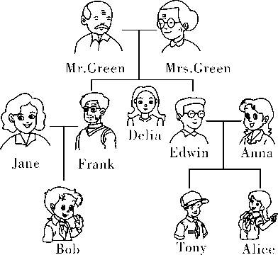
二、根据家谱，填入句中所缺的单词。
6．Frank is Alice's _________．
7．Alice is Anna's _________．
8．Bob is Tony's _______．
9．Delia is Alice's ________．
10．Frank is Mr.Green's _________．
uncle
daughter
cousin
aunt
son

Slide 6
11．Frank is Bob's ________．
12．Anna is Alice's _________．
13．Mr.Green is Bob's _______________．
14．Mrs.Green is Edwin's __________．
15．Alice is Tony's _________．
father
mother
grandfather
mother
sister

Slide 7
三、单项选择。
16.Robert is my father's brother，he is my ______.
A．father B．uncle
C．aunt D．cousin
17．Jane has(有) ______ uncle and ______ aunt.
A．a，an B．a，a
C．an，an D．an，a
B
C

Slide 8
18．Anna is not my sister.______ is my cousin.
A．He B．His
C．She D．Her
19．Bob，______ my good friends，Jim and Tom.
A．this is B．he is
C．that is D．these are
20．Hello！Is he your ______？
A．aunt B．mother
C．sister D．uncle
C
D
D

Slide 9
四、按要求完成句子。
21．This is her friend.(改为复数形式)
_________are her ___________．
22．This girl is my_sister．(对画线部分提问)
____________this girl?
23．Those are my brothers.(改为单数形式)
_________my __________．
24．Is he your father？(作否定回答)
No，__________．
25．Are those his parents？(作肯定回答)
_______，_________．
These
friends
Who is
That's
brother
he isn't
Yes
they are

Slide 10
五、根据句意在下列句中填入表示家庭成员的名词。
26．My mother is Mrs.White and my father is Mr.White.They're my ___________．
27．Your mother's brother is your _________．
28．My ________is my father's sister.
29．Your father's father is your __________．
30．My _____________is my mother's or father's mother.
parents
uncle
aunt
grandfather
grandmother

Slide 11
31．This is Mike.His mother is my aunt.He's my ___________．
32．Your father's parents are your ______________．
33．Susan is my sister.She is my parents‘___________.
34．Susan is my sister.I'm her _____________，Tom.
35．Lucy‘s brother is her mother’s _________．
cousin
grandparents
daughter
brother
son

