Slide 1
Unit 10
You’re supposed to shake hands.
Section A (第2课件)
WWW.PPT818.COM

Slide 2
Warming up
Can you guess which country it is?

Slide 3
Can you guess which country it is?

Slide 4
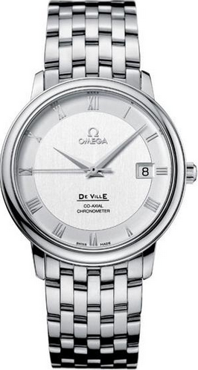
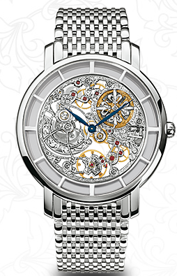
Can you guess which country it is?

Slide 5
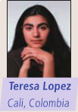
3a
Read the following opinions of a Colombian and a Swiss student. In which country is it OK to be 15 minutes late for dinner?
Where I'm from,we're pretty relaxed about time.We don't
like to rush around,so we don't mind if people are a little late sometimes.If you tell a friend you're going to their house for dinner,it's OK if you arrive a bit late.We like to enjoy our time slowly. We value the time we spend with our family and friends in our everyday lives.We often just drop by our friends' homes if we have time.We don't usually have to make plans to meet our friends.When we see each other,it's polite for boys to shake hands and for girls to kiss each other on the side of the face.We often just walk around the town center,seeing as many of our friends as we can!

Slide 6
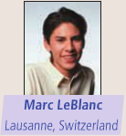
In Switzerland,it’s very important to be on time.We’re the capital of clocks and watches,after all! If someone invites you to meet him or her at noon,then you’re expected to be there at noon.If you’re even 15 minutes late,your friend may get mad.So I make an effort to be on time when I meet my friends.I always leave the house early to avoid heavy traffic because I think it’s impolite to keep others waiting.Also,we never visit a friend’s house without calling first.We almost always make plans to see friends.We usually plan to do something interesting,or go somewhere together.

Slide 7
3b
Read the passage again and complete the chart.
Ideas and customs about... | Colombia | Switzerland
being on time | (1) | (4)
visiting a friend's house | (2) | (5)
making plans with friends | (3) | (6)
(1)W'e're pretty relaxed about time.
(2)We often just drop by our friends' homes if we have time.
(3)We don't usually have to make plans to meet our friends.
(4)It's very important to be on time.
(5)We never visit a friend's house without calling first.
(6)We almost always make plans to see friends.

Slide 8
3c
Role-play a conversation.Student A is Teresa and Student B is Marc.Teresa is late and Marc is mad.
A:Hi,Marc.Sorry I'm a little late.
B:Teresa,you're 10 minutes late!
A:It's just 10 minutes!It's no big deal!
B:Well,in Switzerland,you're supposed to...

Slide 9
Language Points
1.We value the time we spend with our family and friends in our everyday lives.我们珍惜日常生活中和家人、朋友一起度过的时光。（教材第75页）
（1）value此处用作及物动词，意为“重视；珍视”。
e.g.:I value friendship very highly.
【拓展】value 用作名词，意为“价值”，其形容词形式为valuable，意为“贵重的，重要的；有益的，有用的”。
e.g.:Such a magazine has little value except when you have time to kill.
（2）we spend with our family...everyday lives是一个定语从句，修饰前面的名词time。关系代词that在定语从句中作宾语，此处被省略了。

Slide 10
2.We often just drop by our friends’ homes if we have time.如果有时间，我们经常顺便到朋友的家里拜访。（教材第75页）
drop by意为“顺便拜访，随便进入”，后可接表示地点的名词，也可以接表示人的名词。
e.g.:Drop by if you are free.
I just dropped by you.

Slide 11
3.We’re the capital of clocks and watches,after all!毕竟我们是钟表之都！（教材第75页）
（1）the capital of 意为“……的首都/国都”。其中capital用作可数名词，意为“首都；国都”。
e.g.:Beijing is the capital of China.
（2）after all 意为“毕竟；终究”，可位于句首、句中或句末。位于句首时含有“别忘了……”之意，用来说服或提醒对方。
e.g.:I thought I was going to fail the exam,but I passed after all.
After all,he is your father.

Slide 12
4.So I make an effort to be on time when I meet my friends.所以当我与朋友见面时，我努力做到守时。（教材第75页）
(1)make an effort to do sth.意为“努力做某事”
e.g.:Please make an effort to finish it on time.
(2)effort名词，意为“努力；尽力”。
e.g.:All their efforts were in vain.他们的努力全都白费了。

Slide 13
5.Also,we never visit a friend’s house without calling first.而且我们也从不事先未打电话就登门拜访朋友。（教材第75页）
without介词，意为“没有，无”，其反义词为with,其后常接名词、代词或动词-ing形式表示伴随情况或条件，在句中作状语。
e.g.:Jim went to school without having breakfast this morning.

Slide 14
Exercise
从方框中选出合适的短语，并用其适当形式填空。
1.Hurry up!The plane will_____________.
2.We should _____________ to pass the test.
3.Our teacher_____________ because of our homework.
4.They_____________ shake hands when they meet.
drop by,clean...off,take off,make an effort,get mad,after all,be supposed to,at noon
take off
make an effort
gets mad
are supposed to

Slide 15
从方框中选出合适的短语，并用其适当形式填空。
5.Do you often______________ your friends' homes if you have time?
6.We usually have lunch_____________.
7.The students_____________ the chalk____________ the blackboard after class.
8.Don't be too strict with him,_____________,he is a little child.
drop by,clean...off,take off,make an effort,get mad,after all,be supposed to,at noon
drop by
at noon
clean
off
after all

Slide 16
Homework
1.Learn the new words and expressions by heart.
2.Retell the story.

Slide 17
Thank you!

