Slide 1
Lesson 36
Making Plays Is Fun
WWW.PPT818.COM

Slide 2
Teaching aims:
To learn words and phrases about making plays: actress；put on
2. To be able to read and understand the text well.
3. To be able to talk about making plays in English.
4. To love art and life.

Slide 3
Revision
根据汉语意思完成句子。
1. 莎士比亚的悲剧闻名全世界。
Shakespeare’s tragedies are _____ _______ around the world.
2. 大家不要同时说话。
Don’t speak ___ _____ ______ _____.
well known
at the same time

Slide 4
Revision
3. 我们组每个人都干得不错。
Everyone in our group ___ ___ ______ ____.
4. 托尼早起是为了赶第一班公共汽车。
Tony got up early ___ _____ ___ catch the first bus.
5. 《拇指姑娘》是安徒生写的。
Thumb Girl ___ _______ ____ Christian Andersen.
did a good job
in order to
was written by

Slide 5
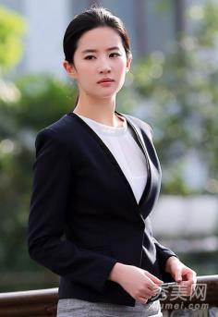
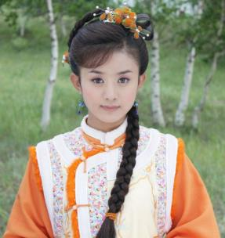
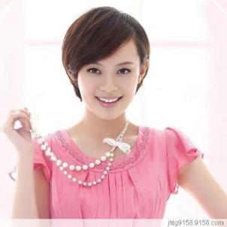
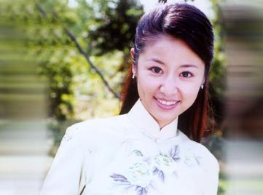
actress
n. 女演员
pl. actresses

Slide 6
Think About It !
1.Who’s your favourite actor or actress?
2.Can you name some people who work behind the scenes on the movies and plays?
幕后

Slide 7
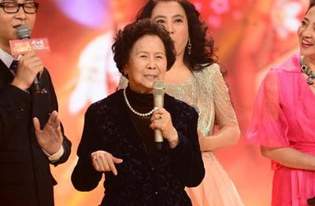
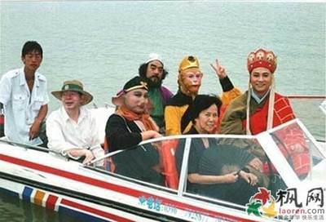
Director：
杨洁

Slide 8
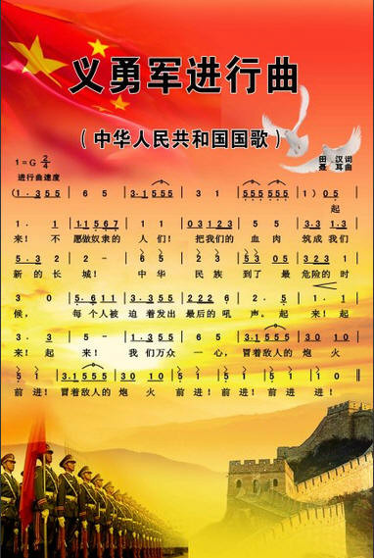
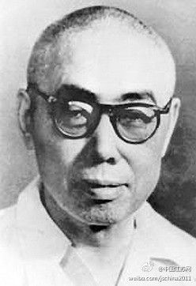
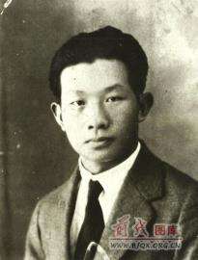
词作者：田汉
曲作者：聂耳

Slide 9
Listen to the passage and tick the correct answers.
1.How long did Jenny finish her study of movies and plays?
A. Two days. B. Two weeks. C. Two hours.
2. Jenny thinks ___is the most important people in the show.
A. directors B. actors and actresses C. the people who work behind the scenes
3.Which experience isn’t mentioned in Jenny’s own show？
A. Writing. B. Listening. C. Acting.
√
√
√

Slide 10
Read the text and find out main phrases .
Main phrases:
·focus on 关注
·put on 上演
·get to know 开始认识
·take actions to do sth. 采取行动做某事
·shoot short movies 拍摄短片
·agree with sb. 同意某人的观点
·the whole class 全班同学

Slide 11
Translate "put on"
1. Put on your coat, it is very cold outside.
穿上你的衣服，外面很冷。
2. She put on a lot of weight last winter.
去年冬天她增加了很多体重。
3. The play has been planned to put on today, but it was put off because of the bad weather.
这部戏剧已经计划在今天上演，但是因为这恶劣的天气而被延迟了。

Slide 12
Read and Answer
(1)For how long did Jenny and her classmates learn about movies and plays?
(2)Who do most people focus on when they watch movies?
(3)Did Jenny’s class like the comedy one group made? How do you know that?
(4)What was the name of the play that Jenny’s group wrote?
For two weeks.
Actors and actresses.
Yes. Their movie made the whole class laugh.
The Fisherman and the Goldfish.

Slide 13
Fill and Retell
______ are only a small part of______________. It can take _________________ to ____________or ___________. We_______ think about the people ____work______________. But ________them, _____________________would be almost __________. Without______________, we would never ____________so many ____________________!
Actors
a movie or a play
hundreds of people
make a movie
put on a play
seldom
who
behind the scenes
without
making a movie or a play
impossible
their hard work
get to know
great stories and stars
积极 大声 自信

Slide 14
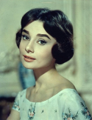
Practice
Ⅰ.Fill in the blanks with the correct forms of the words in the box.
active, action, activity, act, actress, actor
1.Mountain climbing and fishing are my favourite outdoor .
2.Audrey Hepburn was an ,and she was very pretty.
3.He comes from a family of .His parents are well-known movie stars.
4.We’ve in many school plays.
5.Is your brother still an member of the chess club?
6.People should take to protect the environment.
activities
actress
奥黛丽·赫本
actors
acted
active
actions

Slide 15
Ⅱ.单项填空
1.I have a friend Zhang Lei.
A.call B.name C.names D.called
2.He wants to eat the apple.
A.all B.whole C.any D.either
3.He has no ideas of his own, so he always ___his friends about everything.
A.plays with B.argues with
C.agrees with D. agrees on
4.A new study proves a walk every day is enough to keep people away from becoming fat.
A.30-minute B.30 minute’s
C.30-minutes D.30 minute
D
B
C
A

Slide 16
Ⅲ.连词成句
1.learned,they,a,everyone,said,lot(.)
2.talented,movie,they,are,makers(.)
3.always,focused,I,on,their,clothes(.)
4.will,experience,forget,we,an,never,this,is(.)
5.many,great,so,stars,stories,the,in,play,and,are(.)
Everyone said they learned a lot.
They are talented movie makers.
I always focused on their clothes.
This is an experience we will never forget.
So many great stories and stars are in the play.

Slide 17
Homework
1.Finish off the exercises in the activity book.
2.Finish off the exercises in Unit Review.

Slide 18
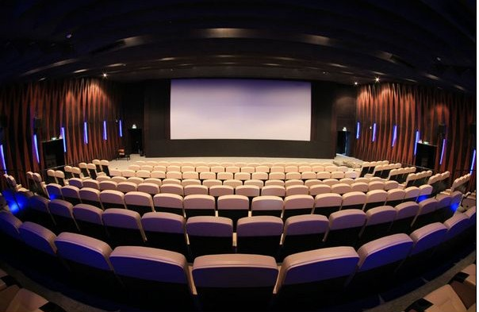
Thank you!

