Slide 1
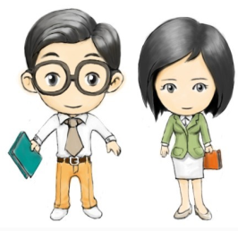
陕旅版六年级下册
第三课时
WWW.PPT818.COM
0

Slide 2
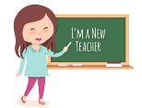
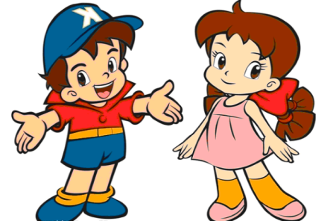
>>Review
Make sentences
-What is … like?
-… is …
-What do you think of …?
-… is …

Slide 3
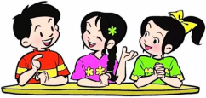
>>Lead-in
Free talk
When do you get up?
When do you have breakfast?
When do you come to school?
How do you come to school?
When do you have English class?

Slide 4
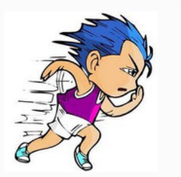
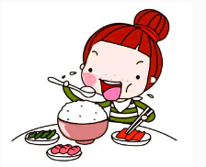
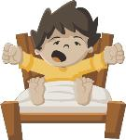
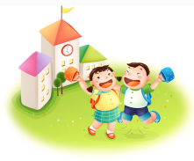
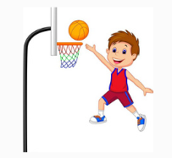
>>Presentation
Say and do
get up
run
have breakfast
have a read
have a class
play football

Slide 5
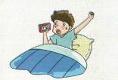
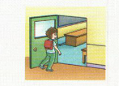
>> Presentation
Look and imagine

Slide 6
>> Presentation
Read and answer
Who was Jack’s English teacher?
Mrs. Brown.
What was she like?
She is very serious.
Where is Jack’s English book?
It’s on the school bus just now.

Slide 7
>> Presentation
Let’s learn more
Jack got up late this morning.
He ran to the school bus without breakfast. He got to the classroom at eight o’clock. Then he couldn’t find his English book.
His English teacher was very serious.
What should he do?

Slide 8
>> Presentation
>> Presentation
Let’s learn more
Let’s learn more
Then it was the English class.
Mrs. Brown came in.
Jack said to her, “I’m so sorry, Mrs Brown.
I can’t find my English book.”
Mrs. Brown wasn’t angry.
She took out a book and smiled,

Slide 9
>> Presentation
Let’s learn more
“Is this your English book?
I saw it on the school bus just now.
What a hard-working boy!”
Jack’s face got red.

Slide 10
>> Practice
Number the pictures
Read again and finish the tasks.
3
1
5
4
2

Slide 11
>> Practice
两人一组，先朗读再表演这个有趣的故事吧。
1
2
3
Read together.
(齐读)
Read in roles.
（分角色读）
Act in roles.
(分角色演）

Slide 12
>> Practice
Read and judge
Jack got up late this morning. ( )
Jack ran to school. ( )
Jack had breakfast at 8:00. ( )
Mrs. Brown is his English teacher. ( )
Mrs. Brown was very kind. ( )
√
√
×
√
答案
×

Slide 13
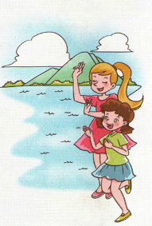
>> Practice
>> Practice
Let’s sing
Over the mountain, by the ocean,
There are two little girls.
One is Mary, the other is Helen,
They enjoy singing and dancing.
Over the mountain, by the ocean,
There are two little girls.
One is Mary, the other is Helen,
They are lucky and happy.

Slide 14
>> Summary
根据图片提示简要复述课文内容
①
②
③
④
⑤

Slide 15
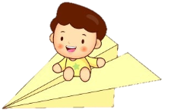
>> Homework
1.听课文录音并跟读，按照正确的语音、语调朗读并表演课文对话。 2.将Let’s learn more课文内容复述给自己的家人 。
3.预习B Read the words。
close

