Slide 1
Unit 2
How do you come to school
第3课时
五年级
WWW.PPT818.COM

Slide 2
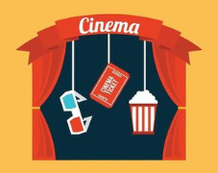
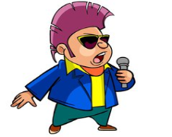
Let's talk
Do you like...?
How....?

Slide 3
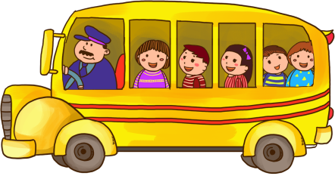
Let's try
Try to use ‘how’ to ask questions!试着用how问问题哦！
How do they come to school?

Slide 4
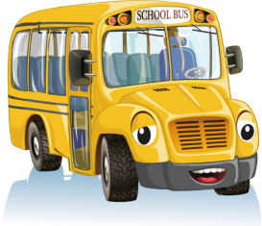
Let's try
Try to use ‘how’ to ask questions!
试着用how 问问题哦！
How does the girl come to school?

Slide 5
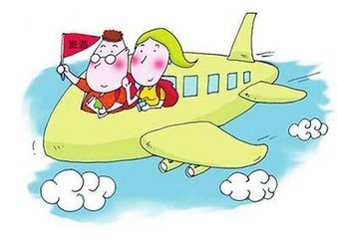
Let's try
Try to use ‘how’ to ask questions!
试着用how 问问题哦！
How do they come to school?

Slide 6
Let's try
Try to use 'how' to ask questions!
试着用how问问题哦！
How does she come to school?
How does the rabbit come to school?
He sits in the basket.

Slide 7
Sound time
Traffic, traffic, on the street,
Beep beep,beep beep!
Trains, trains, through the trees,
Choo-choo, choo-choo!
tr
train
travel
tree
trousers

Slide 8
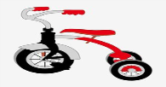
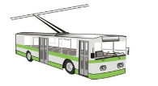
Try to read
tractor拖拉机
tricycle三轮脚踏车
truck卡车
trolley电车

Slide 9
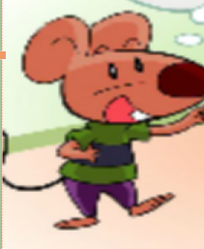
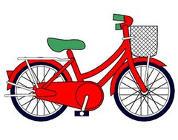
Guess and say
How?
You come to school ....，I think.
ride—riding骑车a bike

Slide 10
Bobby has a new bike. He likes riding it in the park.
This bike is cool!
I can fly now!

Slide 12
Bobby wants to show his bike to Sam.

Slide 13
Dad, can I go to school by bike?
No, you can’t.

Slide 14
Read and discuss
Why can't Bobby go to school by bike?

Slide 15
Try to say
Why？
Because you're
too young.

Slide 16
Bobby is _________.
not happy

Slide 17
How does Sam go to school?
He goes to school by bike.

Slide 18
Bobby's dad does not think so.(如此认为)
Really?
Yes, but he always
sits in the basket.

Slide 19
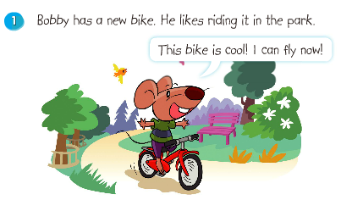
Listen and repeat

Slide 20
Listen and repeat

Slide 21
Listen and repeat

Slide 22
Listen and repeat

Slide 23
Try to remember

Slide 24
Let's act
三人一组，注意语气、动作与表情哦！

Slide 25
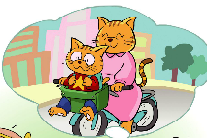
Talk show
Sam has a new bike too. He wants to go to school by bike. Then what will happen ?
Sam : Mum, can I go to school by bike?
Mum: ...

Slide 26
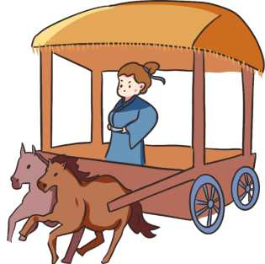
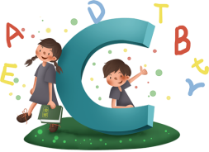
Let's enjoy
carriage

Slide 27
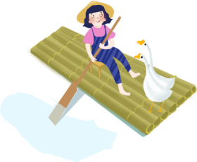
raft

Slide 28
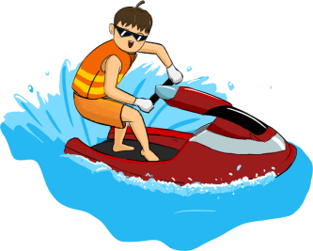
motorboat

Slide 29
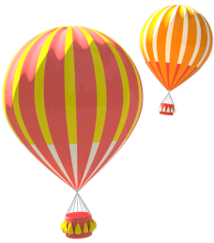
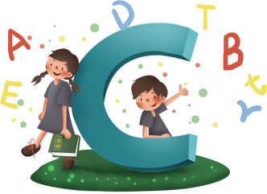
balloon

Slide 30
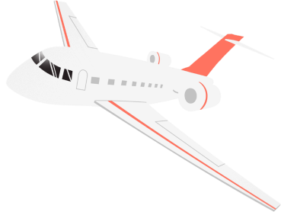
plane

Slide 31
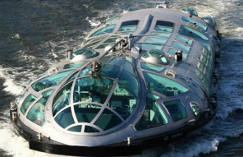
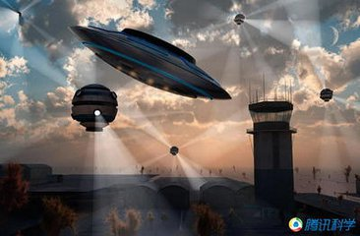
In the future, what will the traffic look like?

Slide 32
Let's share
First, work hard!
Then, be good at thinking !
Finally, the magic world belongs to us!

Slide 33
Homework
Read and act Cartoon time after class.

