Slide 1
Unit 3 Writing Home
Lesson 16 An Email Is Fast
WWW.PPT818.COM

Slide 2
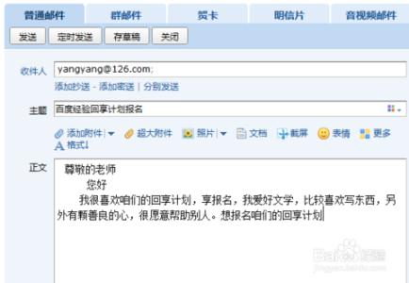
Warming up
Describe it:

Slide 3
For example
This is an email. I should write the subject first, then write the body of the email.

Slide 4

Games
Simon says
Postcard
Address
Subject
Body

Slide 5
Review
Email
use
电子邮件
使用
computer
write
电脑
写

Slide 6
Leading in
Listen and speak
A postcard is slow.
I want to send an email.
What do you want to say?

Slide 7
Presentation
听录音，回答问题。
Why does Danny want to send an email?
Who does Danny send the email to?
Because a postcard is slow, an email is fast and it doesn’t need stamps.
He wants to send an email to Steven.

Slide 8
Consolidation and extension
Find them!
How are you?
Beijing is a very big city.
It’s beautiful!
Mum and I will go back home tomorrow.

Slide 9



Words
big
fine
beautiful

Slide 10
Summing up
重点句型
Let’s
want to…
send an email
go back home
forget to do…
want to 表示 “想要做……”后跟动词原形。

Slide 11
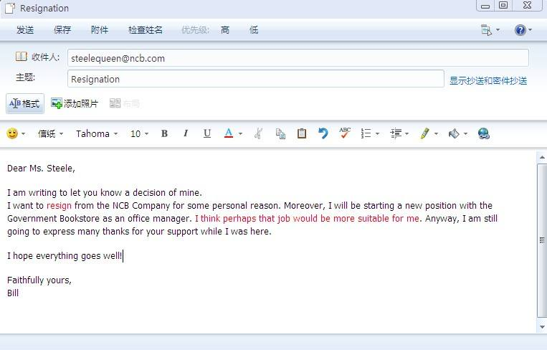
重点句型
收件人的邮箱
邮件的标题
收件人名字或昵称
正文
礼貌性的结语
署名

Slide 12
Evaluation
内容 | 学生A | 学生B | 学生C | 学生D
积极发言
乐于合作
完成情况

Slide 13
Homework
用英语讲述今天所见的事情（使用课本句式）
完成Let’s do it!中的练习
答案：2 3 1

Slide 14

Thank you!

