Slide 1
Unit6 My Holiday
陕旅版
五年级下册
第三课时
WWW.PPT818.COM

Slide 2
>>Warm-up
Sing a song

Slide 3
>>Lead-in
Free talk
Where will you go on the weekend?
Where will you go on the holiday?

Slide 4
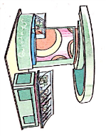
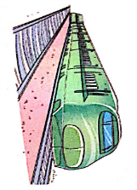
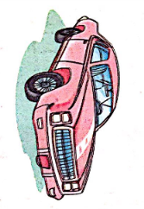
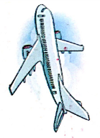
>>Presentation
Look and say
park
Statue of Liberty
Tian’an men
shopping
by plane
by train
by car
on foot

Slide 5
>>Presentation
Tick and talk
A: Where will you go on your holidays?
A: How will you go?
B: I will go to …
B: By/On …

Slide 6
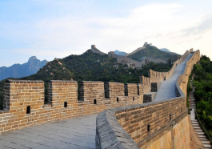
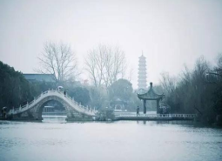
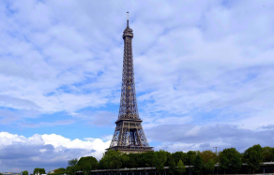
>>Presentation
Ask and answer
Summer holiday is coming.
What will you do this summer?
Will you travel this summer?

Slide 7
>>Presentation
Listen, then ask and answer
Q1: What will Miss White do this summer?
She is going to visit the West Lake.
Q2: How will she go?
She will go by train.
Q3: Will Miss White visit West Lake by plane?
No, she won’t.
Q4: Who will go with Miss White?
Her friends will go with me.
答案

Slide 8
>>Presentation
Let’s learn more
Mr. Zhao: What will you do this summer, Emily?
Miss White: I will travel to Hangzhou. I’m going to
visit the West Lake.
Mr. Zhao: How will you go?
Miss White: I will go by train.
Mr. Zhao: Why not go by plane? It is fast.
Miss White: The train is slow, but I can enjoy the
beautiful places along the way.
点击小喇叭或文本框都可以播放音频

Slide 9
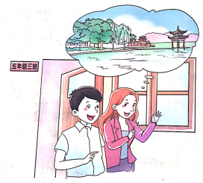
>>Presentation
Let’s learn more
Mr. Zhao: Will your parents go with you?
Miss White: No, they won’t. My friend will go with
me.
Mr. Zhao: Oh. Have a good time!
Miss White: Thank you.
点击小喇叭或文本框都可以播放音频

Slide 10
>>Practice
Read it by yourselves for five minutes.
自已读对话五分钟。
Tips:
当你自己朗读时，遇到不会读或不明白意思的单词或句子，可以把它圈起来，请教同学或老师！

Slide 11
>>Practice
Role play
在小组内练习对话并表演，其他同学评价。
 | 小组合作，声音洪亮，能够模仿录音、有感情地朗读课文。
 | 小组合作默契，声音洪亮，脱离课本，口语表达较流利准确，感情与肢体语言较丰富。
 | 小组合作默契，声音洪亮，结合已有知识或生活实际，对内容有创新，口语表达准确流利，感情与肢体语言丰富。
C
B
A

Slide 12
>>Practice
Group work
活动时间：约5分钟
活动内容：四人一组，谈论彼此自己未来假
期的旅行计划。(What/How will/Will…)
展示方式：小组集体展示，每人至少说2句话。

Slide 13
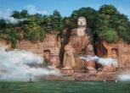
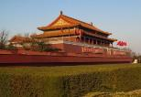
>>Practice
Look and talk
A: Welcome to Xi’an!
Where are you from?
B: We are from France.
A: Where will you go next?
B: We will travel to Qingdao.
A: How will you go there?
B: We will go by car.
France/Qing Gao/by car
A: Have a good time!
B: Thank you.
the USA/Leshan /by train
Australia/Beijing/by bus
the UK/Hangzhou/by plane

Slide 14
>>Practice
Read and report
With
whom
Where
When
What
How
village
next
Saturday
Kevin
visit grand-
parents
parents
by car
City Park
Colin
tomorrow
by bike
plant trees
sister
Alice
farm
May Day
draw pictures
brother
by bus
Liu Zhao-
yang
play-ground
after
class
play
football
friends
on foot

Slide 15
>>Practice
Read and report
① Kevin will go to the village next Saturday.
He will visit his grandparents.
He will go with his parents.
They will go by car.
② Colin will go to the City Park tomorrow.
He will plant trees. He will go with his sister.
They will go by bike.
③ …
④ …

Slide 16
>>Summary
本课所学的重点句型：
-What will you do this summer?
-I will travel to …
e.g.
-What will you do this summer?
-I will travel to Beijing.

Slide 17
>>Summary
本课所学的重点句型：
-How will you go?
-I will go by …
e.g.
-How will you go?
-I will go by car.

Slide 18
>>Summary
本课所学的重点句型：
-Will you parents go with you?
-Yes/No, …
e.g.
-Will you parents go with you?
-No, they won’t.

Slide 19
>>Summary
本课所学的重点句型：
-Where will you go on the holiday?
-I will go to … with …
e.g.
-Where will you go on the holiday?
-I will go to Beijing with my parents.

Slide 20
>>Homework
1.听课文录音并跟读，按照正确的语音、语调朗读并表演课文对话。 2.Pair work:学生2人一组，根据Let’s learn more课文内容进行创编新对话。
3.预习B Let’s sing。
close

