Slide 1
Module 6 Problems
Unit 2 If you tell him the truth now, you will show that you are honest
WWW.PPT818.COM

Slide 2
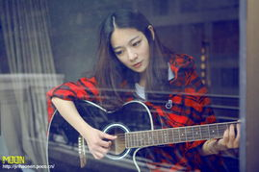
Revision
Review
guitar吉他 n.
play the piano
弹钢琴

Slide 3
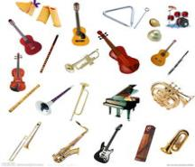
play the violin
拉小提琴
exam考试 n.
instrument
乐器；仪器 n.

Slide 4
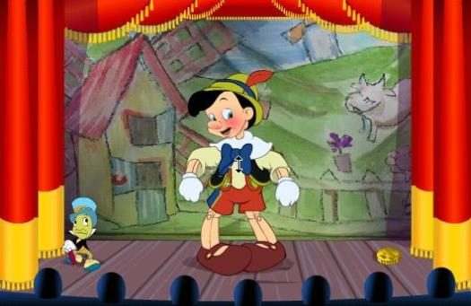
Warm up
Do you know who he is?

Slide 5
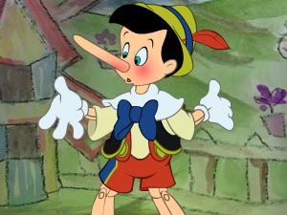
Do you know why his nose became long?

Slide 6
Are you honest to your family?

Slide 7
Are you honest to your friends?

Slide 8
Will you make more friends if you are honest to them?

Slide 9
Presentation
If you have problems…
parents
friends
teachers
Who?
classmates
police
relations

Slide 10
What will you do ?
Talking face to face
Making telephones
How?
Writing letters
Sending emails

Slide 11
Discuss our problems
Try to talk about the personal problem in the daily life, some students give some advice. Try to use the adverbial clause of condition “if”.

Slide 12
Problems’ solutions
He has no friends, what should he do?
If …, he will have friends.
She can’t work out, what should she do?
If …, she will work out.
His parents warned him not to watch TV. What should he do?
If …, he will …

Slide 13
New words and expressions
New words
&expressions
拜访（某人的家）
come round
原因；理由 n.
reason
/'ri: zən/
试用；试
try out
/'æŋgrɪ/
愤怒的；生气的 adj.
angry
不再
no longer
生某人的气
be angry with
修理，修补 n.
修理，修补 v.
/rɪ'peə/
repair

Slide 14
/ tru:θ/
事实；真相 n.
truth
最少的；最小的 adj.
最少量；最小物 n.
/li:st/
least
至少；起码
at least
/'ɒnɪst/
诚实的；老实的 adj.
honest
/ə'pɒlədʒaɪz/
认错；道歉 v.
apologise
/bɪl/
账单；账款 n.
bill
零花钱
pocket money

Slide 15
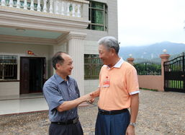
come round 拜访（某人的家）
I’m very happy you come
around and see me.
你来看我我很高兴。
If you tell him the truth, he will be angry with you.如果你告诉他真相，她会很生气的。

Slide 16
try out 试用；试
She knew I wanted to try the boat out at the weekend.
她知道我周末想幵船出去试一下。
拓展：
try out for报名参加；竞争；争取参加；参加选拔
His brother’s example inspired him to try out for the football team.
他哥哥的榜样激励他去接受足球队的选拔测试。

Slide 17
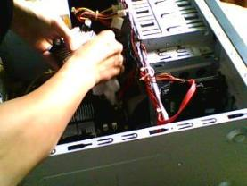
repair 修理；修补 v.
He can repair the computer
他会修电脑。
engineer工程师 n.
He graduated as an engineer.
他取得了工程师资格

Slide 18
honest 诚实的；老实的 adj
My father is the most honest man I have met.
爸爸是我见过的最老实的人。
拓展：
To be honest 老实说；说实在的
To be honest, the house is not quite my style.
说实话，这所房子不太适合我们。
I’d rather get it out the way, to be honest.
老实说，我情愿把它处理掉。

Slide 19
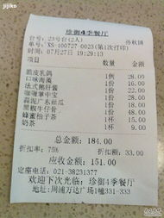
bill 账单；账款 n
He paid his bill for the
dinner quickly.
他立即支付了饭钱。
The first bill you pay each month should be to yourself.
你每个月的第一笔账单必须是支付自己的

Slide 20
Reading and vocabulary
Reading
Look at the letter and the reply.
Decide where they come from.
a). A report. b). A magazine.
c). A story. d). A play.
2. Read the letter and the reply. Choose the best
summary of Steve’s problem.

Slide 21
Dear Diana Do you have a problem? Write to Diana at New Standard Magazine and ask for her advice.
Dear Diana,
Last week, my friend David came round with
a new computer game and asked to play it on
my dad’s computer. I was worried, because I
should ask my dad before I use his computer.
He uses it for his work, and I can only use it
for my homework. The reason is that he thinks

Slide 22
it will go wrong if I play games on it.Well, while my dad was out, we decided to try out David’s game. We copied it to the computer, and at the end of the game, we took it off. However,when I started the computer again to check if everything was OK, some of my dad’s documents were missing. Then, when my dad used the computer last night, he was really angry. He could no longer
find the documents anywhere! They were very important ones.

Slide 23
I did not tell him about the computer game because I did not want him to be angry with me. Now I feel terrible. I am not sure whether a computer engineer can get the documents back. Should I tell him about the computer game? Should I pay to repair it?
Yours,
Steve

Slide 24
Dear Steve,
Oh, dear! You have made two mistakes. It is
bad enough that you used your dad’s
computer to play games when he told you not
to. But it is even worse that you did not tell
him about it. If you tell him the truth now, he
will be angry with you, but at least you will
show that you are honest.
Then you should pay the bill to repair it. But
you should not use your pocket money-after

Slide 25
all, your parents gave you that money. If you
offer to do some housework, he will realise
that you are very sorry.
Remember, next time, play football with
David!
Best wishes,
Diana

Slide 26
Steve’s problem
a). Steve and his friend played a computer game
on his father’s computer, though his
father warned him not to do so. Steve’s
father was really angry.
b). Steve’s friend took out some documents by mistake from Steve’s father’s computer. His
father was very angry. Steve did not know how to repair it.
c). Steve and his friend played a computer game on his father’s computer. Some important documents were missing. His father was angry. Steve was worried about what to do.

Slide 27
3. Complete the advice to Steve.
1. Steve should never _____________________ __________when his father told him not to do so.
2. Steve should tell his father the truth now to show ____________.
3. Steve should __________to repair it, but he should not use his _____________.
4. Steve should ________________ at home, so his father will realize he is very sorry.
used his dad’s computer to
play games
he is honest
pay the bill
pocket money
do some housework

Slide 28
4. Complete the passage with the words in the box.
bill, engineer, honest, least, reason, repair, truth
If Steve wants to get his father’s documents back, a
computer (1) __________ must (2) ________the
computer. But Steve should not use his pocket money
to pay the (3) ______. The (4) ________for this is
that his parents gave him that money. If Steve tells his
father the (5) _______, at (6) ________he
will show that he is (7) ____________.
engineer
repair
bill
reason
truth
truth
honest

Slide 29
Read again
5. Look at the letter by Steve. Find sentences that:
1. say what Steve did and when
2. say what happened next
3. say what the problem is
4. ask what Steve should do

Slide 30
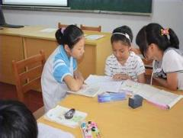
Think of a problem. Write a short letter to Diana about the problem. Use the steps in Activity 5 to help you.
7. Work in pairs. Read each other’s problem letter. Suppose you are Diana and write a reply. Give your advice.

Slide 31
Language points
Language points
1. no longer 不再
He no longer read books.他不再看书了。
辨析：no longer 与 no more
(1). no longer中的longer是副词long的比较级，long有在某一时刻以后之意，着重表示时间的不再延续，意为“如今不再”，通常放在行为动词之前，be动词的后面。no longer可用not any longer代替；no longer 修饰延续性动词，如teach, live, work等，表示动作不再延续。

Slide 32
Her father died, and after that she no longer
went to school (=she didn‘t go to school any
longer) 她的父亲去世后，她就不再上学了。
(2). no more中的more是many / much的比较级
more有again之意，着重表示数量或程度的减
少，意为“再也没有更多（大）的数量（程
度）”。

Slide 33
no more 等于not…any more ; no more
/not… any more 与no longer/not...any longer
同义，但用法有所区别；当涉及数量和程度时要用no more； no more修饰非延续性动词，如come, go, make (the same mistake)
等，表示动作不再发生。
There is no more bread.没有面包了。

Slide 34
2. at least 至少；起码
She was at least that much shorter than me.
她至少比我矮这么多。
We need at least 2 hours.
我们至少需要两小时。
3. be angry with sb. 表示 “生某人的气”。 如：
I shall be angry with you if you break the cup.
你要是把杯子打坏的话，我会生气的。

Slide 35
4. The reason is that he thinks it will go wrong if I play games on it.
原因是他认为如果我在电脑上玩游戏，电脑就会毛病。
(1) reason原因；理由，其后可接for, that。
I have no reason for it.
我没有理由这样做。
Give me your reason for doing it.
告诉我你做这事的理由。

Slide 36
(2)go wrong 表示 “出毛病，出故障；出错”。如：
His television has gone wrong again.
他的电视机又出毛病了。
Follow these instructions and it won’t go wrong.
按照操作指南去做，就不会出错。

Slide 37
5. I’m not sure whether a computer engineer can get the documents back.
我不知道电脑工程师是否可以将那些文件找回来。
(1).引导宾语从句，一般既可用whether也可用if。但句中含有or not时能用whether不用if。
I don’t know whether or not he will come.我不知道他是不是会来。
(2).如果or not 放在whether所引导的从句句尾，则可以用if替换。
I don’t know whether/if he will come or not.
我不知道他是不是会回来。

Slide 38
(3). 在强调任意选择时，用whether…or,此时不用if 替代whether.
He asked me whether1 wanted to go there by train or by bus.
他问我想乘火车还是坐公共汽车去那里。
注: whether…or 一起还有“不管”之意，引导让步状语从句。
Whether he drives or takes the train, he will be here on time.
不管开车来还是坐火车来, 他都会准时到。
⑷.只用whether不用if的情况。强调宾语部分，也可把从句放在句首。
Whether he will come I am not sure. 他是不是来我拿不准。

Slide 39
作介词宾语时，如：
It depends on whether it will be fine.
那得看是不是晴天。
作discuss等动词的宾语时。
We discussed whether we should close the shop.
我们讨论是不是该关掉商店
句子中有if引导的条件句,如再有表示“是否”的宾语从句，用whether 不用if。
He asked me whether I’d love to move to New York if I got the job
他问我如果得到那份工作是否会搬家到纽约。

Slide 40
在动词不定式之前用whether 不用if.
I don't know whether to go there at once.
我不知道是不是该立刻去那里。
容易产生歧义时用whether不用表示“是否”。
Please let me know if you need help.
如果你需要帮助请告诉我。或：请告诉我你是否需要帮助。
对比:Please let me know whether you need help.请告诉我你是否需要帮助。
(5). 在引导主语从句，表语从句，同位语从句时一般用whether 不用if.

Slide 41
Whether it is true remains a question.
(主语从句）那是不是真的仍然是个问题。
The question is whether it is true.
( 表语从句）问题是那是不是真的。
We have a doubt whether it is true
(同位语从句)我们怀疑那是不是真的。
注:whether 引导主语从句放在主语之后时可用if来代替。
It is unclear whether/if he likes the present.
他是不是喜欢那个礼物还不清楚。

Slide 42
6. take off
(1). 脱下; 移去
He took off his raincoat.
他脱下雨衣。
(2). 起飞
The plane will take off soon.
飞机马上就要起飞了。

Slide 43
Learning to learn
In English, some structures look similar,
such as the “if” structure in this module
and that in Module 5. Comparing similar
structures and making notes can help you
learn the structures better.

Slide 44
Phrases and sentences
Useful phrases and sentences
1. tell him the truth 告诉他事实
2. How honest you are! 你是多么诚实呀！
3. use his computer for playing games
用他的电脑玩游戏
4. go wrong 出毛病, 出错
5. take off 删除
6. make sure / be sure 确定, 确信
7. feel terrible 感到害怕

Slide 45
8. offer to pay 主动付钱
9. make mistakes 犯错误
10. tell sb not to do sth 告诉某人别做某事
11. be angry with sb 对某人生气
12. at least 至少
13. pocket money 零花钱
14. after all 毕竟
15. help sb with sth 帮助某人做某事

Slide 46
Exercises
Consolidation
一、根据句意及汉语提示完成句中单词。
1. The_______(实情）of the matter is that we had no other choice.
2. An_________(工程师）is someone whose job is to design or build roads, bridges and machines.
3. Be careful of these____________(仪器).
4.The_______(原因)I called was asked about the plans for Saturday.
truth
engineer
instruments
reason

Slide 47
honest
5.He was an________(诚实的) man.
二. 用方框中词组的适当形式完成下列句子。
come around, try out, no longer, at least
1. I’ve been so sorry you couldn't____________
this week.
2. Most households now own_______ one car.
3. She enjoys__________ new ways of doing things.
4. He was a famous musician, but he plays
_________.
come around
at least
trying out
no longer

Slide 48
三. 根据汉语意思完成英语句子。
1.他问我是想乘火车还是坐公共汽车去那里。
He asked me________ I want to _________by train or by bus.
2. 我很难说我是否有时间跟你们一起去。
Whether I’ll have time to go _________I'm not sure.
3. 我们明天才会被告知是不是应该参加考试。
We’ll _______tomorrow whether we should take the exam or not.
whether
go there
with you
be told

Slide 49
4. 我们弄不清是今天走还是明天走。
We were __________whether to go today or tomorrow.
5. 问题是去慕尼黑还是去维也纳
The question is whether __________Munich or Vienna.
wondering
to go to

Slide 50
Homework
Homework
1. Revise the new vocabulary and expressions.
2. Finish the exercises in the workbook.

