Slide 1
Unit 4
Growing up
Study Skills
WWW.PPT818.COM

Slide 2
Stand By Me伴我同行

Slide 3
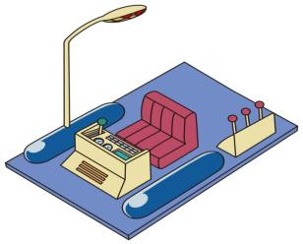
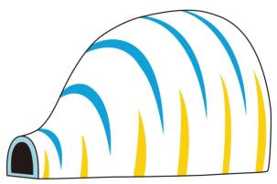
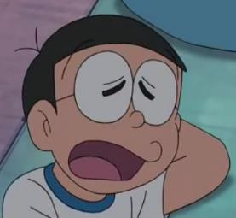
anywhere door
任意门
countryside
Doraemon
Nobi大熊
bamboo dragonfly竹蜻蜓
Gulliver Tunnel格列佛通道
Time Machine
时光机
4 Dimension Pocket
四次元口袋

Slide 4
countryside
compounding(合成)
countryside
country
side
Meaning:
乡村
边
郊区
A
B
C
(AB/A-B)
Rule:
Tips1:Guess the meaning of word C by putting the meanings of A & B together
合成法可以通过合成A和B的词义猜测C的词义

Slide 5
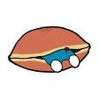
Task1 Guess the meanings of these words and then finish the story.
sleepwalking ,colorblind, far-reaching
梦游
色盲
深远的
One day, when Nobi was , Nobi’s grandson arrived from the future and told him about his unluckiness in the future.
Nobi will be because of a car accident , which has impact(影响) on Nobi. From then on, he will have an life.His grandson decided to ask Doraemon to change Nobi’s life.
sleepwalking
colorblind
far-reaching
unlucky
远的
够到/延伸
延伸的远的/深远的
pancake

Slide 6
lucky
unlucky
un-
lucky
prefix
root word A
词根
Prefix (前缀)
Rule:
B
Meaning:
不
幸运的
不幸的
Tips2: Guess the meaning of B by knowing the meanings of the root word A and prefix 通过了解词根A和前缀的意思猜测B的词义，前缀一般改变词义不变词性

Slide 7
Prefix (前缀)
in-
im-
un-
dis-
mis-
inter-
re-
active correct | inactive incorrect
possible | impossible
necessary | unnecessary
like | dislike
understand | misunderstand
national | international
tell | retell
not
错误
交互
重新

Slide 8
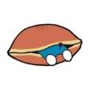
Task2:Nobi’s We-chat
Hi, Linda. How was your study in the USA?
It is (interesting) to study here because I don’t get along well with new friends.
uninteresting
But studying abroad can make you
know .(一些国际的东西).
something international
That’s true. How about you? You used to
be (不积极) and (certain)about your future.
inactive
uncertain
I have changed a lot. I have a new friend called Doraemon. It is my that he is willing to help me. I am confident
that (一切皆有可能).
luckiness
nothing is impossible

Slide 9
lucky
luckiness
lucky
-ness
root word A
suffix
Suffix (后缀)
Rule:
B
Meaning:
幸运的
/
幸运
Tips3: Guess the meaning of B just by knowing the meaning of the root word A 通过了解词根A的意思猜测B的词义, 后缀一般改变词性不变词义

Slide 10
Suffix (后缀)
noun |  | adjective |  | adverb
suffix | words | suffix | words | suffix | words
-er/or-ist |  | -ly |  | -ly
-ing |  | -ful
-ness |  | -less
-sion/tion |  | -y
-ment |  | -able
-ship |  | -al
actor, scientist
weekly
swimming
hopeful
unluckiness
hopeless
quickly
discussion
rainy
development
comfortable
friendship
natural

Slide 11
Task3 Read Doraemon’s impression(印象) of Nobi and match the meanings with the words
Advantages(优点) | Disadvantages（缺点）
1. He does voluntary work for his classmates. | 1.He is powerless at his study and usually gets zero on his exams
2. His small act of kindness always makes a difference to others. | 2. His late arrival at school and lateness in handing in homework make his teacher usually punish him.
3. His expectation for freedom enriches his imagination and he sometimes gets a high mark in his writing. | 3. A shortage of communication with his classmates makes him unpopular among his classmates.

Slide 12
Task3 Read Doraemon’s impression(印象) of Nobi and match the meanings wth the words
voluntary
powerless
arrival
expectation
freedom
shortage
a. being not enough of sth
b. being allowed to do what sb wants to do
c. unable to use one’s power
d. willing to do sth
e. strong hopes or beliefs that sth may happen
f. the action of getting to some place

Slide 13
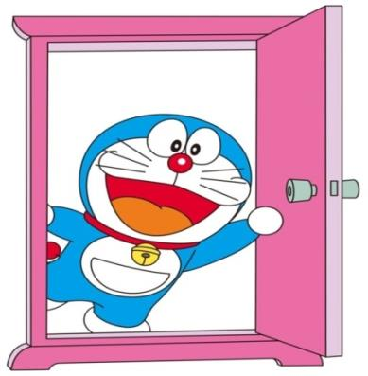
Year 2030
Anywhere Door
writer
how to build
relationship
What is Nobi’s job?
interpersonal

Slide 14
prefix
root word
suffix
inter person al
Meaning:
交互
人们
/
人际的

Slide 15
Read Nobi’s diary and finish exercise 1
September 15 2030 Monday Sunny

Slide 16
Exercise 1 Answer the following questions
1. What is the Chinese meaning of the word “best-seller” in line 2?
A.最佳作者 B. 畅销书 C.最佳销售员
2. Which of the following word has the same meaning as “ ary” in line 4?
imagin
A.practical B. thoughtful C.unreal
3. The word “ ment” in line 5 means “ ”.
achieve
A.成就 B. 目标 C.进步
4. The sentence “friends feel the th from you” means they can feel the from you.
warm
A. ness B. ingness C. ness
loneli
lov
sad
about 1,000 root words
about 100,000 words
Word Formation

Slide 17
Exercise 2 Further understand these sayings by translating
1. Unpleasant advice is a good medicine.
忠言逆耳
2. It is more blessed to give than to receive.
给予比接受更幸福
Further thinking
Giving is a win-win strategy.(in line 10)
What is your understanding of this sentence? Please give me an example.

Slide 18
D
When you face a fficulty in reading,
pen up your mind,
try to ecall(回忆) what you’ve learnt and use reading skills,
be ctive， nergetic，
odest，and rganized！
ever give up!
You are your own
O
R
A
E
M
O
N
DORAEMON

Slide 19
Homework
Use the word formation knowledge in study skills to:
1. Read the story of Anne Frank, finish the exercises on Page 59.
2. Read an article from Nobi’s best-seller Better to Give or Receive, and try to finish the exercises.

