Slide 1
Unit 9
At home
WWW.PPT818.COM

Slide 2
box

Slide 3
table

Slide 4
plate

Slide 5
lunch

Slide 6
kitchen

Slide 7
floor

Slide 8
need

Slide 9
give

Slide 10
bird
angry

Slide 11
where

Slide 12
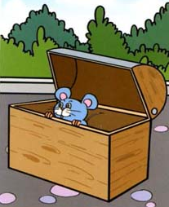
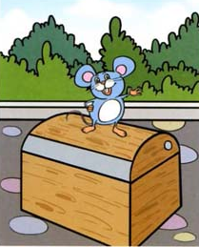
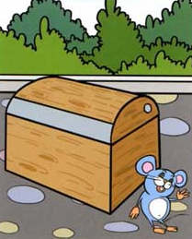
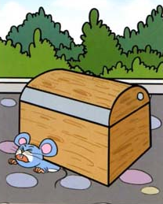
in
on
beside
under

Slide 13
I can help you,
Grandma.
What do you need?
OK, Alice. I need two eggs.

Slide 14
Where are they?
哪里
它们
they’re=they are
in在……里面
They’re in the box.

Slide 15
Where is it?
give 给 me 我（此处为宾格）
Give me a plate , please.
It’s on the table.
it’s=it is on 在……上面

Slide 16
Here you are .
给你。
Thank you.

Slide 17
Great.
Let’s have lunch.
let’s =let us have lunch 吃午饭

Slide 18
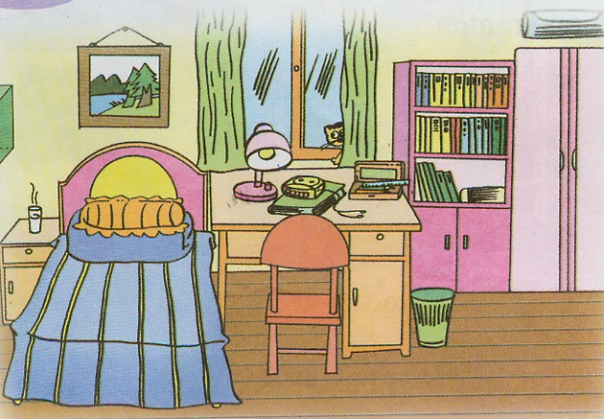

Slide 19
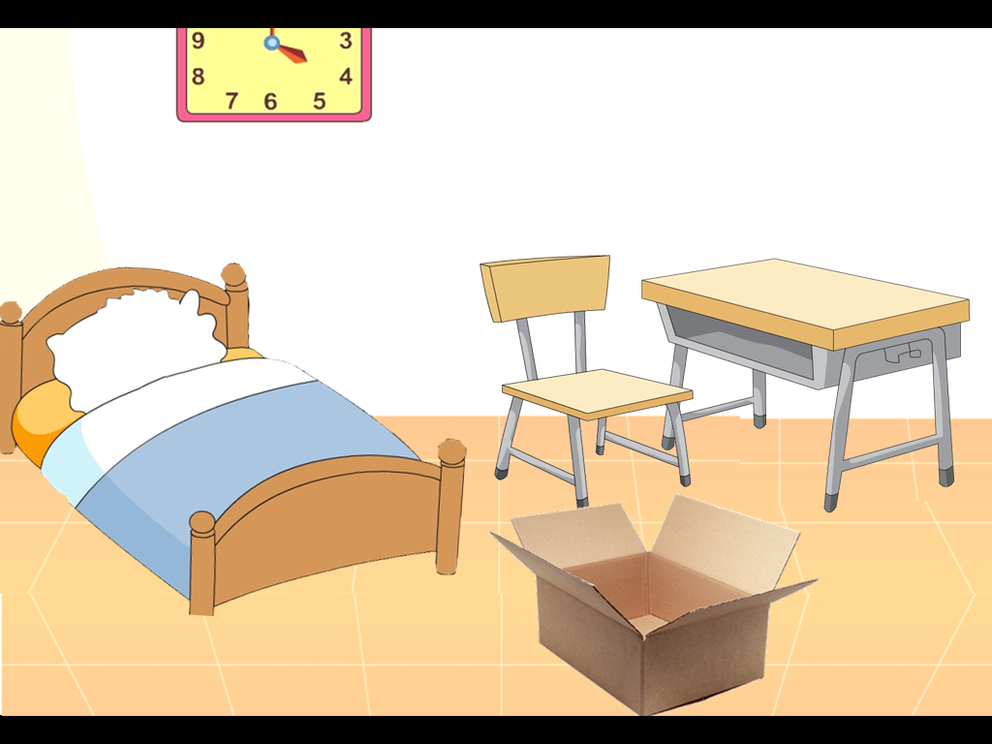
Decorate my room
Listen and choose
Decorate my room
Discuss in pairs

Slide 20
Where is my fish?
Mrs Brown is in her kitchen.
Ginger the cat is hungry.
Ginger can jump. Now she is on the table.

Slide 21
Where is the plate now?
It is on the floor.
Ginger is under the chair.

Slide 22
Ginger is full.
She is happy, but Mrs
Brown is angry.

