Slide 1
Unit8
Chinese New Year
WWW.PPT818.COM

Slide 2
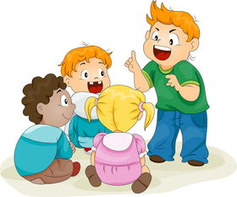
>>Warm-up
Free talk
…...…..…....
Different Culture Different Festival

Slide 3
>>Presentation
Let’s learn
…….…..…....
oo

Slide 4
>>Presentation
I can say
…….…..…....
book
foot
good
cook
look

Slide 5
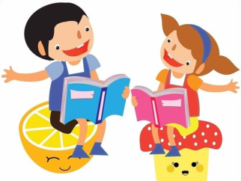
>>Presentation
I can say
…….…..…....
The cook is looking at a cookbook.
To look for something good.
The cook is looking at a cookbook.
To cook us something good.

Slide 6
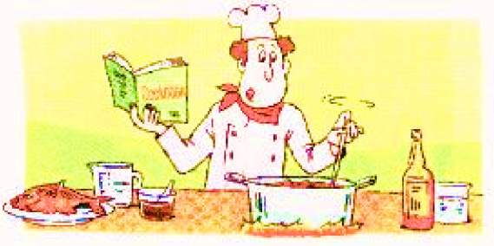
>>Presentation
Sound time
…….……..…....
The cook is looking at a cookbook.
To look for something good.
The cook is looking at a cookbook.
To cook us something good.
oo
book
cook
foot
good
look

Slide 7
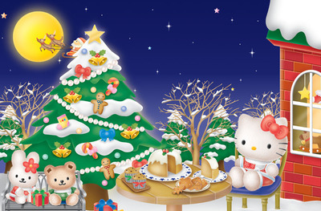
>>Presentation
Culture time
…….…..……....
Christmas Day

Slide 8
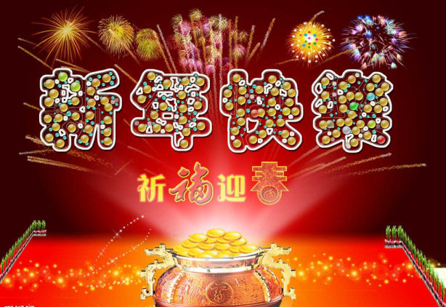
>>Presentation
Culture time
…….…..……....
Chinese New Year

Slide 9
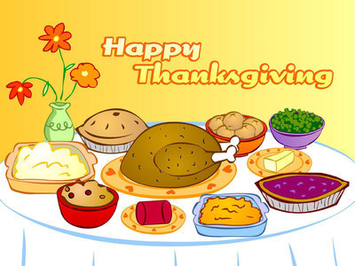
>>Presentation
Culture time
…….…..……....
Thanksgiving Day

Slide 10
>>Presentation
Sound time
……………..…....
Christmas is the most important holiday in the UK.

Slide 11
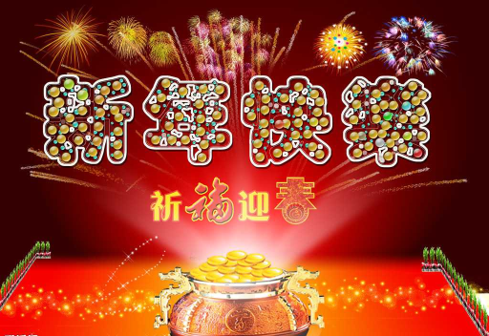
>>Presentation
Sound time
……………..…....
Chinese New Year is the most important festival in China. We also call it “Spring Festival”.

Slide 12
>>Presentation
Sound time
……………..…....
Thanksgiving is a very important holiday in the US.

Slide 13
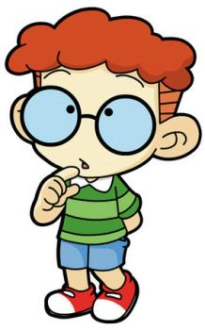
>>Practice
Let’s talk
…………......
Can you say any other festivals?

Slide 14
>>Summary
The cook is looking at a cookbook.
To look for something good.
The cook is looking at a cookbook.
To cook us something good.
book
cook
foot
good
look

Slide 15
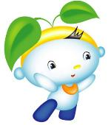
>>Homework
1. 听课文录音，按照正确的语音、语调朗读课文对话。
2.按照正确的语音语调朗读Sound time.
3. 预习Cartoon time。
close

