Slide 1
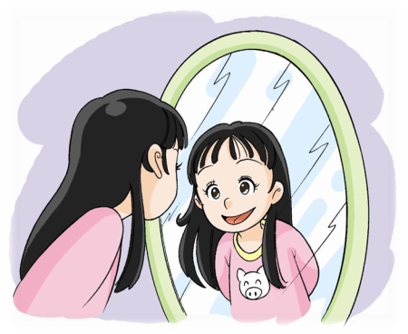
Unit 6 Me
6
3
About me
第一课时
WWW.PPT818.COM

Slide 2
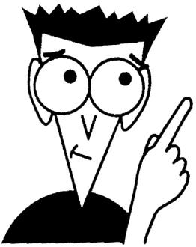
I say you do
Notes:
2
2
2

Slide 3
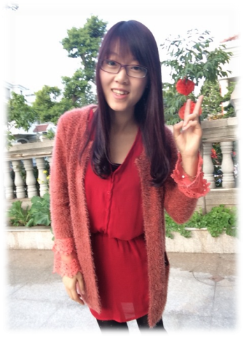
?
She is a girl.
She is tall and thin.
She is an English teacher.
She has long hair.
She can sing and dance.
Notes:
3
3
3

Slide 4
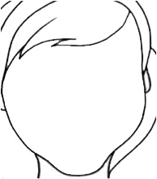
face
Notes:
4
4
4

Slide 5
hair
Notes:
5
5
5

Slide 6
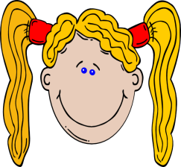
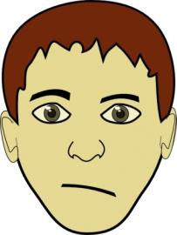
Notes:
6
6
6

Slide 7
My is big.
My is big.
Big and round.
Big and round.
My is long.
My is long.
Long and black.
Long and black.
Notes:
7
7
7

Slide 8
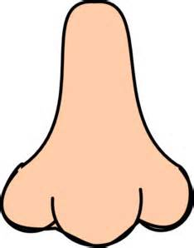
nose
Notes:
8
8
8

Slide 9
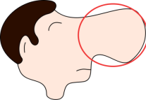
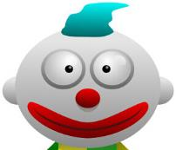
grey
Notes:
9
9
9

Slide 10
mouth
Notes:
10
10
10

Slide 11
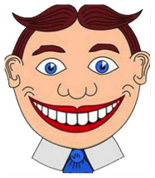
red
red
Notes:
11
11
11

Slide 12
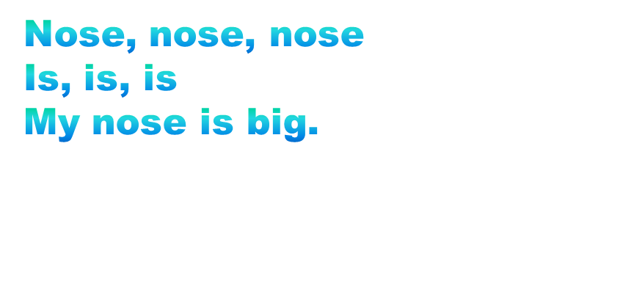
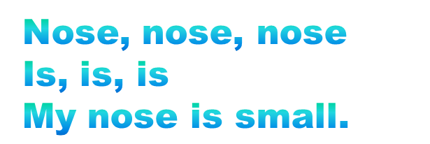
…
______, ______, ______
______, ______, ______
______ ______ ______ ______.
________, ________, ________
______, ______, ______
______ ______ ______ ______.
Notes:
12
12
12

Slide 13
big
black
My eyes are _____ and ______.
eye
s
Notes:
13
13
13

Slide 14
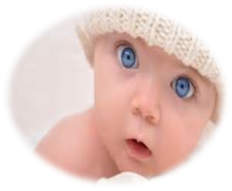
black
Notes:
14
14
14

Slide 15
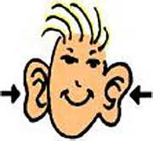
My
ear
s
are big.
Notes:
15
15
15

Slide 16
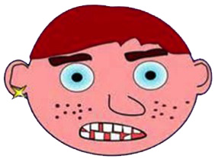

Slide 17
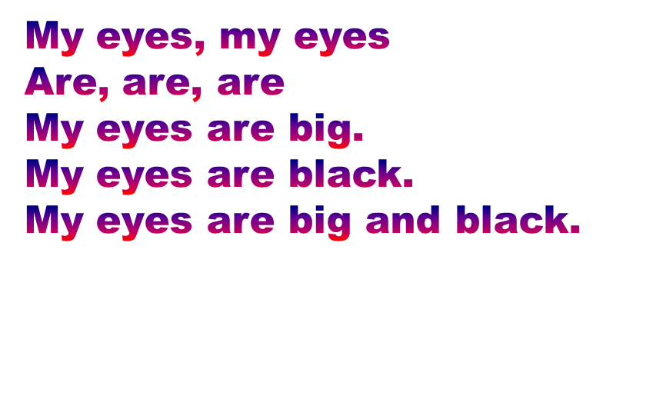
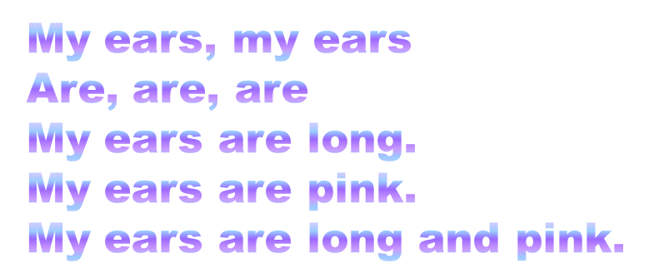
…
_____, ______
___, ___, ___
___ ___ ___ ___.
___ ___ ___ ___.
___ ___ ___ ___ ___ ___.
Notes:
17
17
17

Slide 18
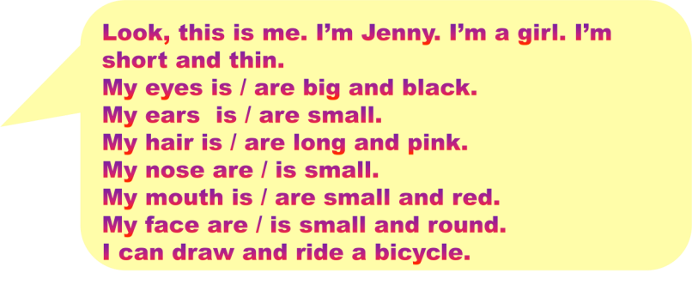
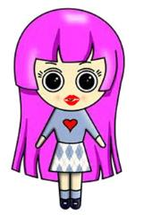
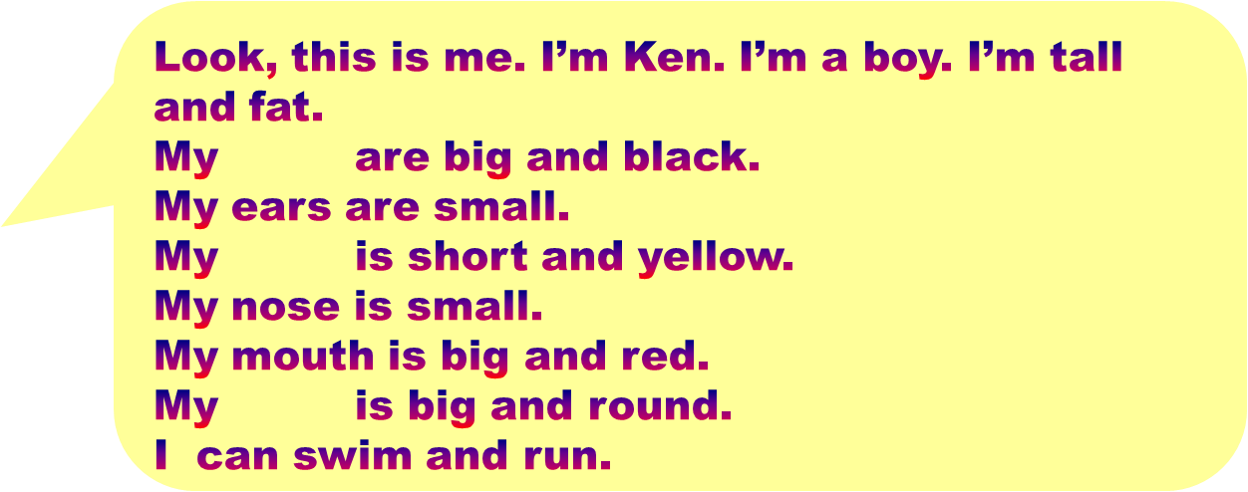
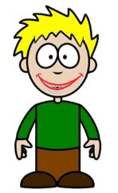
Notes:
18

Slide 19
…
About me
Look, this is me.
I’m ______.
I’m a ____(boy/girl).
I’m ___ and ___. (tall/short, thin/fat).
My eyes …
My ears …
My hair…
My nose…
My mouth…
My face…
I can ____ and ____.
Notes:
19
19
19

Slide 20
?
Notes:
20
20
20

Slide 22
…
Design a new face for Halloween Party and write down the description.
Notes:
22
22
22

Slide 23
Look, this is me.
I’m _____________. I’m a ______.(boy/girl)
I’m ______________.(tall/short, thin/fat)
My eyes are
I can ________________.
Please design a new face for Halloween Party and introduce it to others.
Notes:
23

