Slide 1
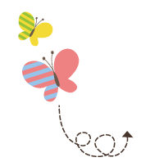
1111111111111111111111111111111111111111111111111111111111111111
Unit 1 Sports
六年级下册
Lesson 5 A Basketball Game
WWW.PPT818.COM

Slide 2
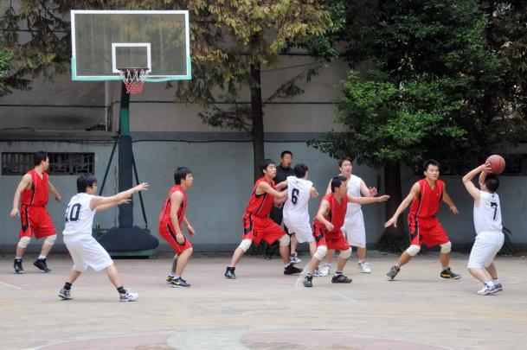
What are they doing?

Slide 3
1. Who won?
Mr. Smith: What did you do this evening, Jenny and Li Ming?
Jenny: We watched Bob play basketball!
“Did Bob’s team play a game?” asks Mr. Smith.
“Yes, his team played with the Orange Team,”says Jenny. “It was a very good game. Everyone played hard!”
“Who won?” asks Mr. Smith.
“Bob's team won!” says Li Ming.
“That’s great!” says Mr. Smith. “Did you have fun?”
“Yes!” answers Li Ming. “We yelled for Bob’s team!”

Slide 4
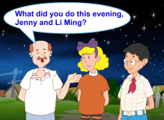
1. Who won?
Li Ming: Go! Bob!
Jenny: Go! Blue Team!
“Does Bob play basketball every day?”asks Li Ming.
“No. He is a policeman. He plays basketball for fun on Saturday and Sunday,”says Jenny.
“He played so well this evening. He is a good player,”says Li Ming.

Slide 5
知识点 1
What did you do this evening, Jenny and Li Ming?
今天晚上你们做什么了，詹妮和李明？
询问某人在过去某段时间做了什么
用法：
What did+主语+do+过去的时间？
句型：
主语+动词过去式+其他.
回答：
—What did your sister do last night?
你妹妹昨晚做什么了？
—She did her homework.她做她的家庭作业了。
例句：

Slide 6
一些表示过去的时间状语：last night, yesterday, three days ago, last year, the day before yesterday, last week, last night等。
拓展

Slide 7
知识点 2
game /ɡeɪm/ n. 游戏；比赛 【四会】
Let’s have a football game! 让我们举行一场足球赛吧！
例句：
字母a的发音是/eɪ/。
发音：
play a game＝play games 进行比赛；
a basketball game 一场篮球赛
短语：
same adj. 相同的； name n. 名字；came v. (come的过去式)来
形近词：

Slide 8
魔法记忆：
巧记比赛相关词汇：
team球队里有运动员，运动员 player去比赛，比赛game论输赢，lose输，win赢，请大家来记清。

Slide 9
知识点 3
ask /ɑːsk/ v. 问 【四会】
May I ask you some questions about health?
我可以问你一些关于健康的问题吗？
例句：
字母a的发音是/ɑː/。
发音：
answer v. 回答
反义词：
ask (原形)→asks(第三人称单数) →asking(现在分词) →asked(过去式)
词形变化：

Slide 10
知识点 4
very /'veri/ adv. 很；非常 【四会】
Jenny is a very good girl.
詹妮是一个非常好的女孩。
例句：
very much 非常 very well很好
短语：

Slide 11
知识点 5
Who won? 谁赢了？
句式：
who 引导的特殊疑问句
who 用来对作主语的人称代词，或表示人的名词提问。
1. 提问时，直接用who替换主语，不用借助任何助动词。
2. who作主语时，谓语动词通常用单数形式。
例句：Who wants to play ping-­pong with me?
谁想和我一起打乒乓球？
用法：

Slide 12
如果who在句子中作宾语，那么提问时，就必须借助相应的助动词。
例句：Who did you play basketball with?
你和谁一起打篮球了？
拓展

Slide 13
—Who ________ a dog in your class?
—Many students ________.
A. have; has B. has; has
C. has; have D. have; have
典例
C
本题考查主谓一致。who作主语时，谓语动词通常用单数形式，所以排除A和D；答语中的主语Many students是复数，谓语动词要用have，所以选C。
点拨：

Slide 14
知识点 6
answer /'ɑːnsə/ v. 回答 【四会】
Who can answer this question? 谁能回答这个问题？
例句：
字母a的发音是/ɑː/。
发音：
ask v. 问
反义词：
answer (原形)→answers(第三人称单数) →answering(现在分词) →answered(过去式)
词形变化：
answer n. 答案
拓展

Slide 15
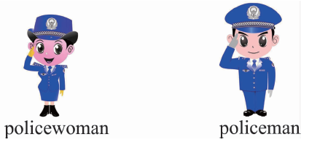
知识点 7
policeman / pə'liːsmən/ n. 警察【四会】
My father is a policeman. 我爸爸是一名警察。
例句：
policemen
复数：
policewoman n. 女警察
对应词：
图示记忆法：

Slide 16
2. Let’s do it!
We played football game.
We played the game at playground.
We played the game at 4 pm yesterday.
We won.

Slide 17
2. Let’s do it!
went to the shop and bought a T-shirt. I taught Jenny to play ping-pong and Jenny taught me to play basketball. We watched a basketball game. It was very interesting. We had a lot of fun.

Slide 18
一、句型转换。
1. Lucy watched TV last night.（对画线部分提问）
_____ _______ Lucy _____ last night?
2. I play ping-pong with my brother.(用yesterday改写句子)
I _______ __________ with my brother ___________.
What
did
do
played
ping-pong
yesterday

Slide 19
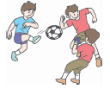
二、单项选择。
1. —What are they doing now?
—They are ________ on the playground.
A. playing game B. playing a games C. playing a game
2. There was a football ________ yesterday morning.
A. sport B. game C. shows
C
B

Slide 20
3. “How old are you? ” ________ Li Ming.
A. ask B. answer C. asks
C
根据引号中的句子是特殊疑问句可知李明在“询问”对方的年龄，且Li Ming是第三人称单数，所以选C。
点拨：

Slide 21
三、问句答语对对碰。
( )1.What did you do last Sunday?
( )2.Where did they play the game?
( )3.Did you have fun?
( )4.What did you buy?
( )5.Who won the game?
A. Bob’s team won.
B. Yes, I did.
C. I watched a basketball game.
D. I bought some bread and juice.
E. At the gym.
C
E
B
D
A

Slide 22
本节课我们学习了以下知识，请同学们一定加强巩固，以便能和同学们进行灵活交流哦！
重点词汇：game, ask, very, answer, policeman
重点句式：What did you do this evening, Jenny and Li Ming?
Who won?

Slide 23
1 熟记本节课所学的句型、短语和单词，必须会听、说、读、写。
2 将Who won?的对话朗读流利。
3 完成配套的课后作业。

