Slide 1
Help others
第二课时
WWW.PPT818.COM

Slide 2
Warming
Learn the sounds
kid dog sad chess
kitchen apple summer welcome
together afternoon computer strawberry
Good afternoon, David!

Slide 3
Practice
Listen and say
此处添加课文录音
1. camera
2. cat
3. sugar
4. wonderful
5.moon
6. hamburger

Slide 4
Pre-reading
Talk with students:
Do you know about bees?
Do you know about ants?
Which do you like?

Slide 5
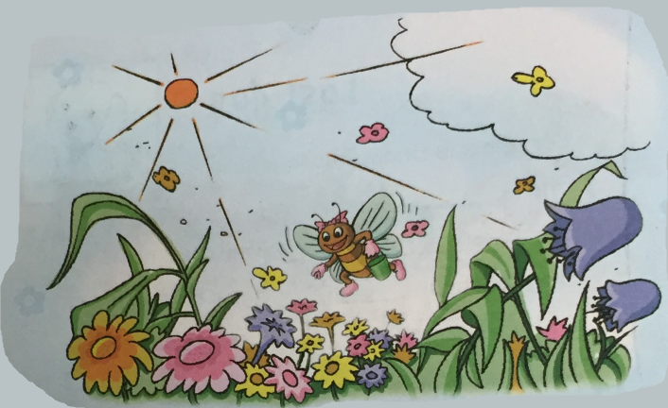
Reading
The bee and the ant
此处添加课文录音

Slide 6
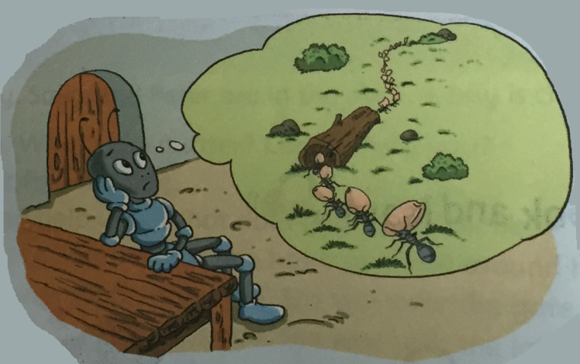
Reading
此处添加课文录音

Slide 7
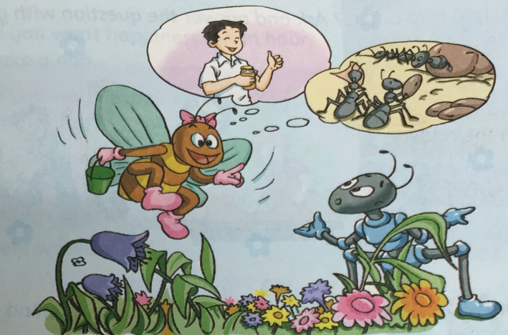
Reading
此处添加课文录音

Slide 8
Talk about the story
Answer the questions:
What did people think of the bee?
Did the bee work hard?
Did the ant work hard?
Why was the ant not happy?
Why did people like the bee?
What did you learn from the story?

Slide 9
Role play

Slide 10
Show time
Act out the story

Slide 11
Presentation
Listen and enjoy
If you want happiness for an hour,
take a nap.
If you want happiness for a day,
go fishing.
If you want happiness for a week,
go travelling.
If you want happiness for a lifetime,
help somebody.
此处添加课文录音

Slide 12
Let’s write!
How can you help others?
I can …

Slide 13
Summary
本课阅读了《the bee and the ant》故事。学生从中学到了：只有为他人服务才能获得他人的尊重。

Slide 14
Homework
把《the bee and the ant》分享给爸爸妈妈。
预习下一课.

Slide 15
The End

