Slide 1
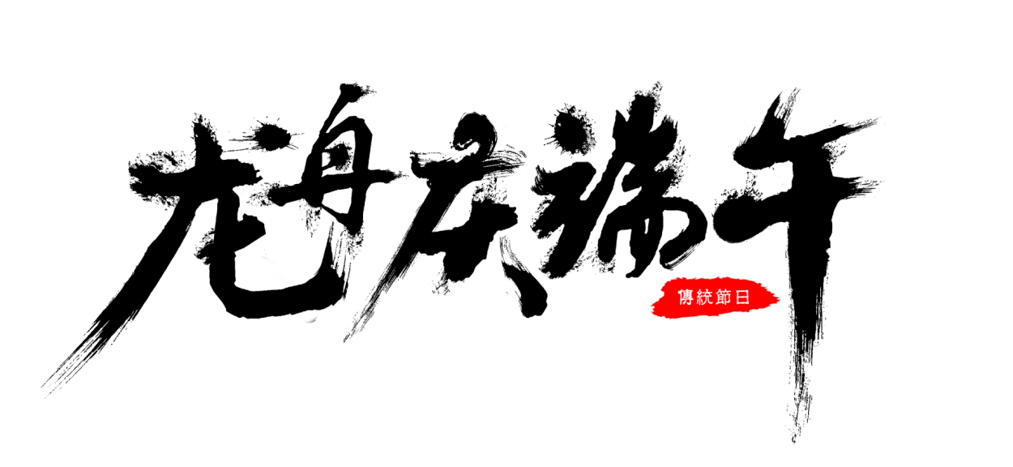
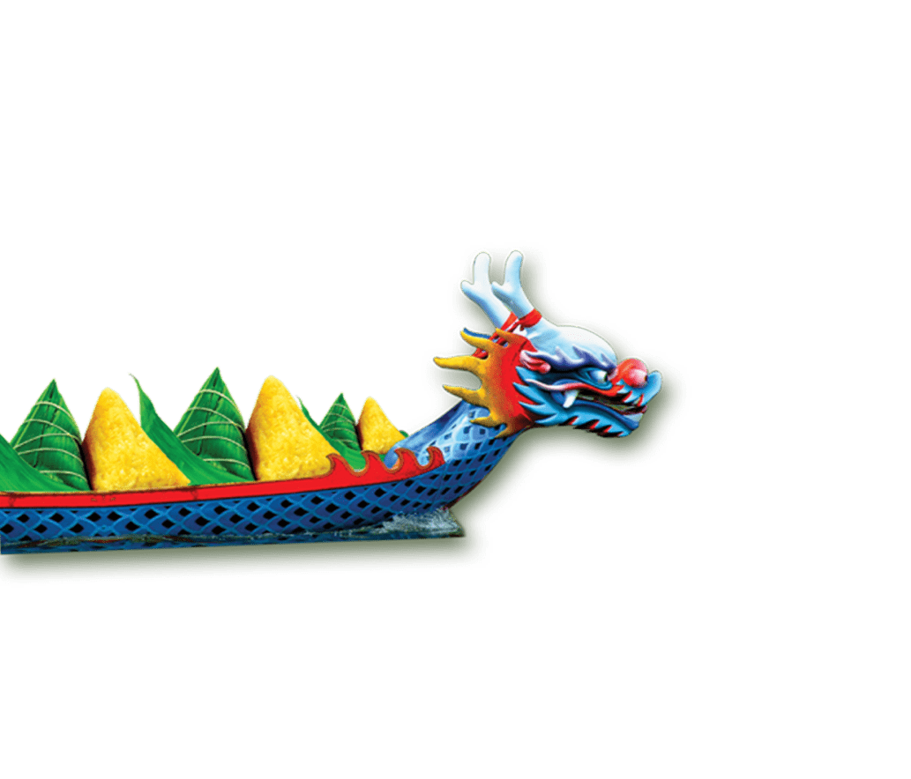
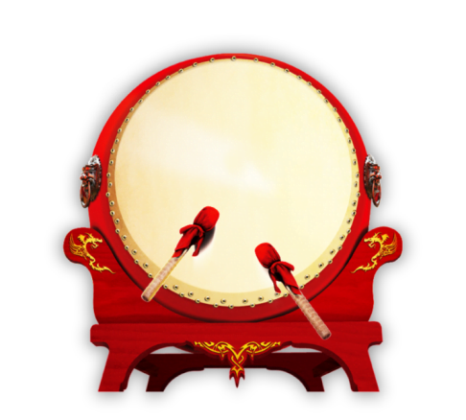
The Dragon Boat Festival
All in the past
中国传统节日端午节英文介绍

Slide 2
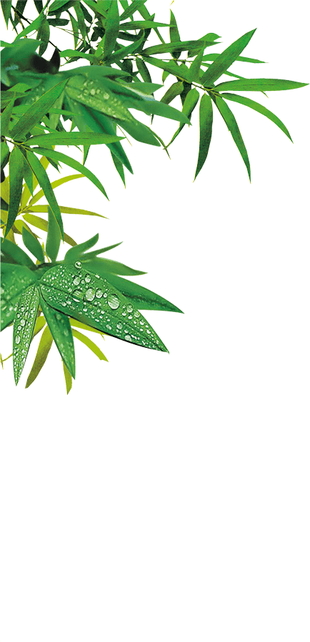
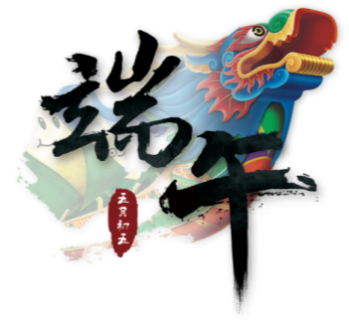
节日介绍
FESTIVAL
据统计端午节的名称在我国所有传统节日中叫法最多，达二十多个，堪称节日别名之最。如有端午节、端五节、端阳节、重五节、重午节、天中节、夏节、五月节、菖节、蒲节、龙舟节、浴兰节、粽子节 、午日节、女儿节、地腊节、诗人节、龙日、午日·灯节等等。

Slide 3
节日介绍
FESTIVAL
端阳节，据《荆楚岁时记》载，因仲夏登高，顺阳在上，五月正是仲夏，它的第一个午日正是登高顺阳天气好的日子，故称五月初五为“端阳节”。 重午节，午，属十二支，农历五月为午月，五、午同音，五、五相重，故端午节又名“重午节”或“重五节”，有些地方也叫“五月节”。 天中节，古人认为，五月五日时，阳重人中天，故称这一天为“天中节”。 浴兰节，端午时值仲夏，是皮肤病多发季节，古人以兰草汤沐浴去污为俗。汉代《大戴礼》云：“午日以兰汤沐浴”。 解棕节，古人端午吃棕时，有比较各人解下粽叶的长度、长者为胜的游戏，故又有“解粽节”之称。 女儿节，明沈榜《宛署杂记》：“五月女儿节,系端午索，戴艾叶，五毒灵符。宛俗自五月初一至初五日，饰小闺女，尽态极研。出嫁女亦各归宁。因呼为女儿节。” 菖蒲节，古人认为“重午”是犯禁忌的日子，此时五毒尽出，因此端午风俗多为驱邢避毒，如在门上悬挂菖蒲、艾叶等，故端午节也称“菖蒲节” 。

Slide 4
What do you know？
1.The Date
2.The Importance
3.The Origin
4.The Customs

Slide 5
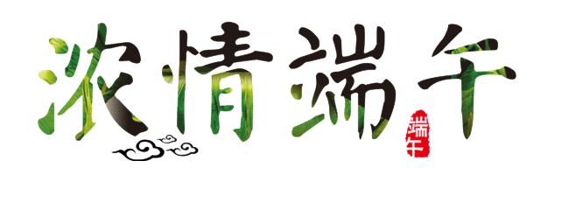
节日介绍
FESTIVAL
The Dragon Boat Festival, the 5th day of the 5th month in the Chinese lunar calendar, has had a history of more than 2,000 years. It is usually in June in the Solar calendar.
端午节（农历五月初五）是中国古老的传统节日，始于春秋战国时期，至今已有2000多年历史。通常在阳历的六月份。
PS:今年的端午节是在6月23日。

Slide 6
节日介绍
FESTIVAL
Today, Dragon Boat Festival in the Chinese people is still a very popular grand festival. Country attaches great importance to the protection of intangible cultural heritage, May 20, 2006, the State Council approved the inclusion of the folk first batch of national intangible cultural heritage.
时至今日，端午节在中国人民中仍是一个十分盛行的隆重节日。国家非常重视非物质文化遗产的保护，2006年5月20日,该民俗经国务院批准列入第一批国家级非物质文化遗产名录。

Slide 7
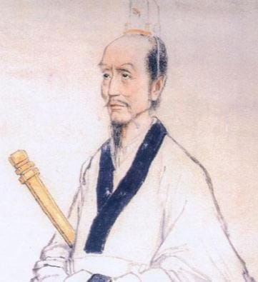
节日介绍
FESTIVAL
The origin of this summer festival centers around a scholarly government official named Qu Yuan. He was a good and respected man, but because of the misdeeds of jealous rivals he eventually fell into disfavor in the emperor's court. Unable to regain the respect of the emperor,in his sorrow Qu Yuan threw himself intothe Mi Luo river.
纪念屈原
屈原（约公元前340—公元前278年），中国战国时期楚国诗人、政治家。

Slide 8
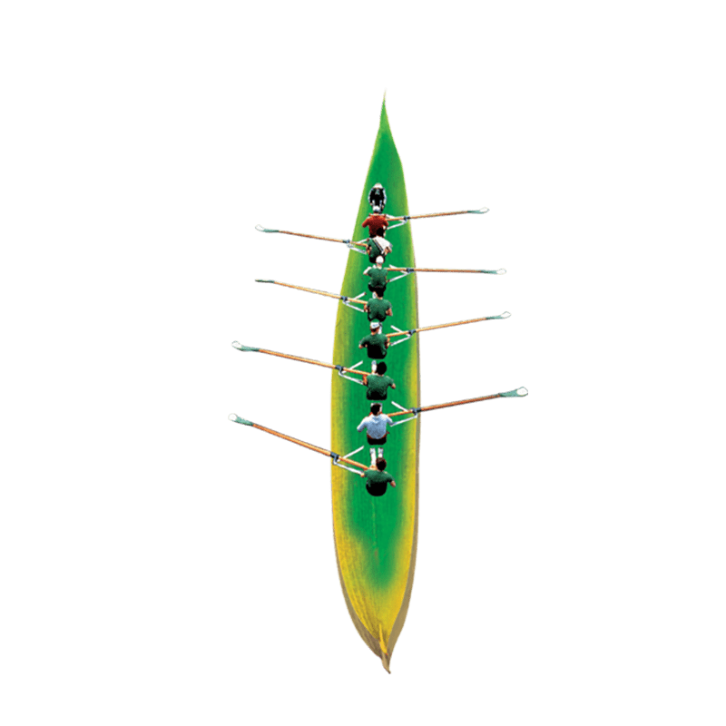
The Customs
FESTIVAL
Hanging Pictures of Zhong Kui 悬挂钟馗像
Hanging Calamus and Moxa 挂艾叶、菖蒲
Dragon Boat Race 赛龙舟
The Culture of Zongzi 粽子
Spice Bag 香囊
Realgar Wine 雄黄酒
Travel sickness 游百病

Slide 9
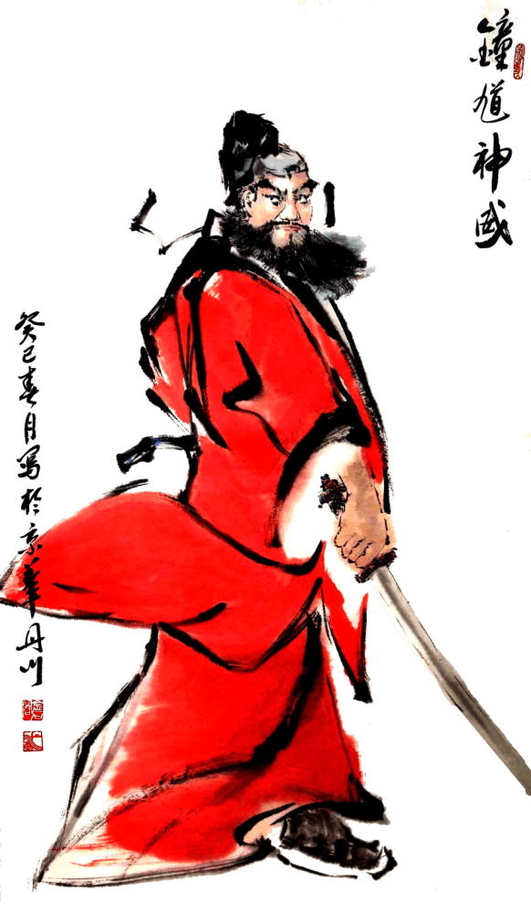
Hanging Pictures of Zhong Kui
FESTIVAL
Hanging Pictures of Zhong Kui 悬挂钟馗像

Slide 10
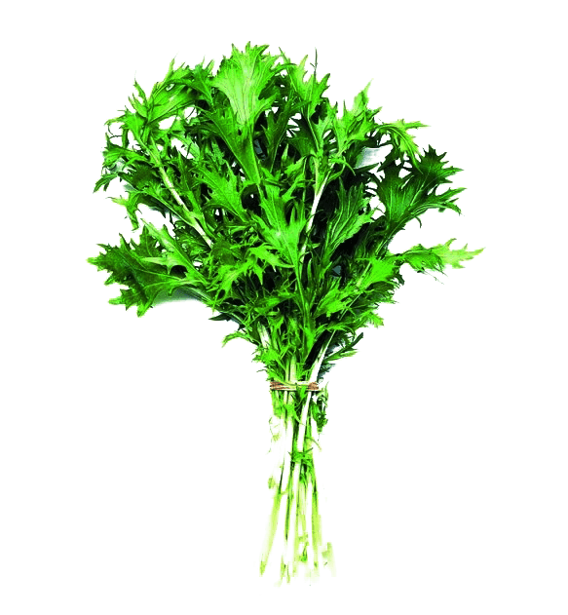
Hanging Calamus and Moxa
FESTIVAL
Hang calamus and moxa (oriental plants) on the front door
This is also to ward off evil.

Slide 11
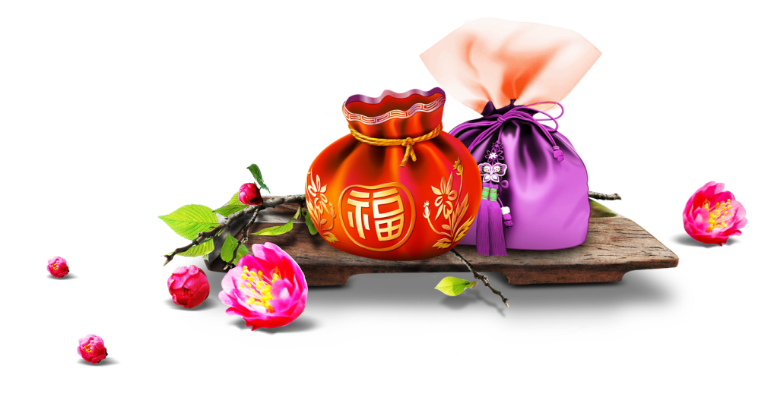
Spice Bag
FESTIVAL
The small bags are hand-made by local craftsmen.
They're made with red, yellow, green and blue silk, fine satin or cotton.
Figures of animals, flowers and fruits are often embroidered onto the bags and inside are mixed Chinese herbal medicines.
端午节最有特色的饰物就是香包。小孩佩戴香包，传说有避邪驱瘟之意。用含有多种香味的药用植物做成的香包也可以预防疾病。
Spice Bag

Slide 12
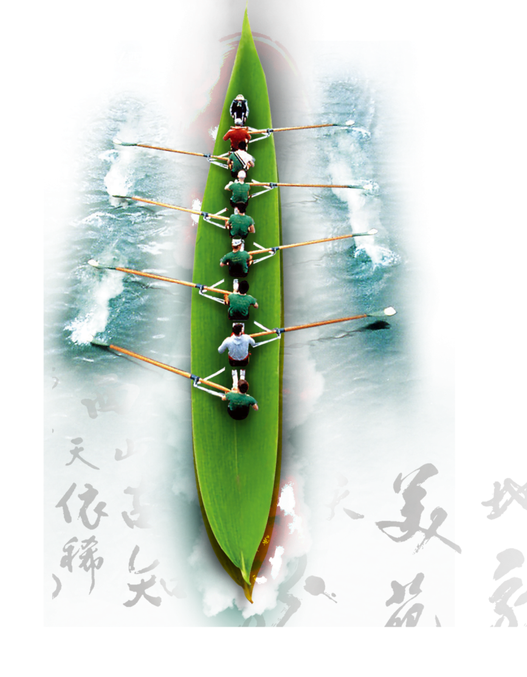
Dragon Boat Race
FESTIVAL
he main event of the festivities is the Dragon Boat Race.

Slide 13
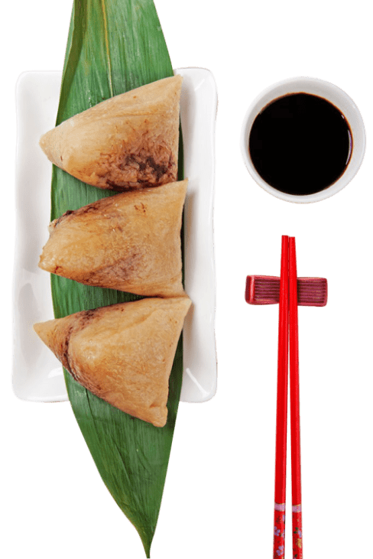
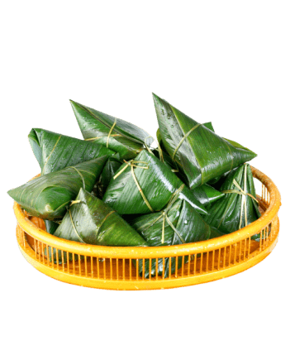
The Culture of Zong Zi
FESTIVAL
The Culture of Zong Zi
Qu Yuan drowned on the fifth day of the fifth lunar month in 277 BC. Since ancient times, Chinese people threw into the water dumpling made of glutinous rice wrapped in bamboo or reed leaves on the day. Therefore the fish would eat the rice rather than the hero poet. This later on turned into the custom of eating Zong Zi.

Slide 14
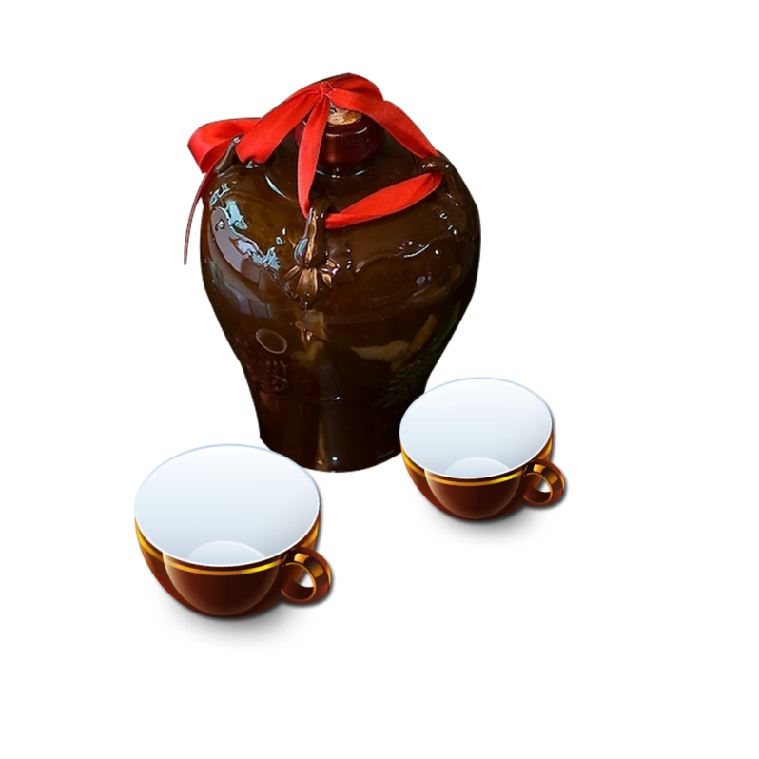
Realgar Wine
FESTIVAL
It is a very popular practice to drink this kind of Chinese liquor seasoned with realgar at the Dragon Boat Festival.
This is for protection from evil and disease for the rest of the year.
In one word, all of the activities are to protect themselves from evil and honor the poet Qu Yuan。
Realgar Wine

Slide 15
Travel sicknes
FESTIVAL
Travel sickness: such practices, prevalent in the custom of the Dragon Boat Festival in Guizhou Province
游百病：此种习俗，盛行于贵州地区的端午习俗。

Slide 16
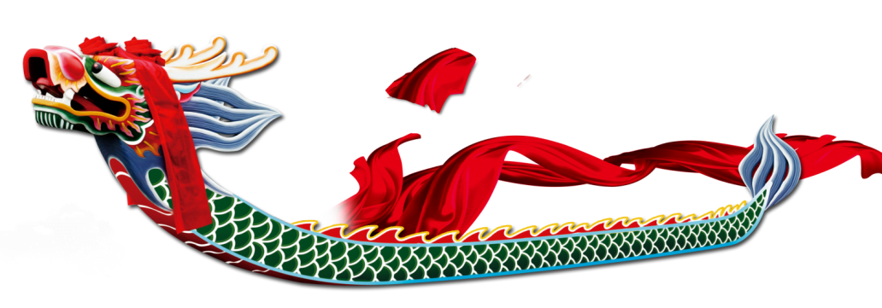
Conclusion
Nowadays, the Dragon Boat Festival is still very popular grand festival in China. I hope Chinese people will remember it isn’t just entertainment, have more kind of feelings.

Slide 17
The Dragon Boat Festival
All in the past

