Slide 1
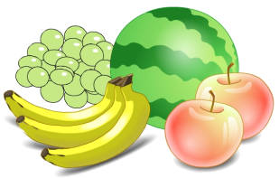
Unit6 It’s a grapefruit.
人教精通版五年级上册
WWW.PPT818.COM

Slide 2
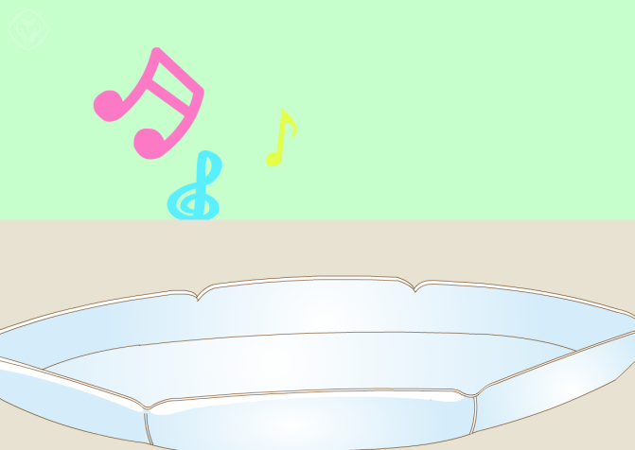
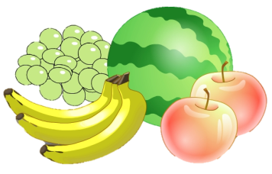
>>Warm-up
Play a game

Slide 3
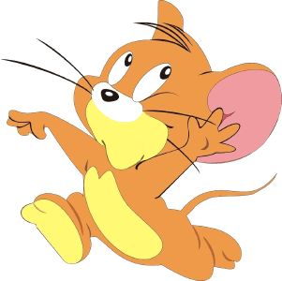
>>Lead-in
Play a game
遇到认识的单词站起来大声读出来吧！

Slide 4
>>Lead-in
Let’s play!
orange
grape
mango
water
pineapple
pear
banana
lemon
apple
milk
peach
juice

Slide 5
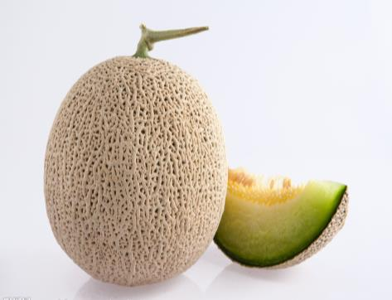
>>Presentation
Look and say
What’s this?
hami melon
?
It’s a hami melon.

Slide 6
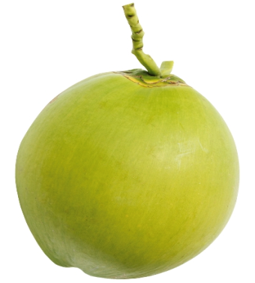
>>Presentation
Look and say
What’s that?
coconut
?
It’s a coconut.

Slide 7
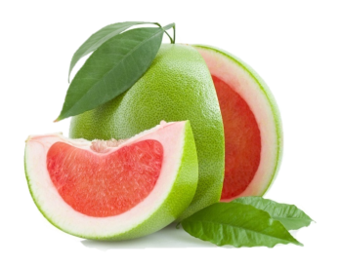
>>Presentation
Look and say
grape
+
fruit
grapefruit（葡萄柚）
It’s a grapefruit.

Slide 8
>>Practice
Let’s chant
Hami melon, hami melon, is it yummy?
Grapefruit, grapefruit, yummy, yummy,
yummy.
Coconut, coconut, it’s so big.

Slide 9
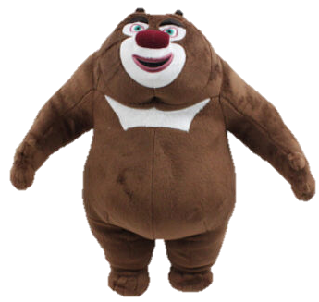
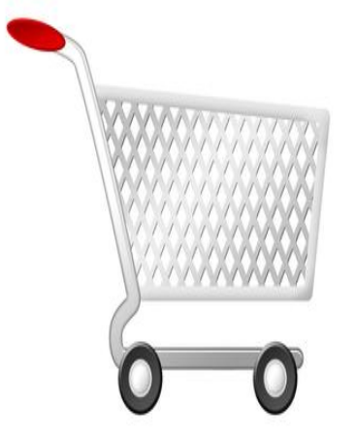
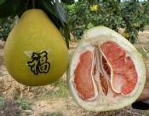
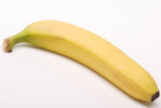
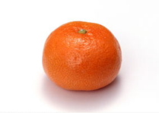
>>Practice
Choose and say
熊大超市

Slide 10
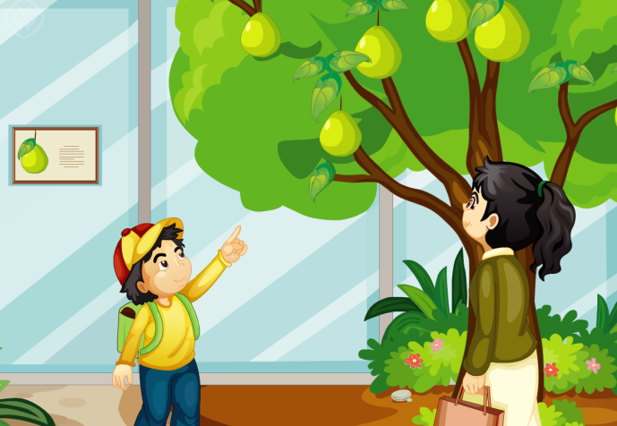
>>Presentation
Just talk
Let’s watch

Slide 11
>>Presentation
Just talk
Read and choose
1. What does the boy want?
A. apple B. pear C. grapefruit
2. Which fruit can you see?
A. hami melon and pear.
B. grapefruit and coconut.
C. Coconut and watermelon.

Slide 12
>>Presentation
Just talk
Listen and choose
√
Tom: Mum, what’s ____ (this/ that) ?
Mum: It’s a _________. (apple/ grapefruit)
Tom: ___________? (A coconut / A grapefruit) It’s so big.
____________? (Can we have one / Can I have one)
Mum: Yes, But not these. We’ll buy one in a shop.
Tom: What’s ____, Mum? (this /that)
Mum: It’s a ________. (hami melon /coconut)
Tom: Is it yummy?
Mum: Yes, _________________. (I’ll buy one for you/
We’ll buy one for you.)
Tom: Thank you, Mum.
√
√
√
√
√
√

Slide 13
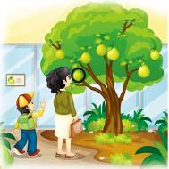
>>Presentation
Just talk
Listen and imitate
Little boy: Mum, what’s this?
Mum: It’s a grapefruit.
Little boy: A grapefruit? It’s so big. Can I
have one?
Mum: Yes. But not these. We’ll buy
one in a shop.

Slide 14
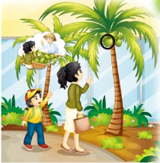
>>Presentation
Just talk
Listen and imitate
Little boy: What’s that, Mum?
Mum: It’s a coconut.
Little boy: Is it yummy?
Mum: Yes, I’ll buy one for you.
Little boy: Thank you, Mum!

Slide 15
>>Practice
Read it by yourself for one minute .
自读对话一分钟。
一分钟倒计时
60
Learning tip :
10
10
50
自己读对话，比一比看谁能在一分钟内读完，并且读得准确、流利！
20
20
40
30
30
开始

Slide 16
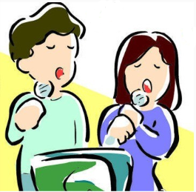
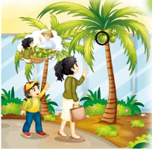
>>Practice
我是超级配音师
温馨提示：
1. 配音声音洪亮，1颗星。
2. 配音模仿逼真，2颗星。
3. 配音有特色， 3颗星。

Slide 17
>>Practice
自编对话：
你和同学约好去购物，请你们2人一组,自编对话并表演。
A: Hello, xxx.
B: Hello, xxx.
A: How’s the weather today?
B: It’s______. (sunny\rainy\cloudy…)
A: Let’s go shopping. Ok?
B: Ok!
A: What’s this\that?
B: It’s a\an _______.(apple\coconut\pear\orange…. )
A: Can I have one?
B: Yes, I’ll buy one for you.
A: Thank you.

Slide 18
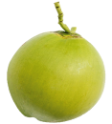
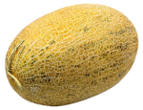
>>Summary
本课新学习的水果类单词有：
hami melon
coconut
grapefruit
本课学习的重点句型：
—What’s this/ that?
—It’s a …
—Can I have one?
—Yes. I’ll buy one
for you.

Slide 19
>>Homework
1.观看课文动画，按照正确的语音、语调朗读课文对话。 2.画出自己喜爱的水果，并写上该水果对应的英文，制作成单词卡片，不少于5张。
3.预习 Lesson 33。

