Slide 1
简约教育PPT模板
The user can perform the presentation on a projector or computer, and the powerpoint can be printed out and made into film. Click here to add content of the text，and briefly explain your point of view.

Slide 2
目录/contents
01
在此输入章节标题
02
在此输入章节标题
03
在此输入章节标题
04
在此输入章节标题

Slide 3
01
输入章节标题
The user can perform the presentation on a projector or computer, and the powerpoint can be printed out and made into film

Slide 4
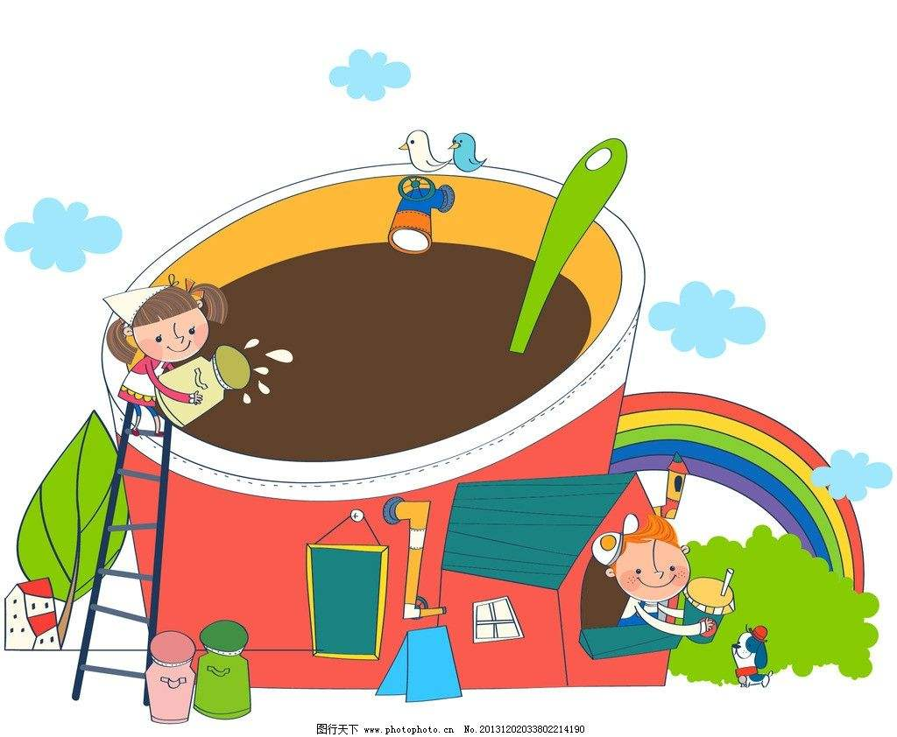
添加标题内容
ADDTHETITLE
The user can perform the presentation on a projector or computer, and the powerpoint can be printed out and made into film. The user can perform the presentation on a projector or computer, and the powerpoint can be printed out and made into film. The user can perform the presentation on a projector or computer, and the powerpoint can be printed out and made into film.
小标题
The user can perform the presentation on a projector or computer. The user can perform the presentation on a projector or computer.
小标题
The user can perform the presentation on a projector or computer. The user can perform the presentation on a projector or computer.

Slide 5
添加标题内容
ADDTHETITLE
01
02
03
04
05
标题内容
The user can perform the presentation on a projector or computer.
标题内容
The user can perform the presentation on a projector or computer.
标题内容
The user can perform the presentation on a projector or computer.
标题内容
The user can perform the presentation on a projector or computer.
标题内容
The user can perform the presentation on a projector or computer.
详细内容
详细内容
详细内容
详细内容
详细内容

Slide 6
Enter title here
The user can perform the presentation on a projector or computer, and the powerpoint can be printed out and made into film.
Enter title here
The user can perform the presentation on a projector or computer, and the powerpoint can be printed out and made into film.
标题
Enter title here
The user can perform the presentation on a projector or computer, and the powerpoint can be printed out and made into film.

Slide 7
02
输入章节标题
The user can perform the presentation on a projector or computer, and the powerpoint can be printed out and made into film

Slide 8
Enter title here
The user can perform the presentation on a projector or computer, and the powerpoint can be printed out and made into film.
Enter title here
The user can perform the presentation on a projector or computer, and the powerpoint can be printed out and made into film.
Enter title here
The user can perform the presentation on a projector or computer, and the powerpoint can be printed out and made into film.
Enter title here
The user can perform the presentation on a projector or computer, and the powerpoint can be printed out and made into film.

Slide 9
添加标题内容
ADDTHETITLE
Enter title here
Enter title here
Enter title here
The user can perform the presentation on a projector or computer.
The user can perform the presentation on a projector or computer
The user can perform the presentation on a projector or computer

Slide 10
添加标题内容
ADDTHETITLE
Enter title here
Enter title here
The user can perform the presentation on a projector or computer.
The user can perform the presentation on a projector or computer.
Enter title here
The user can perform the presentation on a projector or computer.
Enter title here
The user can perform the presentation on a projector or computer.

Slide 11
03
输入章节标题
The user can perform the presentation on a projector or computer, and the powerpoint can be printed out and made into film

Slide 12
添加标题内容
ADDTHETITLE
ENTER TITLE
ENTER TITLE
Click here to add the text, the text is the extraction of your thought, please explain the point of view succinctly.
Click here to add the text, the text is the extraction of your thought, please explain the point of view succinctly.

Slide 13
添加标题内容
ADDTHETITLE
The user can perform the presentation on a projector or computer. The user can perform the presentation on a projector or computer.
TITLE
The user can perform the presentation on a projector or computer. The user can perform the presentation on a projector or computer.
TITLE
The user can perform the presentation on a projector or computer. The user can perform the presentation on a projector or computer.
TITLE
The user can perform the presentation on a projector or computer. The user can perform the presentation on a projector or computer.
TITLE

Slide 14
添加标题内容
ADDTHETITLE
Key words
Key words
Key words
Key words
Key words
Key words
The user can perform the presentation on a projector or computer, and the powerpoint can be printed out and made into film. The user can perform the presentation on a projector or computer, and the powerpoint can be printed out and made into film. The user can perform the presentation on a projector or computer, and the powerpoint can be printed out and made into film.

Slide 15
04
输入章节标题
The user can perform the presentation on a projector or computer, and the powerpoint can be printed out and made into film

Slide 16
添加标题内容
ADDTHETITLE
Enter title
1
Enter title
The user can perform the presentation on a projector or computer, and the powerpoint can be printed out and made into film.
2
Enter title
The user can perform the presentation on a projector or computer, and the powerpoint can be printed out and made into film.

Slide 17
添加标题内容
ADDTHETITLE
Enter title
Enter title
The user can perform the presentation on a projector or computer, and the powerpoint can be printed out and made into film.
Enter title
Enter title
The user can perform the presentation on a projector or computer, and the powerpoint can be printed out and made into film.
The user can perform the presentation on a projector or computer, and the powerpoint can be printed out and made into film.

Slide 18
添加标题内容
ADDTHETITLE
Enter title here
Enter title here
Enter title here
The user can perform the presentation on a projector or computer, and the powerpoint can be printed out and made into film.
The user can perform the presentation on a projector or computer, and the powerpoint can be printed out and made into film.
The user can perform the presentation on a projector or computer, and the powerpoint can be printed out and made into film.

Slide 19
感谢您的聆听
The user can perform the presentation on a projector or computer, and the powerpoint can be printed out and made into film. Click here to add content of the text，and briefly explain your point of view.

