Slide 1
人教版八年级上册
Unit3
I am more outgoing than my sister.
Section B（第2课时）
WWW.PPT818.COM

Slide 2
学习目标
1.能掌握以下单词和短语： mirror, kid, as long as, necessary, be different from, bring out, grade等。
2.能运用所学的语句或固定表达方式表述自己的交友观点：
I think friends…
I don’t care if my friends…
That’s not very important for me.
3.用所学表述人物个性特征及行为习惯的形容词和副词，描述朋友及他人，并能获取文本有效信息。

Slide 3
自学互研
新词自查
根据句意及汉语提示完成句子
1. Mr. Wang is more ______(严肃的) than any other
teacher, we are all afraid of him.
2. The apples on the tree are too tall. I can’t reach (够到)
them.
3. Liu Xiang and Yao Ming are both (两个都) famous
sport stars.
4. You can see yourself in the mirror (镜子).
5. It is necessary (有必要的) to learn a foreign language.
6. My mother understands me. She always touch (抓住)
my heart.
7. You should share (分享) your toys with your friends.
serious

Slide 4
情景导入
Talk about your friends
Example:
Jack is my best friend. He is taller than me. But
he is as friendly as me. He works harder than me, so he always helps me with my study.

Slide 5
2a Write the comparative forms of the following
adjectives. Then use them to write five sentences
about you and your friends.
popular__________ funny ________
quiet ________ friendly ________
shy ________ serious ________
outgoing ___________ smart ________
hard-working ________________________
more popular
funnier
quieter
friendlier
shier
more serious
more outgoing
smarter
more hard-working

Slide 6
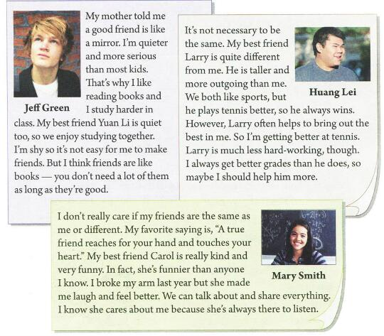
Fast reading
Read and underline the differences between the friends and circle the similarities.

Slide 7
Check the answers.

Slide 8
Detailed reading
2c Are the following statements true or false?
1. Jeff is less serious than most kids.
2. Jeff and Yuan Li are both quiet.
3. Jeff thinks it is easy for him to make friends.
4. Huang Lei is taller than Larry.
F
T
F
F

Slide 9
5. Huang Lei isn’t as good at tennis as Larry.
6. Larry works harder than Huang Lei.
7. Mary thinks her friends should be the
same as her.
8. Carol broke her arm last year and Mary
made her feel better.
T
F
F
F

Slide 10
2d How do you and your friends compare with
the people in the article? Write five sentences.
I’m different from Jeff because I'm louder than the other kids in my class.
My best friend is similar to Larry because she’s less hard-working than me.
__________________________________________________________________________________________________________________

Slide 11
I’m similar to Jeff because I like reading books
and works harder in class.
2. My friend is similar to Carol because she always
makes me laugh.
3. I’m different from Huang Lei because I think
my best friends should be the same as me.
4. My friend is similar to Yuan Li because she is quiet and like studying.
5. I’m similar to Carol because I’m funnier than
any other kids and I make my friends laugh.

Slide 12
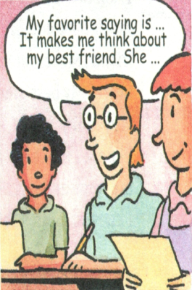
2e Which saying is your favorite? Which friend do you think about when you read this saying? Why? Tell your partner about it.
1.A good friend is like a mirror.
2. Friends are like books—you don’t need a lot of them as long as they’re good.
3. My best friend helps to bring out the best in me.
4. A true friend reaches for your hand and touches your heart.

Slide 13
Example
My favorite saying is “A true friend reaches for your hand and touches your heart.” It makes me think about my best friend, Wu Zhou. He helps me with my English for three years. I was bad in English three years ago. But now I’m interested in it with his help.

Slide 14
问题探究
▲It’s necessary to do sth.
意为“没有必要做某事”。It是形式主语，其句型是It is/ was + 形容词+动词不定式，常用来说明一般的情况，或某一次具体的动作。
导练：It’s necessary to study(study) English well.
▲ as long as
as long as是一个短语连词，引导一个条件状语从句，表示“只要…..”如：He can talk about this as long as you want.只要你想，你就可以谈论此事。
I’ll come as long as you are happy. 只要你开心，我就会来。

Slide 15
▲比较级前的修饰语
比较级前的修饰语可以表示比较的程度，常见的有：even，a little , a bit, much, a lot, far等
导练：1这本书比那本书有趣得多。
This book is a lot more interesting than that one.
2.我们的生活将来会更好的。
Our life will be even better in the future.

Slide 16
课堂评价
Fill in the blanks.
1.I like to have friends who __________ like me. (be)
2. There are some __________ , though. (different)
3. It’s not __________ to be the same. (必要的，必需的)
4. He always __________ me in tennis. (打败)
5. I don’t really ________ if my friends are the same
as me.(对……在意)
6.I think differences are not __________ in a friendship.
(重要的)
are
differences
necessary
beats
care
important

Slide 17
Summary
For me, a good friend …
I think friends …
I don’t really care if my friends …
That’s not very important for me.
It’s not necessary to be the same.

Slide 18
Homework
Make a survey of your friends or families
and find out their differences(talented/
smarter/ …).And then give a report for
the next class.

