Slide 1
Unit 5 Topic 2
A few students are running around the playground.
Section C
WWW.PPT818.COM

Slide 2
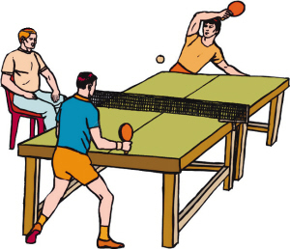
What is he doing?
He is sitting and watching.
What are they doing now?
They are playing ping-pong.

Slide 3
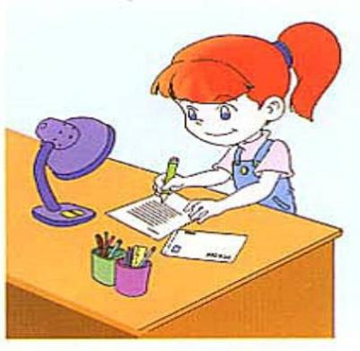
write a letter
A:
B:
Look, what is she doing?
She is writing a letter.

Slide 4
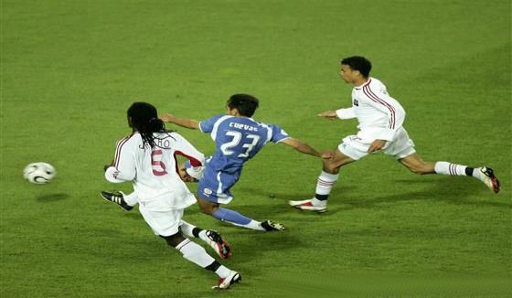
A:
B:
What are they doing now?
They are playing soccer.
They are having a soccer game.

Slide 5
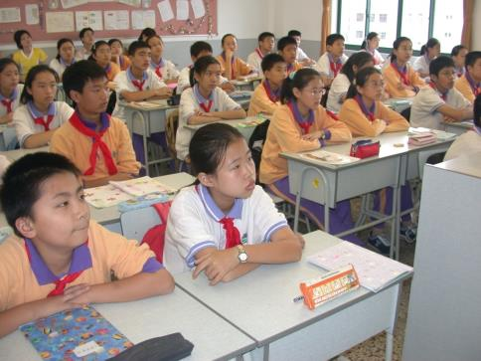
have lessons
A: Look,
B:
what are they doing?
They are having lessons.

Slide 6
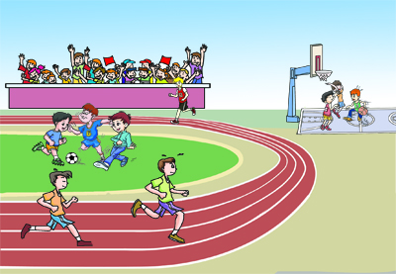
Look at the pictures and describe what the students are doing.
Some students are playing basketball.
Some students are having a soccer game.
A few students are running around the playground.
...

Slide 7
Look at the pictures and describe what the students are doing.
插入新教材P13 1a 图 2
Some girls are dancing.
Helen and Ann are playing ping-pong.
Three students are swimming in the swimming pool.

Slide 8
Look at the pictures and describe what the students are doing.
Kangkang is reading English newspapers.
Michael is doing his homework.
Wang Wei is writing a letter.
Sally is cleaning the blackboard at the back of the classroom.

Slide 9
Read and understand.
Underline the structure be + v.-ing in 1a and read them aloud.
(Miss Wang is showing a new student around the school.)
(On the playground) A few students are running around the playground. Some students are having a soccer game. Some students are playing basketball . Look! Many students are sitting
there and watching.

Slide 10
(In the gym) Three students
are swimming in the swimming pool.
What about the girls over there? Oh! They are dancing. But Helen isn't dancing with them. She is playing ping-pong with Ann.

Slide 11
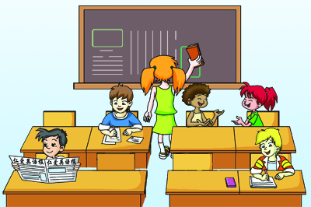
(In the classroom) Look at your classmates. They are not having lessons. Kangkang is reading English newspapers. Michael is doing his homework. Is Wang Wei doing his homework, too? Oh, no! He is writing a letter.
What are Jane and Maria doing? They are talking. Where is Sally? Aha, she is cleaning the blackboard at the back of the classroom.

Slide 12
Key points
1. Grammar (Present Continuous)
现在进行时表示正在发生或进行的动作。谓语动词形式为："be(am/is/are) + v.-ing"。

Slide 13
2. New phrases:
show sb. around
a few
have a soccer game
play ping-pong
have lessons/classes
write a letter
clean the blackboard
at the back of

Slide 14
Read 1a and match the activities with the students.
some students
a few students
Helen and Ann
three students
Kangkang
Sally
play ping-pong
swim
run
clean the blackboard
read English newspapers
have a soccer game

Slide 15
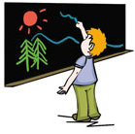
Look at the pictures and complete the sentences.
Example:
The boy is drawing pictures.
He isn't cleaning the blackboard.

Slide 16
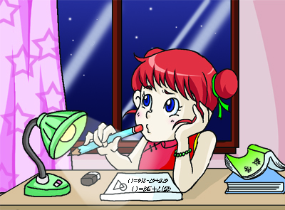
1. The girl _______ her homework.
She _____________ a letter.
is doing
isn’t writing

Slide 17
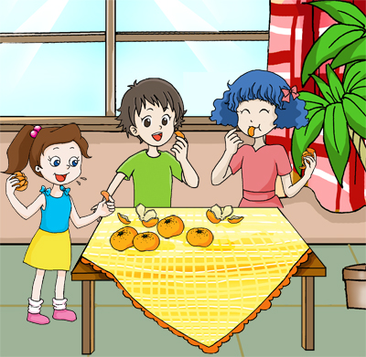
are eating
2. The girls ___________ oranges.
They _______________ orange juice.
aren’t drinking

Slide 18
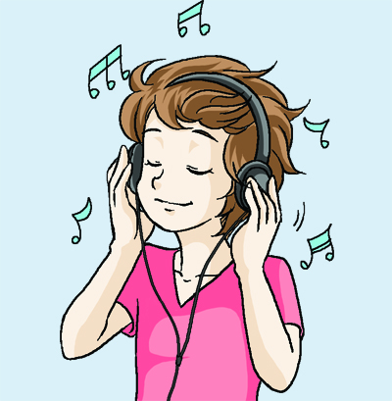
3. I _____________ to music.
I ________________ a song.
am listening
am not singing

Slide 19
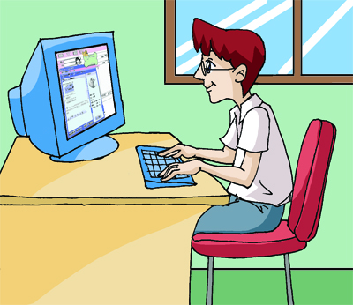
isn’t watching
4. The man ______________ TV.
He __________ on a computer.
is playing

Slide 20
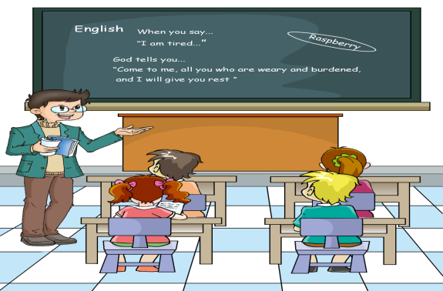
aren’t playing
5. The students _____________ games.
They __________ an English class.
are having

Slide 21
Ask and answer questions with the information in 2a.
Example:
A: Is the boy cleaning the blackboard?
B: No, he isn't.
A: What is he doing?
B: He is drawing pictures.

Slide 22
Observe what your classmates are doing. Then write a short passage to describe them.

Slide 23
Read and complete the sentences.
Eight
guest
They
new
person
orange

Slide 24
Chant and pay attention to the liaison ( ).
'Here is the 'father.
'Here is the 'mother.
'Here is the 'sister.
'Here is the 'brother.
'Father and 'mother.
'Sister and 'brother.
‘Hand in ’hand.
With 'one a'nother.

Slide 25
Summary
1. Review the names of school buildings.
2. Consolidate the present continuous tense.
3. Learn some new words and phrases:
show sb. around, sit, write,
at the back of, draw pictures...

Slide 26
Homework
Draw a picture about what your family members are doing, and then write a short passage to describe the picture. (Present Continuous Tense, at least 50 words)

