Slide 1
Unit 1
Where did you go on vacation?
SectionB3a-self check
WWW.PPT818.COM

Slide 2
Read the passage and fill in the blanks.
Review
On July 15th, Jane and her family got to Penang in _________. The weather was ______ and ____. So they decided to go to the _____. She and her sister tried __________. It was so _______. She felt like she was a ____. They had Malaysian yellow ______ for lunch. They were delicious! They ____ bicycles to Georgetown in the afternoon.
Malaysia
sunny
hot
beach
paragliding
exciting
bird
noodles
rode

Slide 3
They saw many old and new _________ there. Weld Quay is a very ___ place. They saw the houses of the Chinese _______ from 100 years. They really enjoyed _______ _______ the town.
buildings
old
traders
walking around

Slide 4
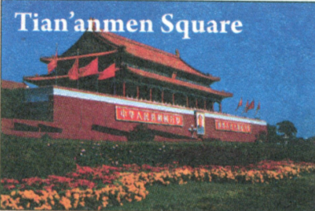
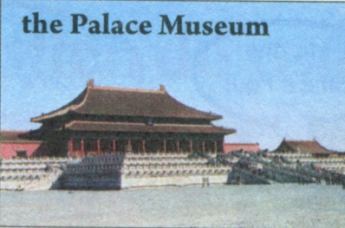
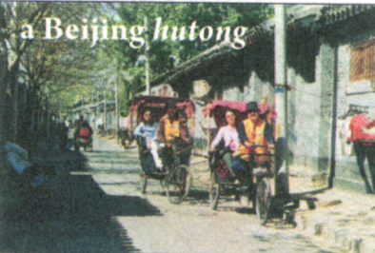
3a Complete the diary entry about a trip to one of these places. Use the words and phrases in the box to help you.

Slide 5
hot and sunny tired Beijing duck
delicious take some photos beautiful August buy something special interesting learn something important
August
Wednesday,________20th
Today the weather was ____________. I went to____________________. It was________ .
We _________________________. I liked this place because______________________________. For dinner we had___________. It was ________ . In the evening, I felt really_______ .
hot and sunny
Tian’anmen Square
beautiful
took some photos
I learned something important
Beijing duck
delicious
tired

Slide 6
How to write an English diary?
写日记的格式：
在左上角写上日期, 先星期(week)再日期(date)，
在右上角写上天气(weather)。 然后另起一行,
就可以写下你想要写的事情或感想了。
注意写日记时, 要使用正确的时态, 如果你
记叙的是已经发生的事情, 一般都应用过去
时态。如果写的是感想等, 就可以用一般现在时。

Slide 7
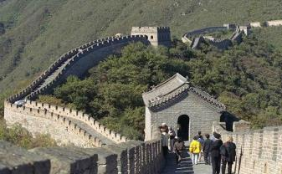
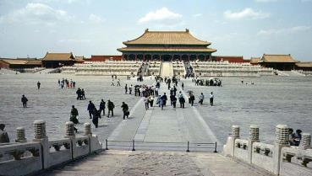
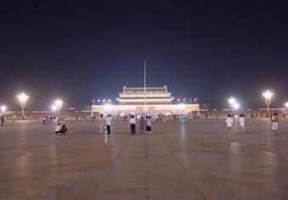
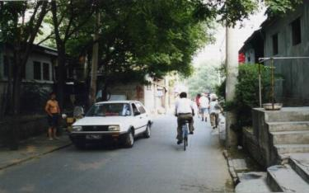
Imagine you are an American student on
vacation in Beijing.Write a Travel diary.
the Great Wall
the Palace Museum
Tian’an Men Square
a Beijing Hutong

Slide 8
Thursday, August 1st
Today I went to the Palace Museum. It was cool.
Then I went to visit the Great Wall. How great it is!
I took many photos there. In the afternoon, I went to
Tian’an Men Square. The square is very large. Today
is Chinese Army Day. So there were many people
there and it was very crowded. We had great fun
playing there! At last, we traveled around Beijing
Hutong on three-wheelers. The Chinese people are
very friendly. I felt very happy today, but I was
really tired.

Slide 9
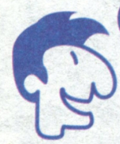
4. Imagine you are all of foreigners on vacation in China. You meet each other at the airport on your way home. Talk about what you did on your vacation.
Hi, Paul. I’m Anna. Where did you go
on vacation?
Hi, my name’s Paul.
I went to Nanjing.
Oh, I went to Beijing. Did you do anything special in Nanjing?

Slide 10
1. Complete the conversations with the correct words in the box.
Self check
anything, everything, nothing, anyone, everyone, no one
1. A: Did ______ go on vacation with
you last month?
B: Yes, my family went to the
countryside with me.
anyone

Slide 11
2. A: Did your family go to the beach with
you last weekend?
B: No. _______ from my family went,
but my friend went with me.
No one

Slide 12
3. A: I didn’t bring back anything from
Malaysia.
B: ________ at all? Why not?
4. A: Did you buy ________ in the shopping
center?
B: No, I didn’t. ___________ was very
expensive.
5. A: How was the volleyball game yesterday?
B: Great! _________ had a fun time!
Nothing
anything
Everything
Everyone

Slide 13
Last August, our class ___ (do) something very special on our school trip. We _____ (go) to Mount Tai. We ______ (start) our trip at 12:00 at night. Everyone in our class ____ (take) a bag with some food and water. After three hours, someone looked at the map and _____ (find) out we _______ (be, not) anywhere near the top.
did
went
started
took
found
weren’t

Slide 14
My legs ____ (be) so tired that I wanted to stop. My classmates ____ (tell) me to keep going, so I _____ (go) on. At 5:00 a.m., we got to the top! Everyone _______ (jump) up and down in excitement. Twenty minutes later, the sun _______ (start) to come up. It was so beautiful that we ______ (forget) about the last five hours!
were
told
went
jumped
started
forgot

Slide 15
Exercise
用括号中单词的正确形式填空。
1. I ______ (buy) a new dictionary the
day before yesterday.
2. — What day ____ (be) it yesterday?
— It ____ (be) Friday.
3. They _____ (be) here half an hour ago.
4. We often ______ (play) games last
term.
bought
was
was
were
played

Slide 16
5. She _____ (give) me a book a
moment ago.
6. The girl _____ (get) up very early this
morning.
7. They _____ (take) photos near the river
an hour ago.
8. He _____________ (not watch) TV
yesterday evening.
gave
got
took
didn’t watch

Slide 17
Thank You!

