Slide 1
Unit 8 Culture Shapes Us
Different Manners
WWW.PPT818.COM

Slide 2
学习目标
1. To learn about different manners in different countries.
2. To learn to use “though” and “although” in adverbial clause.
3. To know about different manners and try to be polite.

Slide 3
Listening
Listen to the first two paragraphs and answer the questions:
1. How long has Wu Zhou lived in Canada?
2. Why doesn’t he feel Canadian?
He has lived in Canada for twenty-three years.
It’s because North American manners and Chinese manners are so different.

Slide 4
Reading
Read the lesson and match the behaviors with the correct countries.
asking an adult’s age
Canada
putting food on a guest’s plate
giving a tip to waiters and hotel workers
China
sharing the cost of a meal in a restaurant

Slide 5
Language points
1. If someone praises you and says that…
praise sb. for sth. 因...... 赞扬某人
The teacher praised him for cleaning the room.

Slide 6
Language points
2. When Chinese people eat out in restaurant, they may take turns paying for the meal.
1. take turns doing sth. 轮流做某事
It ’s one’s turn to do sth. 意为轮到某人做某事
2. pay for sth. 付……的钱

Slide 7
Language points
Read the sentences again and pay attention to the underline words.
①Though Wu Zhou has lived in Canada for 23 years, he still doesn’t feel Canadian.
②Although Canadian culture is different from Chinese culture, he has many good friends in Canada.
③In China if someone praises you, you should be modest, but in Canada you should just say “Thanks”.

Slide 8
Language points
though 意为“虽然，尽管”，为从属连词，相当于although，用来引导让步状语是，可放在主句前或之后。
【注意】
Though/ although不能和but连用，但可以用yet 或 still 表“然而、可是”之意。

Slide 9
Exercise
Match and complete the sentences.
Although people have different cultures and customs,
but he has already made many friends there.
Brain hasn’t been to China,
they have the same feelings.
He has been at the new school for only a few days,
he still feels lonely.
Though Liu Feng has many friends in America,
but he knows a lot about our country.

Slide 10
Project
Do you know any table manners?
Dos | Don’ts

Slide 11
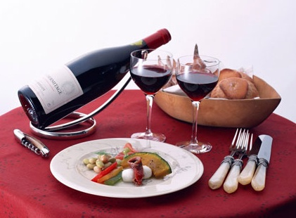
Discussion
Work in groups. Talk about other manners you know in different countries. First write down what you know on the paper, then share them with other groups.

Slide 12
Homework
1. Make a project about different manners in one of the countries you’d like to travel to.
2. Give us a report about it next time!

Slide 13
Thank You

