Slide 1
Unit1 Welcome to our school!
人教精通版五年级下册
WWW.PPT818.COM

Slide 2
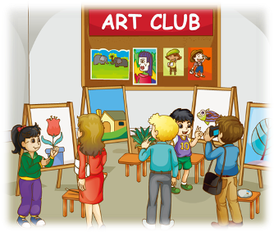
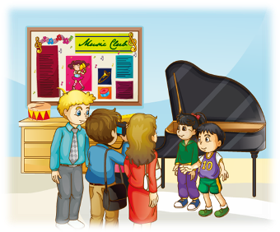
>>Warm-up
Let’s review
This is our … We often ... in it. We have …
lessons in a week.

Slide 3
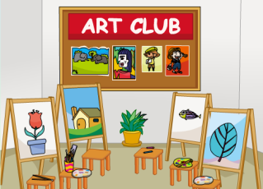
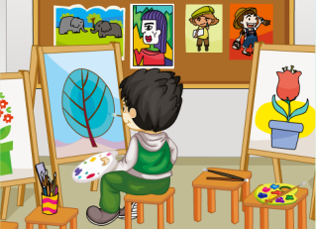
>>Presentation
Look and say
We often paint a picture in the art club.
art club
paint a picture

Slide 4
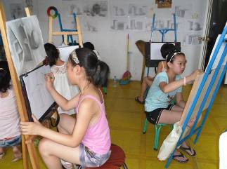
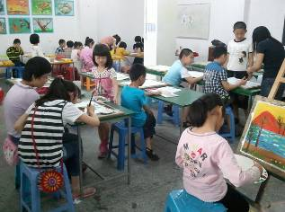
>>Presentation
Look and say
What do they do in the art club?
They often …
draw a picture
paint a picture

Slide 5
>>Presentation
Ask and answer
What do you often do in the art club?
We often …
How many art lessons do you have in
a week?
We have …

Slide 6
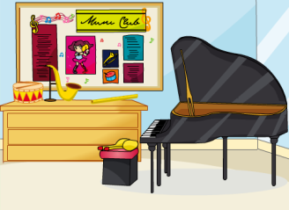
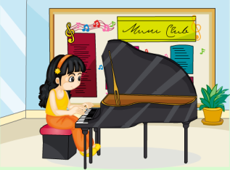
>>Presentation
Look and say
We often play the piano in the music club.
music club
play the piano

Slide 7
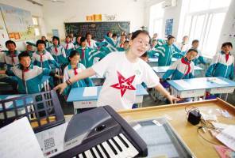
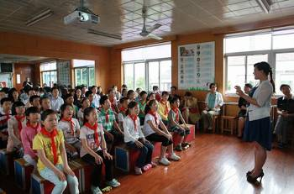
>>Presentation
Look and say
What do they do in the music club?
They often …
dance
sing

Slide 8
>>Presentation
Ask and answer
What do you often do in the music club?
We often …
How many music lessons do you have in a week?
We have …

Slide 9
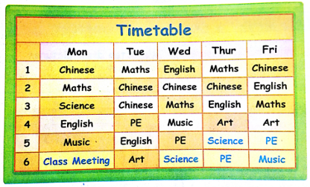
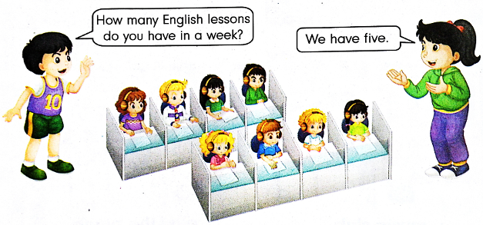
>>Practice
Let’s talk

Slide 10
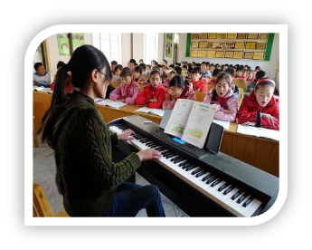
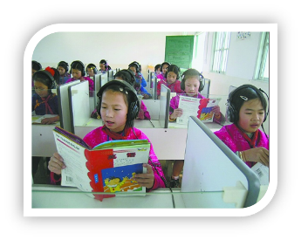
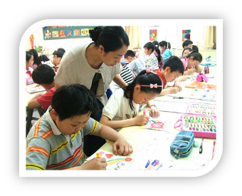
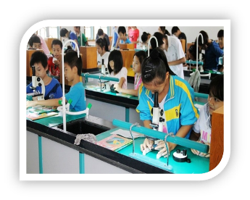
>>Practice
活动1
看图写句子

Slide 11
>>Practice
活动2
制作精美课表

Slide 12
>>Practice
Let’s chant
（单击图片可播放动画）

Slide 13
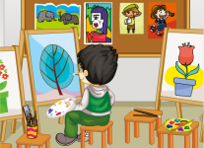
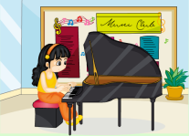
>>Summary
We often … in … club.
How many ... lessons do you have in a week?
We have …

Slide 14
>>Homework
1.在四线三格中正确抄写本课新学的单词和短语，至少五遍。 2.登录“优教同步学习网”，预习 Lesson 7。

