Slide 1
Module 8 Choosing presents
Unit 3 Language in use
WWW.PPT818.COM

Slide 2


birthday

Slide 3
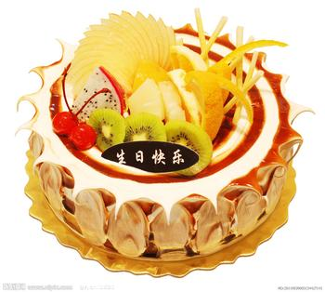
buy a birthday cake

Slide 4
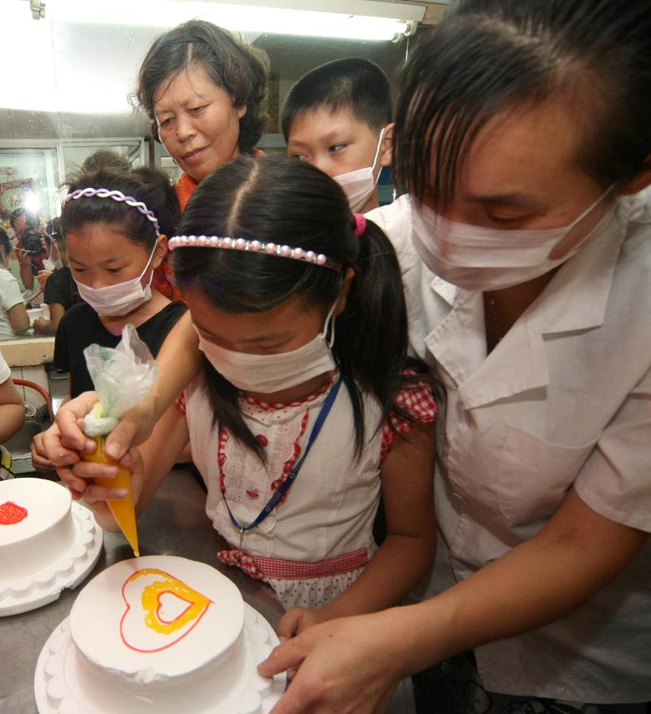
make a birthday cake

Slide 5
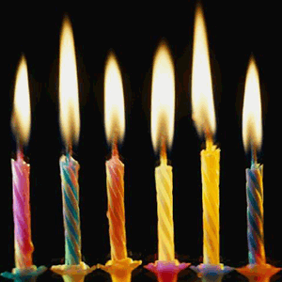
buy birthday candles

Slide 6
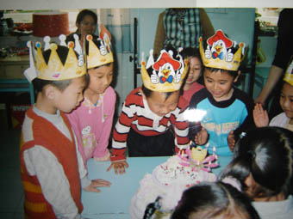
have a birthday party

Slide 7
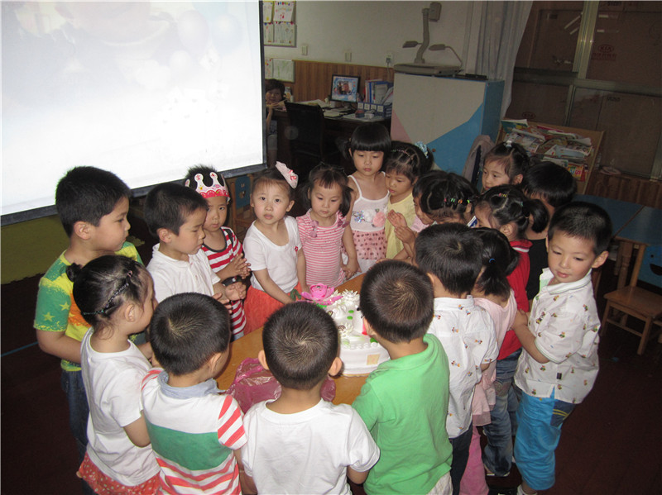
sing Happy Birthday song

Slide 8
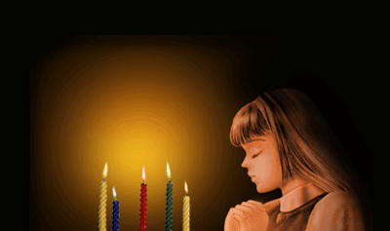
make a birthday wish

Slide 9
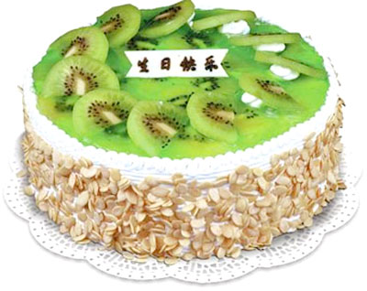
eat a birthday cake

Slide 10
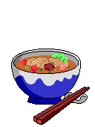
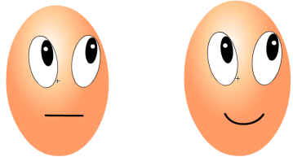
eat eggs and noodles

Slide 11
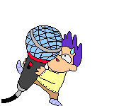
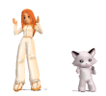
sing and dance

Slide 12
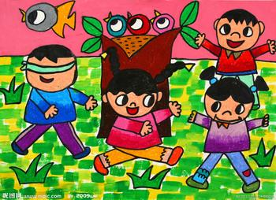
play games

Slide 13


get birthday cards

Slide 14
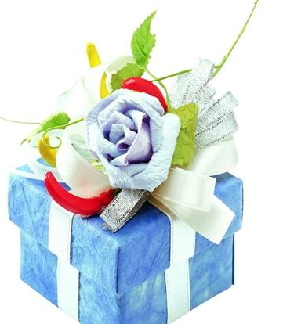
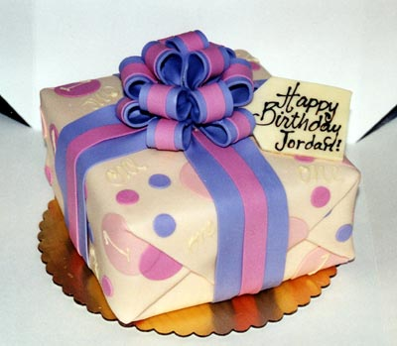
get birthday presents

Slide 15
buy a birthday cake 买生日蛋糕
make a birthday cake 做生日蛋糕
buy birthday candles 买生日蜡烛
have a birthday party 举行生日晚会
sing happy birthday song 唱生日歌
make a birthday wish 许生日愿望
eat a birthday cake 吃生日蛋糕
eat eggs and noodles 吃蛋和长寿面
sing and dance 唱歌跳舞
play games 玩游戏
get birthday cards 送生日卡片
get birthday presents 收到生日礼物

Slide 16
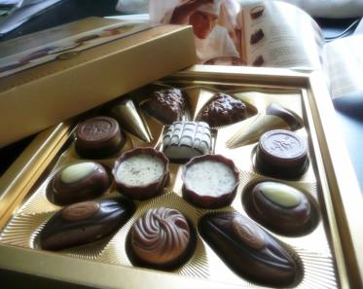

a box of chocolates
a CD

Slide 17


a cinema ticket电影票
a concert ticket 音乐票

Slide 18


a magazine
杂志
a football

Slide 19
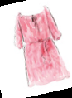
a silk dress
a scarf 围巾

Slide 20
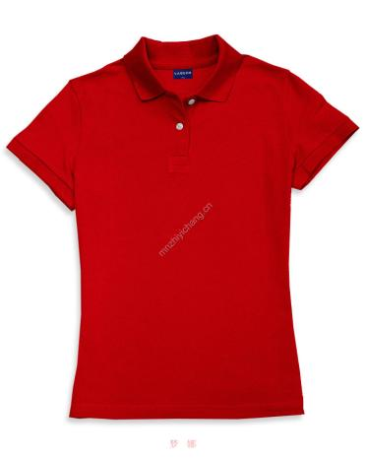
a T-shirt

Slide 21
a box of chocolate
a CD
a cinema ticket
a concert ticket
a football
a magazine
a scarf
a silk dress
a T-shirt

Slide 22
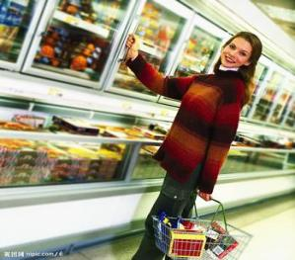
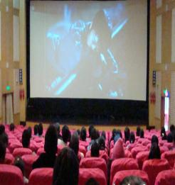
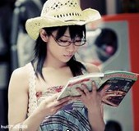
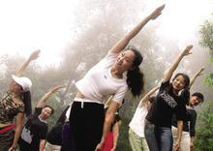
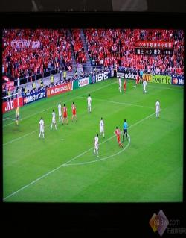
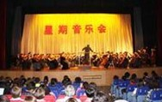
go shopping
watch a film
read a magazine
get some exercise
watch football matches
go to a concert

Slide 23
一盒巧克力
一张电影票/音乐会票
一条丝绸裙子
11条丝绸围巾
保持健康
每天
去购物
去看电影
去听音乐会
去看足球赛
看足球赛
在周末
在电视上/通过电视
花费…在…
a box of chocolates
a cinema / concert ticket
a silk dress
eleven silk scarves
stay healthy
every day
go shopping
go to the cinema
go to concerts / a concert
go to football matches
watch a football match
at weekends
on television
spend … on sth

Slide 24
Examples in this module:
Daming always gets birthday presents.
She often goes to the cinema.
What do you usually do at a Chinese birthday party?
We sometimes give birthday cards.
My mother never makes a birthday cake.

Slide 25
Sum up:
动词第三人称单数的变化规则。
动词第三人称单数
① 一般动词后加-s。
② 以s, x, ch, sh,结尾的，后加-es。
③ 以辅音字母+o结尾，一般加-es。
④ 辅音字母+y结尾的单词，变y为i，
再加-es。

Slide 26
Look at the sentences. Pay attention to the verbs.
eat
I/We/You/They usually ____ breakfast.
He/She/It usually ____ breakfast.
1. I ____ (like) birthdays.
2. She always ______ (invite) him to her parties.
3. We ____ (play) the piano.
4. She ____ (sing).
5. He _____ (come) to my party.
eats
like
invites
play
sings
comes

Slide 27
比较下列两组句子
We have dinner at school.
You sing very well.
They go to school on Sunday.
He never listens to music.
She always wears school clothes.
It often eats meat.

Slide 28
当主语为he/she/it/单数名词时，谓语
动词要用第三人称单数形式。其否定句
在谓语动词前加doesn’t (does not)，并
把行为动词变为动词原形。
例如：She likes noodles.
她喜欢面条。
She doesn’t like noodles.
她不喜欢面条。

Slide 29
(2) 当主语是第三人称单数时，谓语动词
的形式需做以下变化。
① 一般在词尾加-s。help-helps
② 以s, x, ch, sh 结尾, 加-es。wash-washes
③ 以辅音加o结尾,加-es。go-goes
④ 以辅音加y结尾，变y为i，加-es。
study-studies

Slide 30
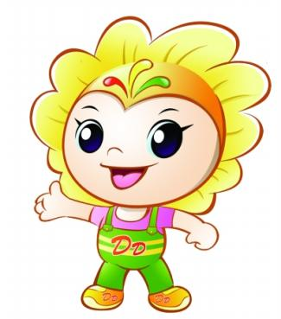
把下列动词变为第三人称单数形式。
read
carry
watch
do
reads
carries
watches
does

Slide 31
一般现在时的动词第三人称单数变化形式：
stop use
watch wash
go do
study carry
have
1. 动词+ s
2. 以s, x, ch, sh, 结尾 + es
3. 以辅音字母加y结尾改y为i +es
4.不规则变化
stops
uses
watches
washes
does
goes
studies
carries
has

Slide 32
eat ______________ say ________
wash ____________ fix _________
go ______________ pass ________
carry ____________ fly _________
study ___________ arrive _______
believe _________ check ________
cross ___________ cry __________
cut ____________ develop _______
enjoy ___________ hurt ______
have ___________ be ______
spend __________
eats
says
washes
fixes
goes
passes
carries
flies
studies
arrives
believes
checks
crosses
cries
cuts
develops
enjoys
hurts
has
is
spends

Slide 33
用动词的适当形式填空：
My friend _______ (study) in a middle
school.
2. He ____ (go) to bed at nine every day .
3. Miss Green likes _______ (dance).
4. She _______ (teach) us English .
5. Tony often _______ (watch ) TV .
6. There _____ (be) some meat on it.
7. His sister and I ______ (have) lunch .
8. Do you finish _______ (read) the book?
9. He _________ (not like) the bag .
10. Mary _________ (buy) many books.
studies
goes
dancing
teaches
watches
is
have
reading
doesn’t like
buys

Slide 34
用括号所给词的一般现在时形式完成下列句子，并把句
子改成否定句。
I ___________(live) in Beijing.
I don’t live in Beijing.
2. He _________(watch) TV every evening.
He doesn’t watch TV every.
3. Li Hong often _________(listen) to the music.
Li Hong doesn’t often listen to the music.
4. She _________ (feel) happy.
She doesn’t feel happy.
5. They ___________ (can) play chess.
They can’t play chess.
6. Lily _________ (be) from England.
Lily isn’t from England.
live
watches
listens
feels
can
is

Slide 35
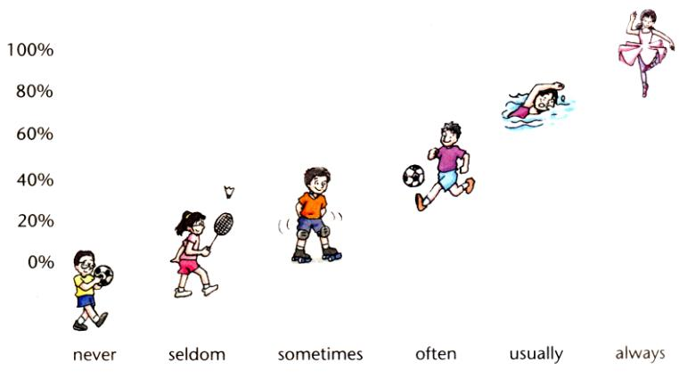
频度副词
Adverbs of frequency tell you how often
things happen. Look at the graph below.

Slide 36
频度副词是表示与次数, 频度有关的副词, 其排列是(由大到小):
always (总是), usually (通常),
often (常常), sometimes (有时),
seldom (不常), never (从不)。

Slide 37

表示频度方面的区别
1. always是频度最大的词，意为“总是；永远”。
I always remember my first day at school.
我将永远记住我上学的第一天。
usually意为“通常”，即很少例外，频度仅次于always。
What do you usually have for breakfast?
你通常早餐吃什么？

Slide 38
2. often 意为“经常”,在频度上不如usually那么频繁。
Li Ping often does his homework in the afternoon.
李平经常在下午做作业。
never 从未；永不；决不。
I have never been there.
我从未到过那里。

Slide 39
3. sometimes意为“有时候”,频度比often小,表示动作偶尔发生,间断较大。既可以放在be动词、助动词之后,行为动词之前,也可以放在句首,还可以放在句尾。
I sometimes go to the library.
我有时去图书馆。
Sometimes I read a book in the evening.
我有时在晚上看书。

Slide 40
Grammar
一般现在时
表示经常或习惯性的动作、现在的状态、客观存在的普遍真理等，常与下列词语
连用：
always / usually / often / sometimes / never
on Sundays / Monday afternoon every day/ week / month / year in the morning / afternoon / evening

Slide 41
频度副词
always＞usually＞often＞sometimes＞seldom（很少）＞never等是频度副词，放在助动词,be 动词之后或 行为动词之前。
我经常在六点半起床。
I often get up at half past six.
2. 他通常在星期六上午打篮球。
He usually plays basketball on Saturday morning.
3. 他们从来不玩电子游戏。
They never play computer games.
4. 我们总是在下午踢足球。
We always play football in the afternoon.

Slide 42
频度副词在句中的位置
频度副词在句中习惯上位于be动词之后、
行为动词之前，助动词之后。
She is often late for school.
她上学经常迟到。
He usually goes to bed at about 12.
他通常(午夜)十二点钟睡觉。
When do you usually get up in the
morning? 早上你通常什么时候起床？
He never has anything to do.
他一向无所事事。

Slide 43
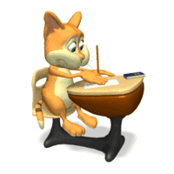
Rewrite the sentences with the words in brackets .
1. I go to the cinema. (often) ________________________________
2. He plays football on Saturday. (usually) ________________________________
I often go to the cinema.
He usually plays football on Saturday.

Slide 44
3. She gets up at 7:00. (always) ________________________________
4. They eat chocolate at home. (never) ________________________________
She always gets up at 7:00.
They never eat chocolate at home.

Slide 45
Rewrite the sentence with the words in brackets.
1. I go to the cinema. (often)
2. He plays football on Saturday.( usually)
3. She gets up at 7:00 am. ( always)
4. They eat chocolate at home.( never)
I often go to the cinema.
He usually plays football on Saturday.
She always gets up at 7:00 am.
They never eat chocolate at home.

Slide 46
Complete the sentences with Would you like… or Let’s.
Would you like to go to the playground and play football?
1. ______________ to go to the football match?
2. ______ go to a taijiquan class.
Would you like
Let’s

Slide 47

3. ________ stay at home.
4. ______________ to go to the cinema?
It’s Jackie Chan.
5. ______________ to watch TV?
6. ______________ play basketball.
Let’s
Would you like
Would you like
Let’s

Slide 48
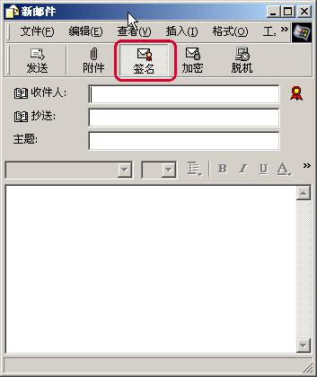
Dear all,
My birthday party is at four o’clock
on Saturday evening at my house.
Would you like to come?
Mike

Slide 49
Hi Mike,
Thanks. I’d like to come.
See you then.
Jane

Slide 50
It’s great to hear from you Mike, but I’m afraid I can’t come. I always watch my little sister play football on Saturday evening.
Jack

Slide 51
Read the emails and check (√) the true sentences.
√
1. Mike’s birthday party begins
at 4:00 pm.
2. Jane doesn’t want to go to the party.
3. Jack has got a little sister.
4. Jack always does his homework on Saturday afternoon.
×
√
×

Slide 52
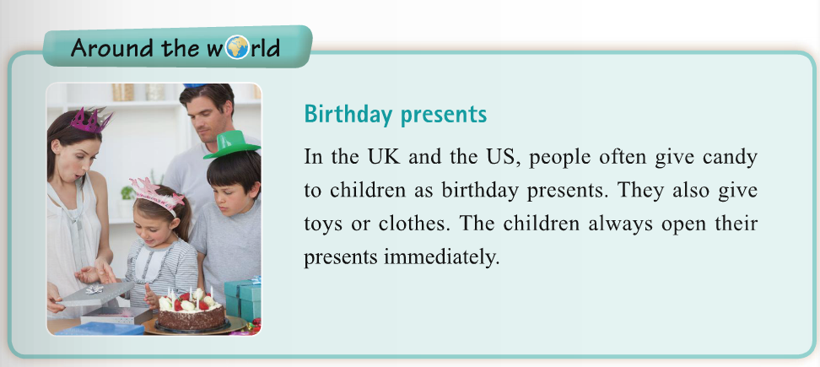
送...作为礼物
give … as presents

Slide 53
呆在家里
在星期六下午四点钟
到时见。
收到某人的来信
恐怕我不能来。
送…作为礼物
stay at home
at four o’clock on Saturday afternoon
See you then.
hear from sb
I’m afraid I can’t come.
give … as presents

Slide 54
Today is the 5th of March. It’s my b_________. I get a lot of p_________ from my friends and family. They are in nice b_____. My father gives me a yellow box and there is a b____ in it. Because I like reading. Jack, one of my friends, gives me a big box. What’s in it? It’s a box of c_________. I like eating them. My sister gives me a round box. I think it’s a big cake, but it is a
f _______ . I like playing football very much, so I’m
h _______ to have it. My uncle gives me a pair of
s ______, and my aunt gives me a silk shirt. My mother buys CDs for me. I like them very much.
Now my friends are s ______ the song “Happy Birthday to you” to me.
irthday
resents
oxes
ook
hocolates
ootball
appy
hoes
inging

Slide 55
Writing
Think of one of your friends. Write a description of him / her. Then choose a present for him / her.

Slide 56
Planning a classmate’s birthday party
Work in pairs. Ask and answer questions about each other’s birthday party.
When is your birthday?
Do you always have a birthday party?
What do you usually do at your birthday party?

Slide 57
Make a survey
Plan a birthday party for your partner.
Choose the time and place
Choose the food
Choose what to do

