Slide 1
Unit 9
Was I a good girl back then?
WWW.PPT818.COM

Slide 2

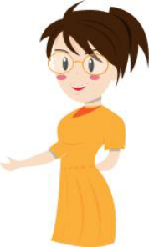
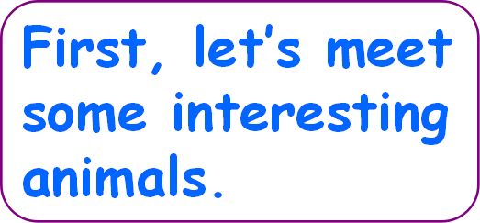

Slide 3

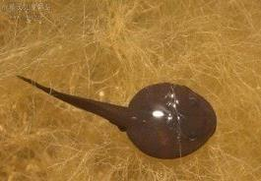
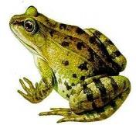
When I was a baby, I was very soft(柔软) and lived in the water. I had one long tail and no legs. I looked like a comma (逗号).
Now I am a strong adult, I can jump very fast with my four strong legs , I like croaking at night.

Slide 4
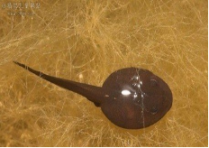
was
was
`(was, am)
When I a baby, I very soft and in the water.
I one long tail and no legs.
I like a comma (逗号).
(am, was)
lived
(lived, live)
(had, have )
had
(looked, look)
looked
use simple past 过去时 tense.

Slide 5

（am, was）
（can, could）
am
can
Now I a strong adult, I jump very fast with my four strong legs , I croaking at night.
like
（liked, like）
use simple present tense 用现在时

Slide 6
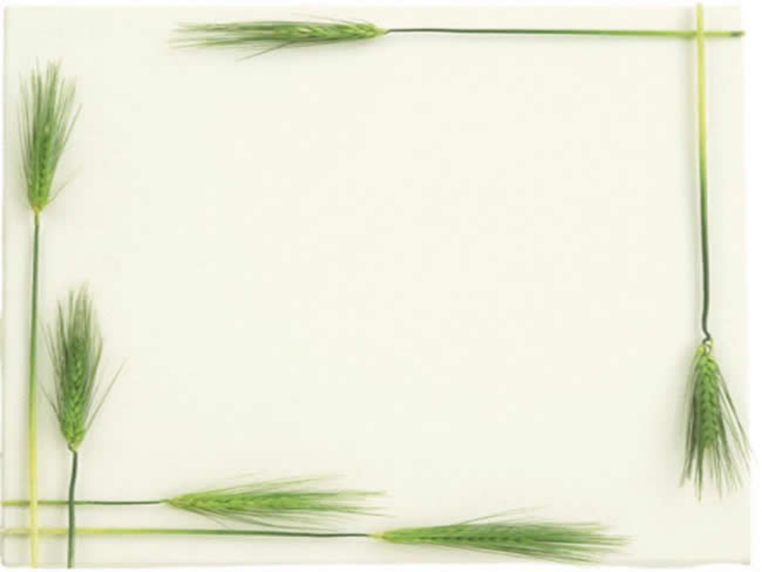
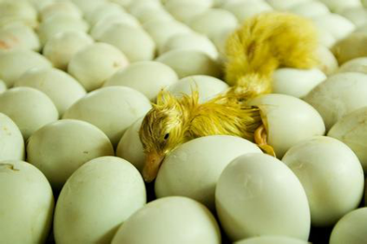
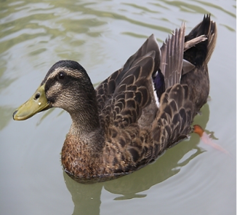
Who am I
a duck

Slide 7
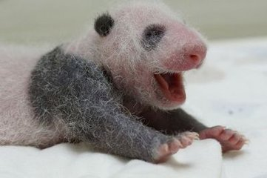
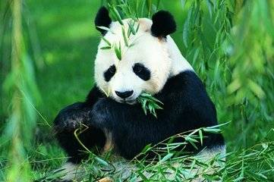

Slide 8
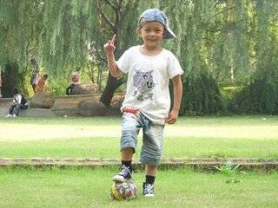
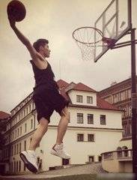
Before he was years old,
he in the playground.
seven
liked
playing
football
eighteen
But now he is years old, he in the playground.
playing
basketball
likes

Slide 9
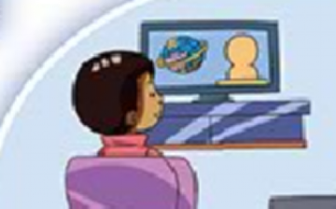

five
When he was year old,
he
watching
liked
TV.
But now he
surfing
likes
the
Internet.

Slide 10

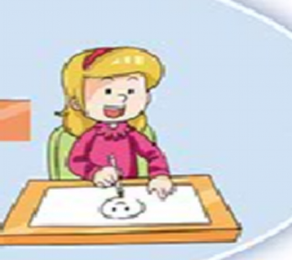
Before, she
watching
liked
cartoons.
But now she
likes
drawing
cartoons.

Slide 11
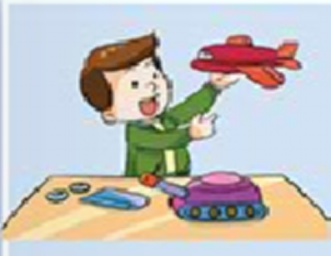
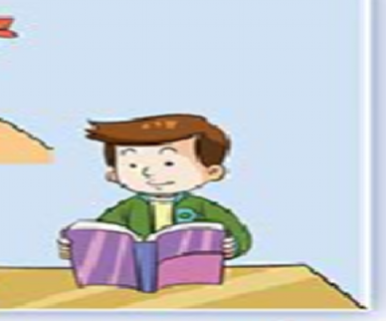
liked
playing with
Before he
toys.
But now he
likes
reading books.

Slide 12
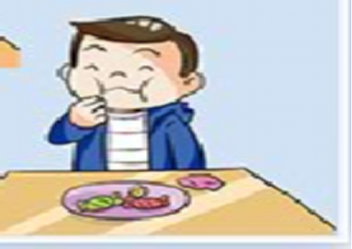
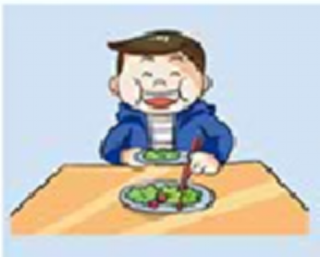

Before,
he
liked eating candy.
But now
he
likes eating vegetables.

Slide 13
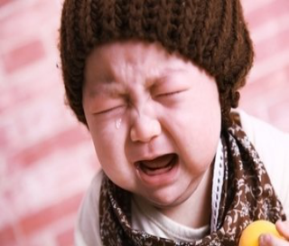

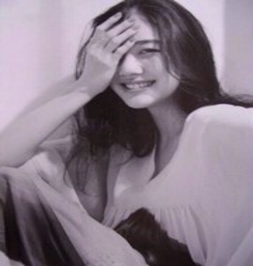
Before she
often cried.
But now she
always smiles.

