Slide 1
Unit 8 Culture Shapes Us
A Visit to Chinatown
WWW.PPT818.COM

Slide 2
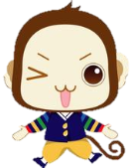
学习目标
1. To learn expressions about festivals and cultures.
2. To learn about culture differences.
3. To be able to talk about festivals and culture differences.
4. To realize the differences between different cultures.

Slide 3
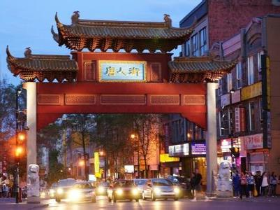
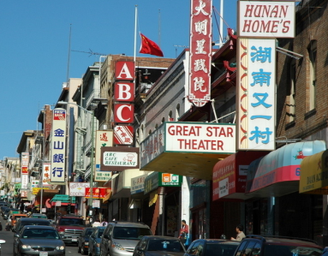
Warming up
Chinatown
Would you like to see what Chinatown is like?

Slide 4
Think about it.
What do you usually do to prepare for the Spring
Festival?
We usually go shopping to buy many good things, clean our rooms and visit the relatives.
What Western festivals are celebrated in China?
We often celebrate Chrismas.

Slide 5
Reading
Read the text and answer the following questions.
1. What did Jenny and Brian buy?
2. What did Brain have for lunch?
3. When did Danny and Jenny watch the dragon dancing performance?
Jenny and Brain bought a big Christmas tree, some decorations and gifts.
Brain had a bowl of noodles for lunch.
They watched the dragon dancing performance
during the Spring Festival.

Slide 6
Reading
Read the lesson and write true(T) or false(F).
1. Jenny and Brain went shopping in Chinatown. ( )
2. Jenny and her parents live in Chinatown. ( )
3. There's a North American town in China. ( )
4. Some Chinese people eat dumplings during the
Spring Festival. ( )
T
F
F
T

Slide 7
Reading
Fill in the blanks according to the dialogue:
Jenny and Li Ming went shopping in _________. They bought a big Christmas tree, some___________and gifts. For lunch, they used chopsticks and a spoon____________ a fork and a knife. Jenny’s parents also loved to have lunch and shop there,__________ parking is a problem. Jenny’s Dad had to park his car in the____________ parking lot. Most of the people spoke__________there. Li Ming also told Jenny that young children got gifts--___________ from their parents during the Spring Festival. They went to ___________ and watched______________ performances. It was the most important festival in China.
Chinatown
decorations
instead of
although
underground
Chinese
lucky money
temple fairs
all kinds of

Slide 8
Language points
1. I had a bowl of noodles, and I used chopsticks and a spoon instead of a fork and a knife.
instead adv. 代替，替代。通常用在句尾。如放在句首要用逗号隔开。
instead of 代替，“而不是”可放在句首和句末。

Slide 9
Language points
2. What do you usually do to prepare for the Spring Festival?
1. prepare 做动词，意为“准备”。
prepare for 为......做准备
prepare...for 为......准备......
prepare to do 准备做......
2. prepare的名词形式是preparation.

Slide 10
Language points
3. My parents love to have lunch and shop there, although parking is a problem.
although conj. 虽然，尽管，但是，引导
让步状语从句，不和but 连用，但可和yet
和still连用。
Although it rained hard, they went on working.
=It rained hard, but they went on working.

Slide 11
Project
How do Chinese people celebrate the Spring Festival?
How do Western people celebrate Christmas?

Slide 12
Project
make dumplings
Spring Festival
Christmas
buy new clothes
clean up the house
give lucky money to children
hang red lanterns
visit relatives and friends
go to a temple fair
attend a family get-together
sing Christmas songs
decorate a Christmas tree
buy some Christmas gifts

Slide 13
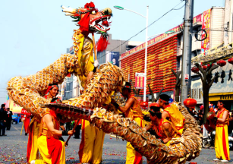
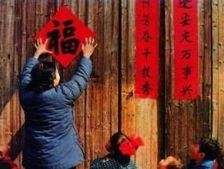
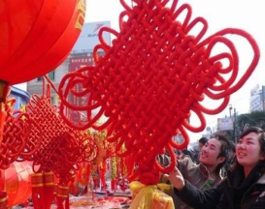
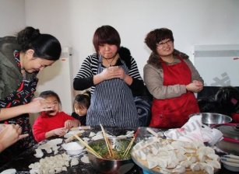
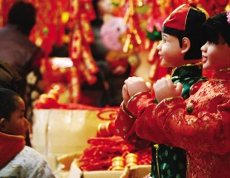
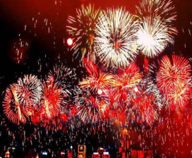
Discussion
Work in pairs and talk about Spring Festival.

Slide 14
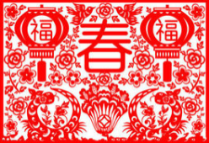
文化知识
春节是指汉字文化圈传统上的农历新年。传统名称为新年、大年、新岁，但口头上又称度岁、庆新岁、过年。古时春节曾专指节气中的立春，也被视为是一年的开始，后来改为农历正月初一开始为新年。一般至少要到正月十五（上元节）新年才结束，但在民间，传统意义上的春节是指从腊月的腊祭或腊月二十三或二十四的祭灶，一直到正月十九。春节俗称“年节”，是中华民族最隆重的传统佳节。

Slide 15
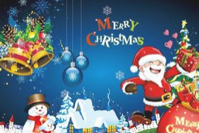
文化知识
圣诞节（Christmas）又称耶诞节，译名为“基督弥撒”，西方传统节日,在每年12月25日。弥撒是教会的一种礼拜仪式。圣诞节是一个宗教节，因为把它当作耶稣的诞辰来庆祝，故名“耶诞节”。
大部分的天主教教堂都会先在24日的平安夜，亦即12月25日凌晨举行子夜弥撒，而一些基督教会则会举行报佳音，然后在12月25日庆祝圣诞节。

Slide 16
Homework
Make a poster about a festival. (Chinese/ Foreign)

Slide 17
Thank You

