Slide 1
Unit 6
When was it invented?
listening &speaking
WWW.PPT818.COM

Slide 2
Section A
Period One

Slide 3
four modern inventions
“What’s this?
①
②
③
④

Slide 4
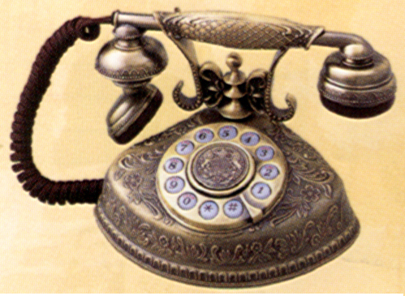
It was made by Bell at first .
贝尔（人名）

Slide 5
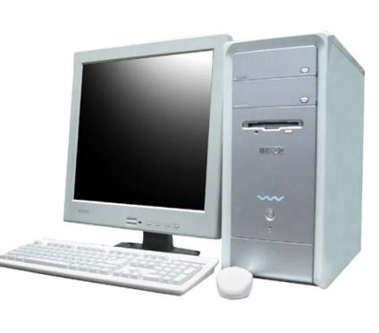
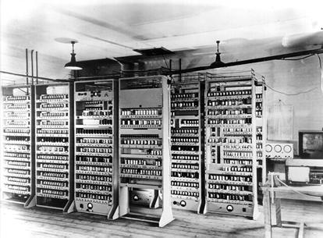
It used to be like this

Slide 6
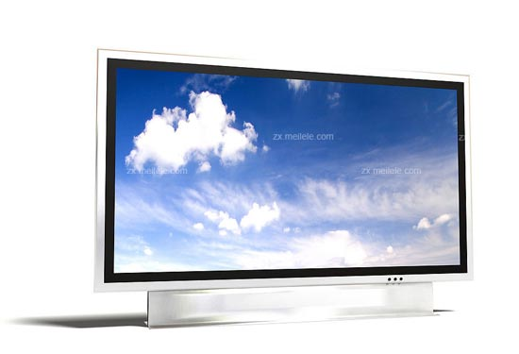
It is used for watching programs.(节目）
[ˈprəʊgræm]

Slide 7
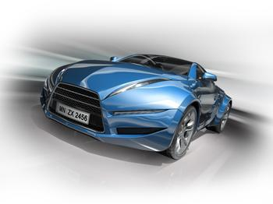
It was made of steel and iron [ˈaɪən]
铁

Slide 8
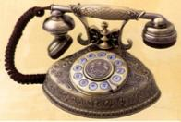
inventions
[ɪnˈvenʃn]发明
When were they invented?
[ɪnˈve nt]

Slide 10
d
a
c
b
_______was invented in _______.
1

Slide 11
Practice the sentences.
Picture d: The telephone was invented
in eighteen seventy-six(1876).
Picture a: Cars were invented in
eighteen eighty-five(1885).
Picture c: The TV was invented around
nineteen twenty-seven(1927).
Picture b: The personal computers
were invented in nineteen seventy-six(1976).

Slide 12
再听一次，填单词。
Alice: Was your life very difficult when you were a kid?
Grandma: Oh, not really. Why?
Alice: Well, you didn't have modern inventions like a , right?
Grandma: Of course we did! How old do you think I am? The telephone was in 1876. You need to take a history class, Alice!
Alice: Haha! How about ? They weren’t invented yet, were they?
Grandma: Yes, they were. Cars were invented in 1885. My family had a car.
telephone
car

Slide 13
Alice: Well, did you have a TV?
Grandma: No, we couldn’t one. They were expensive in those days. The TV was invented around 1927, I think.
Alice: Well, I know that you didn’t have a because we learned in school that personal computers were invented in 1976.
Grandma: You’re right. But I have now!
afford
computer

Slide 14
Summaries
modern inventions
be invented in
need to
take a history class
couldn’t afford one
in those days
personal computers
现代发明
在某年、某地发明
需要做某事
上历史课
买不起
在过去
个人电脑

Slide 15
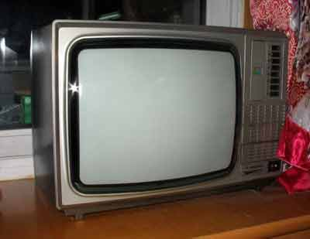
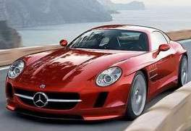
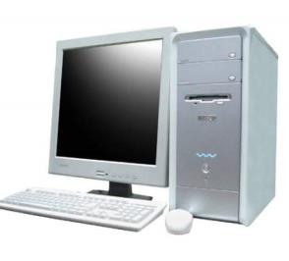
1c
A: When was the … invented?
B: It was invented in _____.

Slide 16
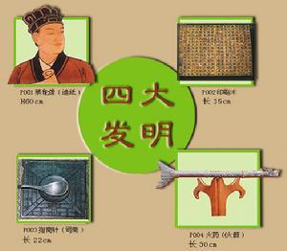
homework
paper-making
造纸术
printing
印刷术
Talk about Chinese great inventions with your partner and write the conversation on your exercise book.
compass
指南针
gunpowder
火 药

