Slide 1
Unit4 Is it in your bag?
WWW.PPT818.COM

Slide 2
Chant
In, in, is it in the bag?
On, on, is it on the box?
Near, near, is it near the desk?
Under, under, it’s under the chair.

Slide 3
The dog is _____ the bike.
near

Slide 4
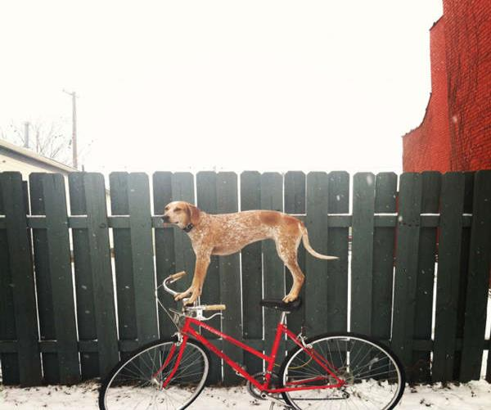
The dog is _____ the bike.
on

Slide 5
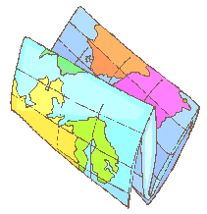
The pencil is _____ the desk.
under

Slide 6
The doll is ____the box.
in

Slide 7
Look, what’s that?
It’s my English book.

Slide 8
Where’s the pencil-box?
It’s in front of the desk.

Slide 9
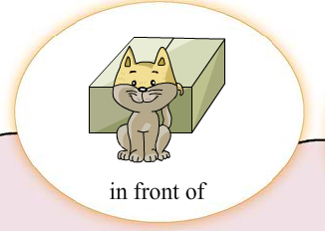
The cat is in front of the box.

Slide 10
The chair is ___________the desk.
in front of

Slide 11
Where’s the schoolbag?
It’s behind the desk.

Slide 12
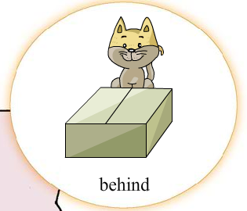
The cat is behind the box.

Slide 13
Where is the book ?
Is it on the bed?
No, It’s ______ the bed.
behind

Slide 14
Where’s the schoolbag?
It’s beside the desk.

Slide 15
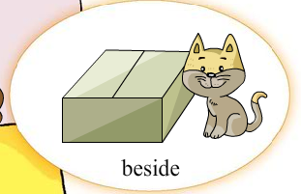
The cat is beside the box.

Slide 16
The desk is ______the bed.
beside

Slide 17
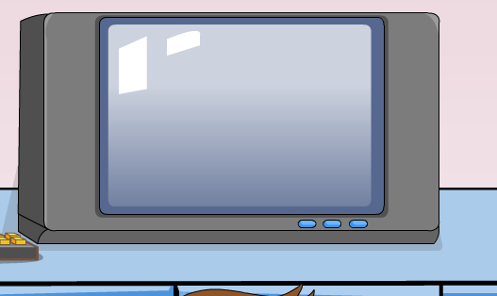
Is the pencil-box in front of the TV?
No, It’s ______ the TV.
near

Slide 18
Is the pencil-box behind the TV?
No, It’s ______ the TV.
beside

Slide 19
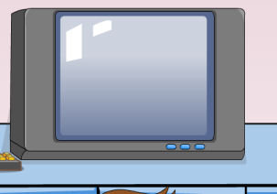
near(在……附近)和beside(在……的旁边)
near
The dog is ______ the bike.
beside
The pencil-box is _______ the TV.

Slide 20
English
front
in front of
在……的前面
方位介词
behind
以下单词你会拼读吗？
在……的后面
beside
在……的旁边
TV
schoolbag

Slide 21
同学们，在生活和学习中你是个粗心大意的孩子吗？ 请看以下的小短片，看看是否也是你生活的写照呢？

Slide 22
Homework 1.认读本课新单词和课文对话。 2.抄写《活动手册》P49 Unit4的单词。

Slide 23
Thank you ! 周末愉快！

