Slide 1
Unit 2 Topic 1
You should see a dentist.
Section D
WWW.PPT818.COM

Slide 2
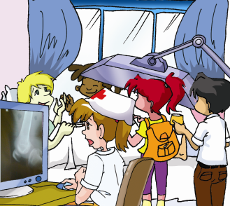
Review
What happened to Michael?
How long should he stay at home?
He hurt his left leg.
A week.

Slide 3
M, J & K: Hey, Michael. How are you feeling today?
Michael: Not too bad. But my left leg still hurts when I move it.
Oh, thank you for your flowers and fruit.
Kangkang: Don’t worry! Your X-rays show it’s nothing serious.
Maria: You had better stay in bed and not move your left leg
too much.
Michael: Yes, I will. But I’m worried about my lessons.
Jane: Have a good rest and don’t worry about
it. We can help you with your study.
Kangkang: Follow the doctor’s advice, and you’ll get well soon.
Michael: Thanks a lot.

Slide 4
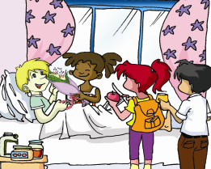
Maria, Jane and Kangkang come to visit Michael at his home.
1
Then mark T（True) or F（False).
F
Michael’s right leg still hurts when he moves it. ( )
Michael’s friends brought some food and fruit for him. ( )
Kangkang asked Michael not to move his leg too much. ( )
Michael had better stay in bed and have a rest. ( )
Michael’s friends will help him
with his lessons. ( )
F
F
T
T

Slide 5
Read 1 and fill in the blanks.
M, J & K: Hey, Michael. How are you feeling today?
Michael: Not too bad. But my left leg still hurts when I move it.
Oh, thank you ______ your flowers and fruit.
Kangkang: Don’t worry! Your X-rays show it’s _______ ________.
Maria: You ______ _____ stay in bed and not move your left leg
_____ _______.
Michael: Yes, I will. But I’m worried about my lessons.
Jane: _____ ___ ____ _____ and don’t worry about
it. We can _____ you ________ your study.
Kangkang: ________ the doctor’s advice, and you’ll ______
_______soon.
Michael: Thanks a lot.
for
nothing serious
had better
too much
Have a good rest
help with
Follow
get
well

Slide 6
Task
Suppose you are Miss Wang. Write an email to Michael and give him some advice.

Slide 7
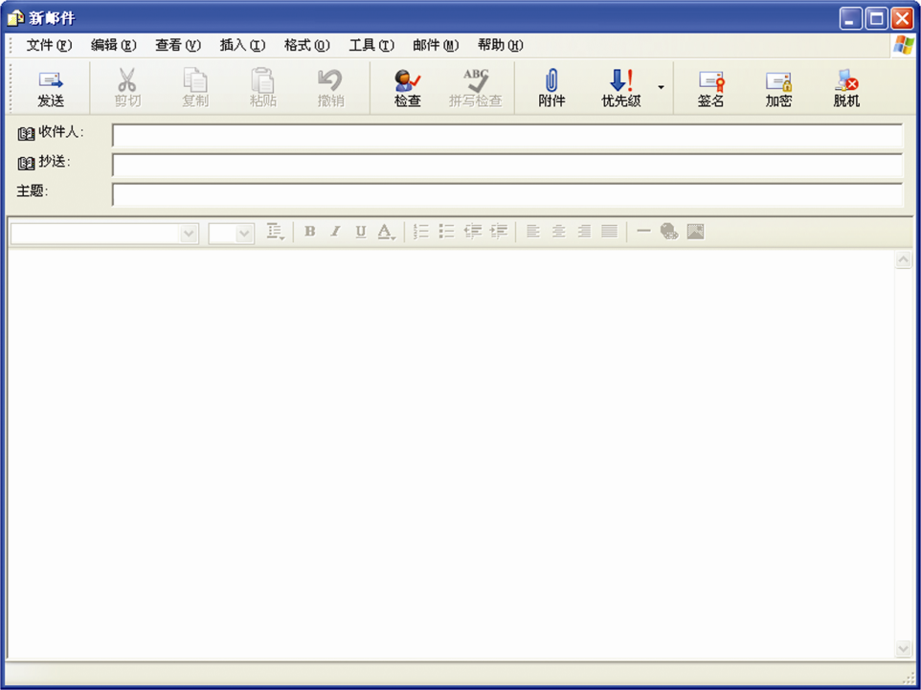
2
Written work
Michael@hotmail.com
Some advice
Dear Michael,
I’m very sorry to hear that you had an accident. Are you OK now? ____________________________
________________________________________________________________________________________
Yours sincerely,
Wang Yuyue
You’d better stay in bed and not move your leg too much. Follow the doctor’s advice and you will get well soon.

Slide 8
Give advice
What’s wrong with him?
He has a toothache.
What should he do?
He should go to see a dentist.

Slide 9
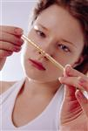
Give advice
What’s the matter with the woman?
She has a fever.
What should she do?
She should drink plenty
of boiled water.

Slide 10
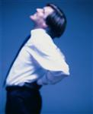
Give advice
What’s wrong with the man?
He has a backache.
What shouldn’t he do?
He shouldn’t lift heavy things.

Slide 11
Give advice
What’s the matter with her?
She has a stomachache.
What shouldn’t she do?
She shouldn’t drink cold water.

Slide 12
Give advice
drink hot tea with honey.
see a doctor.
eat ice cream or candy.
take some cold pills.
stay in bed.
drink plenty of boiled water.
play football too long.
have a good rest.
eat hot food.
You’d better
You’d better not
You should
You shouldn’t

Slide 13
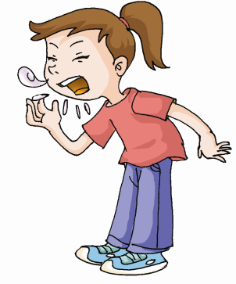
Task
Lily has a bad cold. Suppose you are Lily’s friend. Write an email to Lily and give her some advice.

Slide 14
Lily@renai-edu.com
Some advice
Dear Lily,
I am sorry to hear that you has a bad cold. Are you OK now? You should ____________________________
____________________________________________________________________________________________________________________________________________
Your,
Jennifer

Slide 15
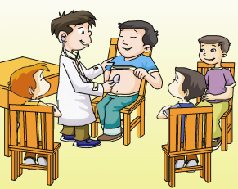
Project
Choosing Dr. Best
1. Write down the names of different kinds of illnesses on cards and mix them up.
2. One student chooses one of the cards and acts as the “patient”. The other students guess what’s wrong with him or her.

Slide 16
Project
Choosing Dr. Best
3. The one who gets the correct answer first will be the “doctor”. Then the “doctor” gives the “patient” some advice.
4. Play the game several times and choose the “Dr. Best” of your class.

Slide 17
summary
Grammar
Modal Verbs (Ⅰ): should/shouldn’t; had better/had better not
You ___________________ see a dentist.
You ___________________ drink coffee or tea in the evening.
You ___________________ take some medicine.
You ___________________ go to school today.
should/had better
shouldn’t/had better not
should/had better
shouldn’t/had better not

Slide 18
Functions
You don’t look _________ .
I _______ a toothache/a cold / a cough / a backache / a fever / the flu / a stomachache / a headache.
I am sorry to _____ that. I’m ________ terrible!
___________ have you been like this? _____ are you feeling, Nick?
______ two pills, three times a day.
well
have
hear
feeling
How long
How
Take

Slide 19
Key points
plenty of 是“许多”的意思，其后面可接可数名词，也可接不可数名词，通常用于肯定句。
e.g. plenty of eggs/milk
both … and …表示“不仅……而且……; ……和……(两者)都”。其谓语动词用复数。
e.g. Both Edward and Bella love this movie.

Slide 20
Exercises
1. — I have a terrible toothache.
— I’m sorry to hear that. You should_____ _____ _____ .
2. She has a bad cold. She ______ ______ ______ drink cold water.
3. —________ _________ _________ _______ , Lily ?
— I feel terrible, Mum.
see a dentist
had better not
What’s wrong with you

Slide 21
Exercises
4. — I hope you will get well soon.
— _________ __________ .
5. ______ ________ _______ have a good rest? (你为什么不)
6. Don’t _______ ________ me. I will get well in two days. (担心)
Thank you
Why don’t you
worry about

Slide 22
Exercises
7. Thank you ________ these beautiful flowers.
A. at B. for C. of D. to
8. You’d better _______ in the sun.
A. not reading B. not to read
C. not read D. don’t read
9. Please buy me some chocolate.
= Please buy some chocolate _______ _______ .
B
C
for me

Slide 23
Exercises
10. Could you please _______ ____ ______ ? (叫出租车)
11. She ______ off her bike and _______ herself
seriously last Sunday.（fall/hurt）
12. Michael returned home yesterday.
= Michael ______ ______ home _______ yesterday.
call a taxi
fell
hurt
didn’t go
until

Slide 24
Translate these sentences:
1. 昨天我们等你一直等到十一点。
2. 吉姆要等到他妈妈回来才会去逛街。
3. 不要担心这样的事情。
We waited for you until 11 yesterday.
Jim won’t go shopping until his mother comes back.
Don’t worry about such things.

Slide 25
4. 你最好担心一下你的女儿啦！
5. 迈克尔打算去看他生病的叔叔。
6. 我和汤姆都生病了。
7. 去年雨水多。
You’d better worry about your daughter!
Michael is going to visit his sick uncle.
Both Tom and I are sick/ill.
There was plenty of (a lot of) rain last year.

Slide 26
8. 我们每天都应该锻炼。
9. 你不应该嘲笑别人。
10. 你最好呆在床上好好休息 。
11. 我们现在最好不告诉她这个可怕的消息。
We should do exercise every day.
You shouldn’t laugh at others.
You’d better stay in bed and have a good rest.
We’d better not tell her the terrible news.

Slide 27
Homework
Review the key points of Section A - Section D.
Finish the exercise book.

