Slide 1
Unit 7
Will people have robots?
Section A Period 1 (1a-2b)
WWW.PPT818.COM

Slide 2
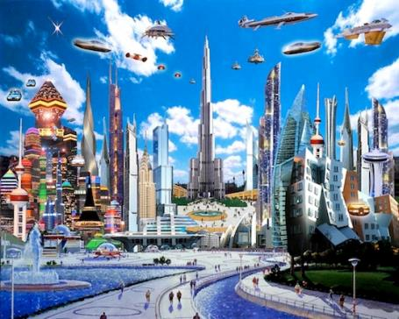
Discuss
What do you think our life will be like in the future?

Slide 3
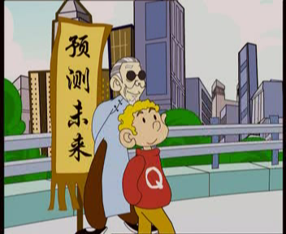
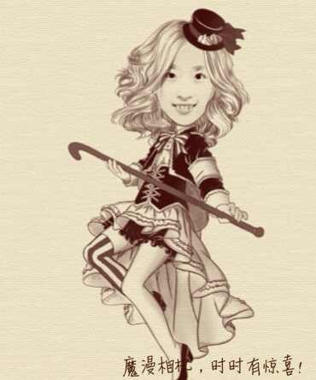
Some predictions about the future!
/prɪ'dɪkʃn/预言
/’fju:tʃə(r)/未来
魔法师

Slide 4
Everything is possible!

Slide 8
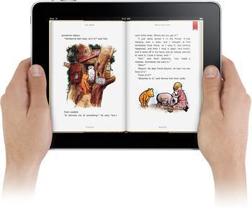
Books will only be on computers,
not on paper.
/‘peɪpə/纸张
Do you agree?
-Will books only be on computers, not on paper?
--Yes, they will./No, they won’t.

Slide 9
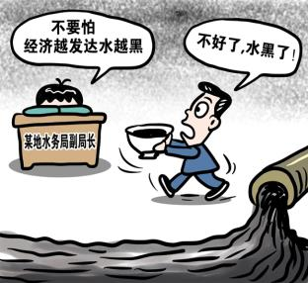
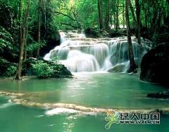
There will be more pollution.
/pə‘lu:ʃn/ 污染
Do you agree?
--Will there be more pollution ?
--Yes, there will.
--No, there won’t.
There will be less pollution.

Slide 10
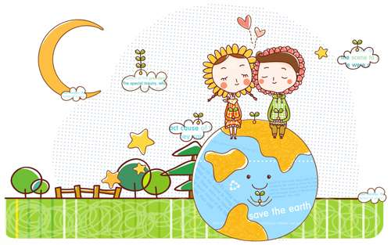
Will there only be one country?

Slide 11
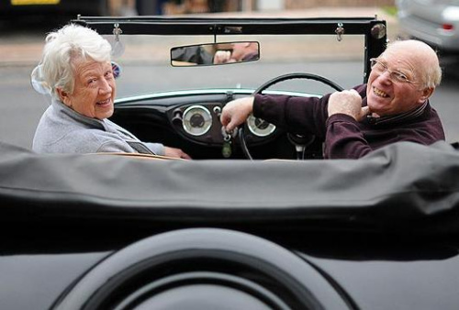
Will people live to be 200 years old?

Slide 12
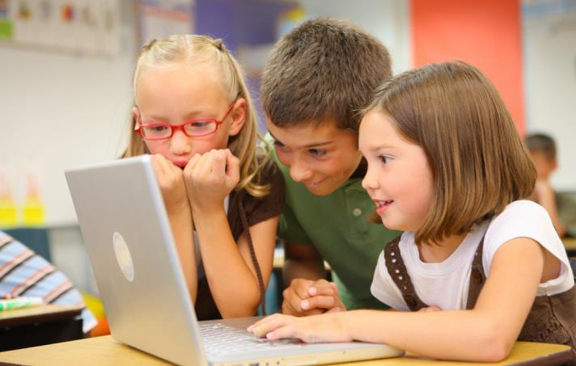
Will students study at home on computers?
Notes:
www.enteacher.cn
12

Slide 13
How will the world be different 100 years from now? Read these predictions. Check (√) A (for agree) or D (for disagree).
1a
___A___D 1. People will have robots in their homes.
___A___D 2. People won’t use money. Everything will be free.
___A___D 3. Books will only be on computers, not on paper.
___A___D 4. Kids won’t go to school. They’ll study at home on computers.
___A___D 5. There will only be one country.
___A___D 6. People will live to be 200 years old.

Slide 14
Listen and circle the predictions you hear in 1a.
1b
___A___D 1. People will have robots in their homes.
___A___D 2. People won’t use money. Everything will be free.
___A___D 3. Books will only be on computers, not on paper.
___A___D 4. Kids won’t go to school. They’ll study at home on computers.
___A___D 5. There will only be one country.
___A___D 6. People will live to be 200 years old.

Slide 15
1b
‵
‵
‵
‵
A: Do you think people will have robots in their homes in 100 years？
B: Yes, I do. I saw a robot on TV, and it cleaned the kitchen.
A: Well, I don’t think people will use money.
B: Do you think everything will be free？
A: Yeah, probably.
B: I think there will be only one country.
A: Only one country in the world? Will there be world peace？
B: I hope so.
A: I think kids won’t go to school. They’ll study at home on computers.
B: Oh, I disagree.
A: You do？
B: Yeah, there will always be schools.
‵
‵
‵
‵
‵
‵
‵
‵
‵
‵
‵
‵
‵
‵
‵
‵
‵

Slide 16
1c
Ask and answer questions about the predictions in 1a.
A: Will people use money in 100 years?
B: No, they won’t. Everything will be free.
Will people live to be 200 years old?
A: Yes, they will.

Slide 17
A: Do you think there will be robots in
people’s homes?
B: Yes, there will. I think every home will
have a robot.
A: Will kids go to school?
B: No. Kids won’t go to school. They will
study at home on computers.
…

Slide 18
2a
Listen and circle the words you hear.
1. There will be (more / less / fewer) people.
2. There will be (more / less / fewer) free time.
3. There will be (more / less / fewer) cars.
4. There will be (more / less / fewer) pollution.
5. There will be (more / less / fewer) trees.

Slide 19
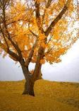
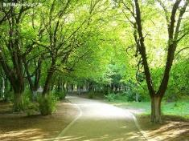
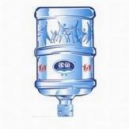
more trees
可数名词复数[C]
more +
不可数名词 [U]
more water

Slide 20
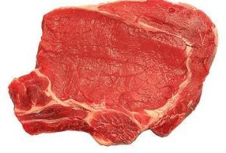
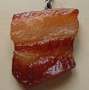
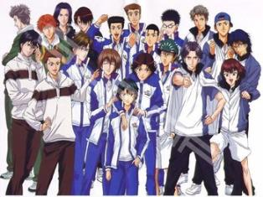
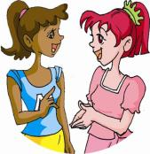
less meat
less + 不可数名词[U]
fewer people
fewer + 可数名词复数[C]

Slide 21
Remember
many—more—most much—more—most
few—fewer—fewest little—less—least
修饰可数名词 ( C N) 修饰不可数名词( U N)

Slide 22
2a
Listen and circle the words you hear.
1. There will be (more / less / fewer) people.
2. There will be (more / less / fewer) free time.
3. There will be (more / less / fewer) cars.
4. There will be (more / less / fewer) pollution.
5. There will be (more / less / fewer) trees.

Slide 23
2b
Listen again. Check (√) the predictions you hear.
_____ 1. There will be fewer people.
_____ 2. There will be less free time.
_____ 3. People will use the subways less.
_____ 4. There will be more pollution.
_____ 5. Cities will be very big and crowded.
√
√

Slide 24
单项选择
A
1. Are you _______ your winter holiday next week?
A. going to have B. will have C. had D. have
2. Do you often ______ from your parents?
A. heard B. hears C. to hear D. hear
3. _____ Lucy ____ her homework in her room
now?
A. Is, doing B. Does, do C. Do, do D. Did, do
4. There ______a soccer match next Monday .
A. is B. has C. will be D. will have
D
A
C

Slide 25
5. Mary usually _______ up at five o’clock.
A. will get B. got C. get D. gets
6. They ______ four English classes a week
last term.
A. has B. have C. had D. are having
7. A bird can ______ but I can’t.
A. flies B. flying C. flew D. fly
8. They _______ to see me tomorrow evening.
A. will come B. comes C. are coming D. came
D
C
D
A

Slide 26
summary
1、可以用助动词________加动词__________谈论将来的事情。
2、可以用____________________句型表示“将会有……”。
3、 __________________________表示“将会有更多的……”。
4、__________________________表示“将会有更少的……”。
will
原形
There will be +名词
fewer修饰____________
less修饰____________
There will be more+名词
可数名词复数
There will be fewer/ less+名词
不可数名词

Slide 27
Homework
1、Preview Section A 2c- 3c.
2、Finish your exercise book.

Slide 28
Life will be more enjoyable in the future!
Thanks for listening !

