Slide 1
Unit1 I can play the piano.
WWW.PPT818.COM

Slide 2
knowledge tree
Grammar
---What can you do?
---I can... /I can't...
Key structures
the usage of can
---Can sb. do...?
---Yes, sb. can. / No, sb. can't.
Composing
a simple passage
Skills
Key vocabulary
Suppling infromation on people's abilities.
piano,ride,tennis,club,worry, board,worry about...

Slide 3
Teaching objects:
To learn some key words and useful expressions.
To learn the usage of can.
01
02
To talk about one's abilities.
To understand the dialogue, about joining school clubs.
03
04

Slide 4
Quick response
A: Can you... ? B: Yes, I can. \ No, I can’t.
A: What can you do?B: I can ... but I can’t ...

Slide 5
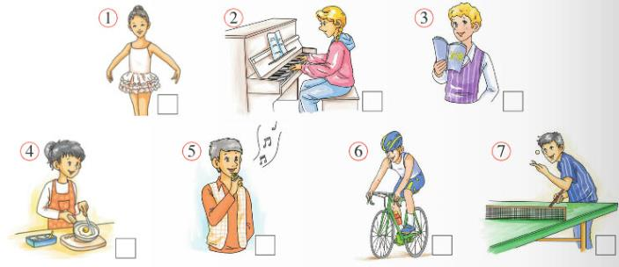
mATCH
Match the words and expressions from the box with pictures.
cook
dance
play table tennis
play the piano
ride a bike
sing
speak Chinese

Slide 6
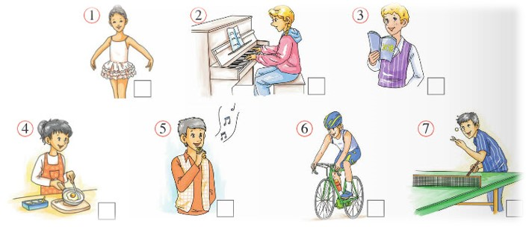
listen
Listen and check (√)the things in Activity
Which Tony’s dad can do?
cook
ride a bike
Tony’s dad can ______ and _______________.

Slide 7
listen
Who
skills:
try to
catch the
key words
What club
Why

Slide 8
retell
who ?
which club ?
why ?
“can”
the Music Club
can
play the piano
Daming
would like
to join
the Food and
Drink Club
cook
?
can
Betty
would like
to join
new
term
dance
?
the Dance Club
can
Lingling
would like
to join
?
would like
to join
the Table
Tennis Club
can
play table tennis
Tony
Daming would like to join...because he can....
He can ..., so he'd like to join....

Slide 9
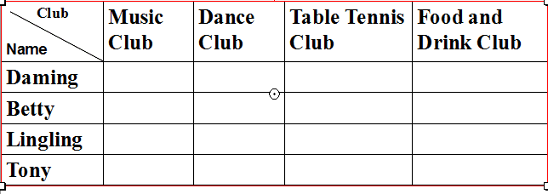
Check(√) the clubs they want to join.

Slide 10
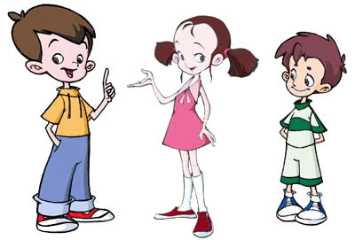
Discussion
Discuss language difficulties in groups.

Slide 11
这个学期
Daming: Look! The new clubs for this term are
on the board. I’d like to join the Music Club
because I can play the piano. What about
you, Betty?
Betty: I like cooking, so I can join the Food and
Drink Club. Can you cook, Daming?
Daming: No, I can’t. Well, I can cook eggs,
but that’s all. What about Lingling?
Which club can she join?
this term
在布告板上
on the board
I’d like to
I would like to 我想要…
what about + doing
……怎么样？
仅此而已
that’s all

Slide 12
Betty: I think she’d like to join the Dance Club
because she can dance really well. Tony,
how about you ?
Tony: I’d like to join the Chinese Club .I can’t
speak Chinese very well.
Daming: Don’t worry about Chinese. We can
teach you Chinese! So choose your
favourite club.
Tony: OK then. I play table tennis, so I choose
the Table Tennis Club. That’s my favourite!
……怎么样？
how about
说中文
speak Chinese
Don’t worry about
别担心··· ···
教你中文
teach you Chinese

Slide 13
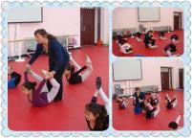
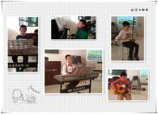
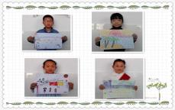
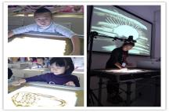
Brainstorm
What clubs are there in our school ?
the Dance Club
the Sports Club
How rich and
colorful our
school life!
the Music Club
the Basketball Club
the Art Club
the Football Club
the Chess Club
the Chinese Club
the Singing Club
the English Club

Slide 14
Group work
Make a survey
Know more about your classmates,talk about your abilities.
What can they do?
What can't they do?
What clubs would they like to join?

Slide 15
show time
Group members | Club | Can do… | Can′t do…
If you can do something, you can join the club.
If you can’t do something, you can also join the club.

Slide 16
Harvest
Summary

Slide 17
exercise
Complete the passage with the correct form of the words from the box.
board choose club music term
Can you cook ? No? Join the Food and Drink
(1)________ . Can you play the piano? Join
the(2)_________ Club. What about dancing?
(3)_________The Dance Club. There are lots
of new clubs every(4)_______ . They’re all on
the(5)______and you can choose your favourite.
Club
Music
Choose
term
board

Slide 18
exercise
Choose the correct answer
1. —What can you do, Lingling?
—I can __________.
A. play the football B. play the chess
C. play the piano D. play a basketball
2. I can sing English songs ______ I can
dance.
A. and B. so C. or D. but

Slide 19
exercise
3. He can sing, ________ he can’t cook.
A. and B. so C. or D. but
4. —Can Jim play basketball? —____.
A. Yes, I can B. Yes, he can
C. No, you can’t D. No, he isn’t.
5. —Can you speak English well?
— ______.
A. No, I can’t B. Yes, I have
C. No, I don’t D. Yes, I speak

Slide 20
exercise
Fill in the blanks with proper forms
to play
1.He’d like ________(play)football with his friends.
2.What about ________(have) a break.
3.Tony can speak Chinese very_____.(good)
4.Miss Yao teaches ______(they) English.
5.I like ________(sing).
having
well
them
singing

Slide 21
exercise
Fill in the blanks with proper words
iano
1. I can play the p______ .
2. Don’t w______ about your maths.
3. We will take our PE exam this t______.
4. Which c______would you like to join?
5. All the information about the programmes are written on the b________.
orry
eam
lub
asketball

Slide 22
Homework
Task 2:Make a poster
Draw a picture for your club.
Add the title of your club.
Invite people to join.
Task3 :Write a report
In my class ,everyone has his own hobbies. XX can..., so he/she would like to join... . And ... can...
Task 1: Read
Read the conversation in a
fluent way.

