Slide 1
Unit7 It’s Tuesday 第2课时
陕旅版四年级上册
WWW.PPT818.COM

Slide 2
Let’s sing---The days of a week

Slide 3
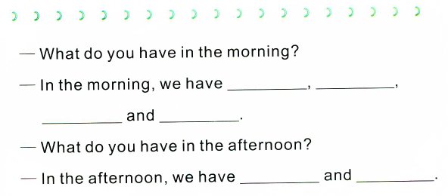
Write out your classes today

Slide 4
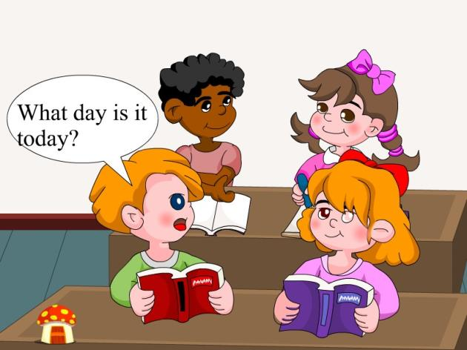
动画欣赏：What day is it today？

Slide 5
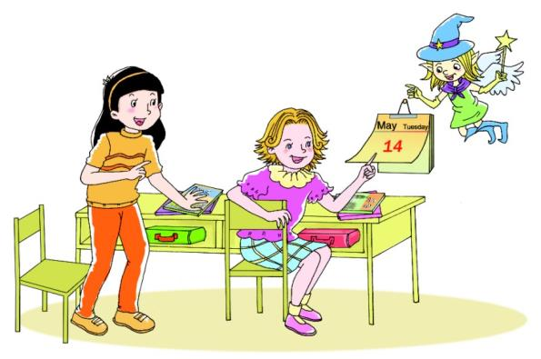
Let’s talk
听录音，回答问题：
What day is it today?

Slide 6
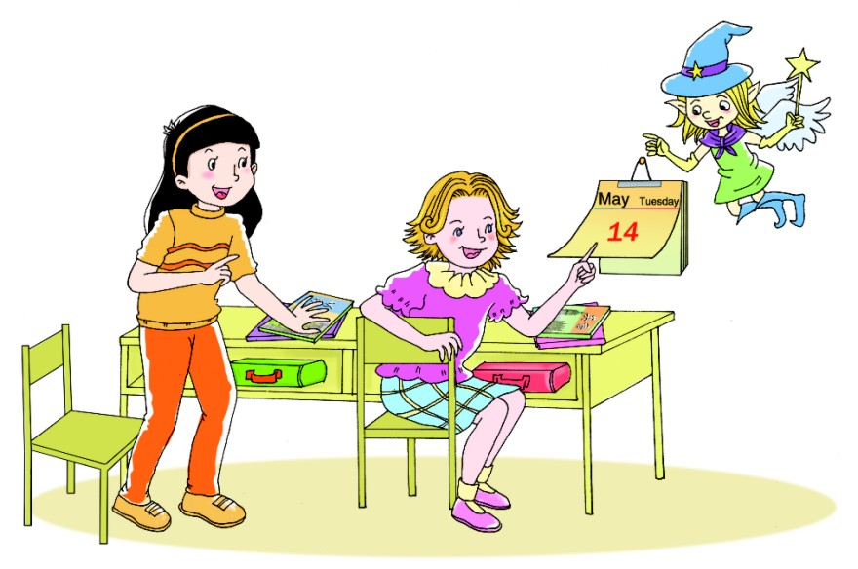
What day is it today?
It’s Tuesday.
We have Chinese and English on Tuesday.

Slide 7
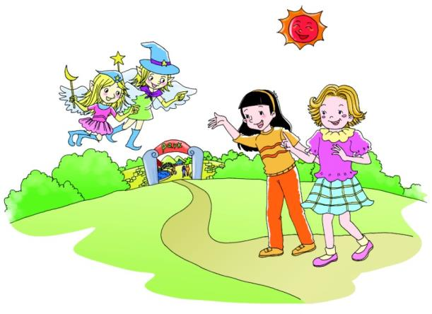
Let’s talk
听录音，回答问题：
What day is it today?

Slide 8
What day is it today?
It’s Saturday.
Oh! We don’t have classes today.

Slide 9
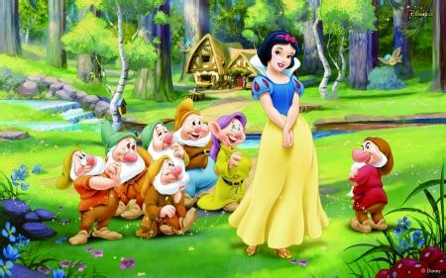
What day is it today?
Role play
It’s Wednesday.
It’s Monday.
It’s Friday.

Slide 10
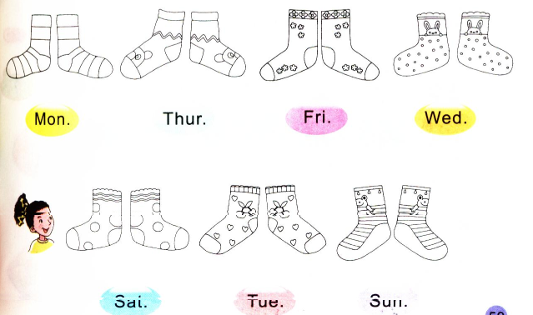
Listen and color

Slide 11
Summary
谈及自己与他人一周内的安排时用句型:
What day is it today?
今天星期几？
It’s+星期.
We have+科目+on+星期.

