Slide 1
Unit 2 Lesson 2 She likes dancing.
WWW.PPT818.COM

Slide 2
Warm up(热身): Good morning to you.
Revision(复习): sing, draw, read, run, skip, make
things (TPR)
— Do you like…?
— Yes, I do./ No, I don’t.

Slide 3
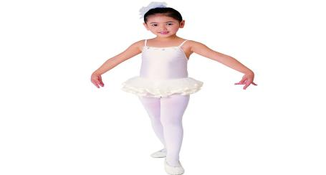
Presentation(呈现)
1)Vocabulary
dance— dancing 跳舞

Slide 4
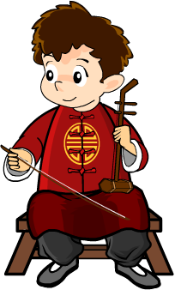
erhu—play the erhu 拉二胡

Slide 5
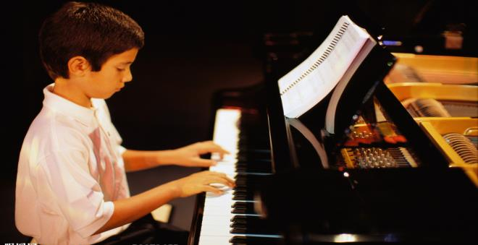
piano— play the piano 弹钢琴

Slide 6
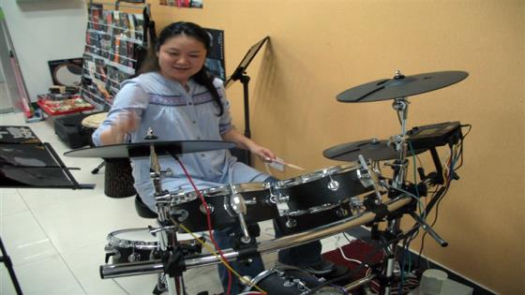
drum— play the drums 敲鼓

Slide 7
2) Sentence structures
— Do you like playing the erhu/piano/drums? (T asks.)
— Yes, I do.(Ss answer.)
→He/ She likes playing the erhu/piano/drums.
He/ She likes… 他/她喜欢……
→

Slide 8
Practice(练习)
Pair work: Role play.
Describe different pictures using the new sentence “He/She likes…”.(用新句型“He/She likes…”.描述不同的图片。)
“记忆大比拼”
S1: Do you like…?
S2, S3, S4, S5: I like…
Ss: He/She likes…

Slide 9
Production (运用)
Interview (Use the structure: Do you like…? He/She likes…)
Activity Name | Running | Skipping | Dancing | Singing

Slide 10
Thank you!

